Slide 1
Thermonuclear Supernovae
Lifan Wang
Texas A&M University
Oct 6, 2013

Slide 2
List of Topics
SNIa Sub-Groups
Ejecta Geometry
High and Low Velocity
Viewing angle
CSM Environment
The Clash between the Ejecta and the CSM/Progenitor
Light Echo
Extinction

Slide 3
1. SNIa Sub-Groups
Spectroscopy
Normal Si II Velocity/Normal Velocity Gradient (NV)
High Velocity Si II Velocity/High Velocity Gradient (HV)
Photometry
Fast Decliner/SN 1991bg-like
Slow Decliner/SN 1991T-like
SN 2006bt-like
Spectroscopy and Photometry
SN2002ic-like (Strong Interaction with CSM)
SN 2002cx-like (Type Iax)
SN 2003fg-like/Super-Chandrasekhar
SN2001ay-like (Extremely slow decline, dis-obeying l.c. shape relation)
Environment
Normal Extinction
Peculiar Extinction

Slide 4
2. What is more likely a good model?
A. Onion
B. Cauliflower
C/O
Mg
Si
Ca
Ni/Fe
Ca II High
Velocity

Slide 5
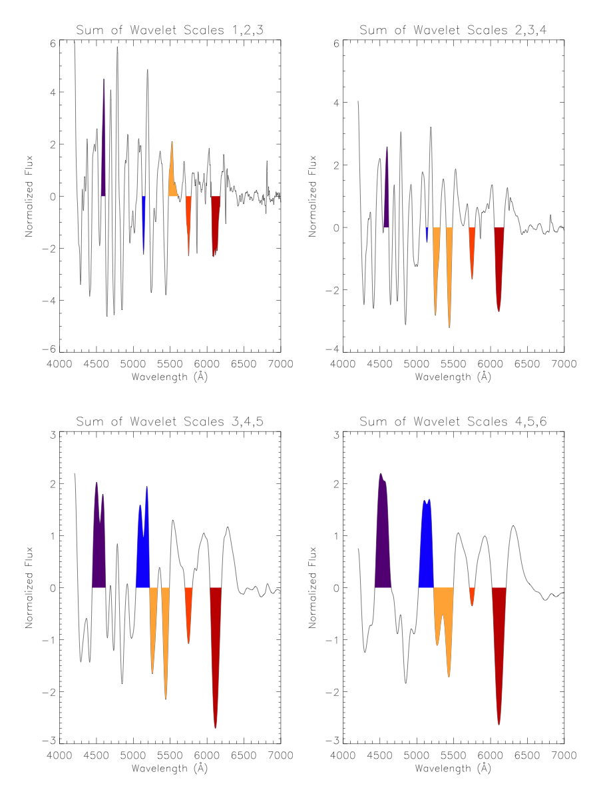
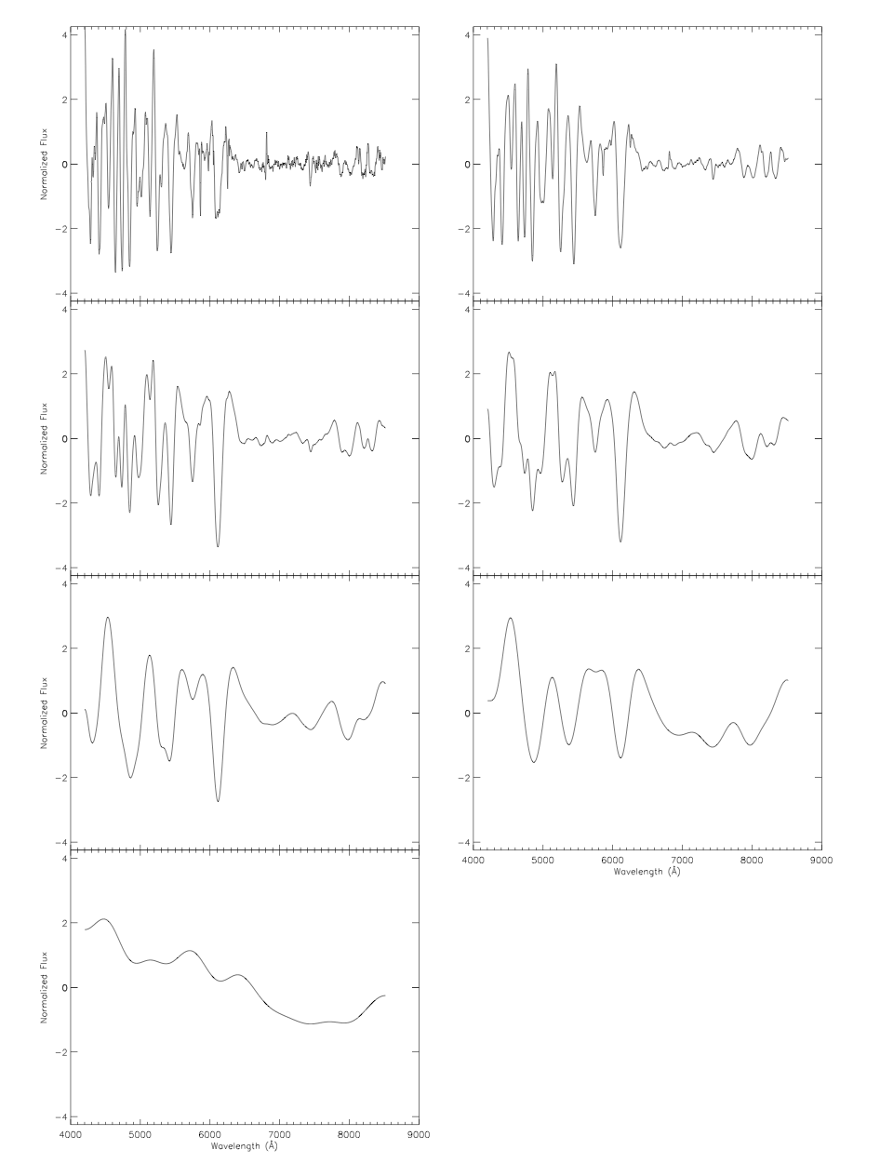
Wavelet

Slide 6
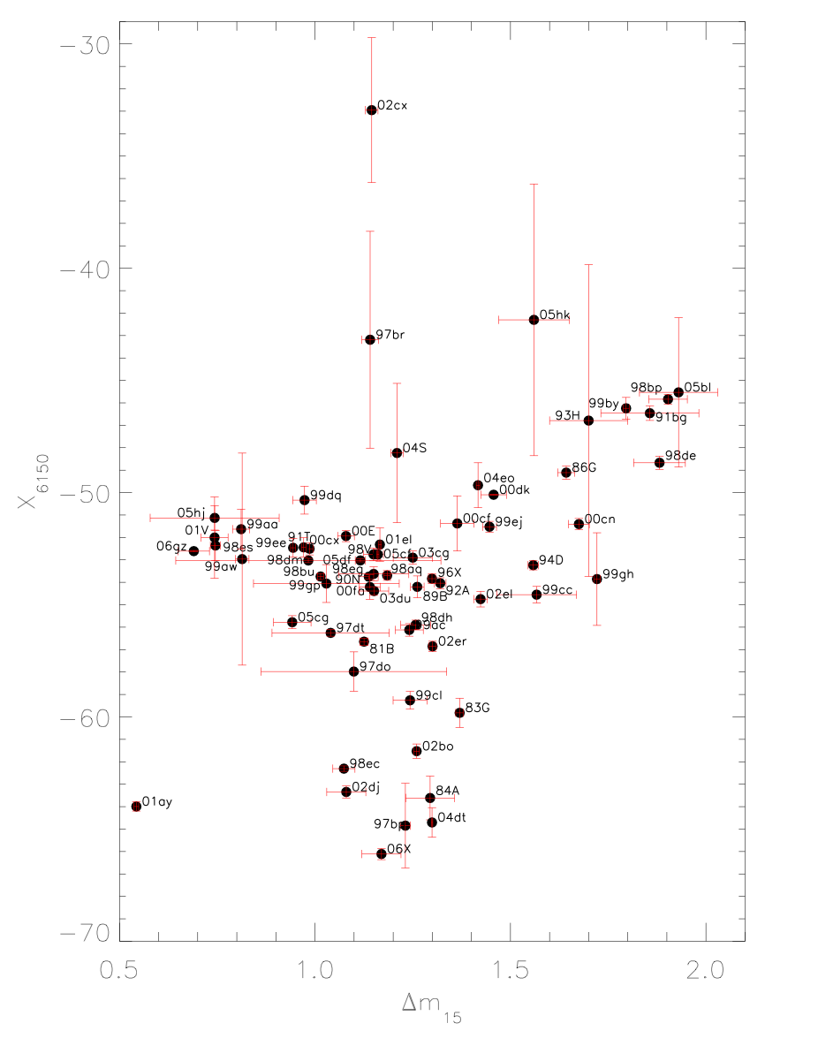
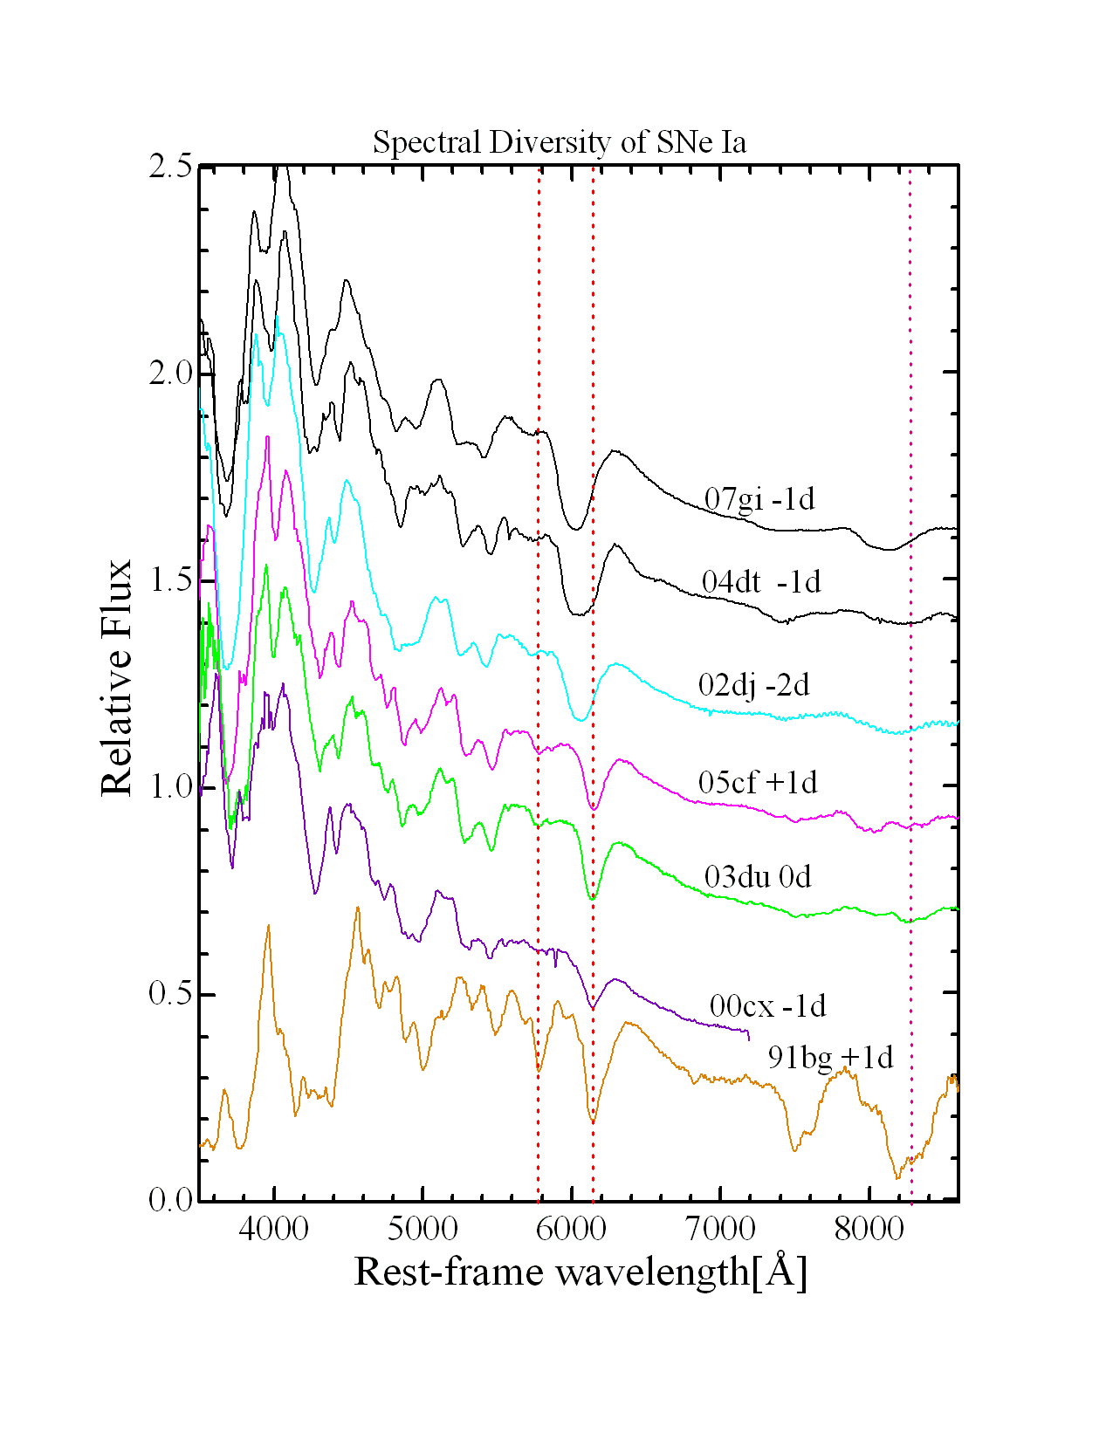
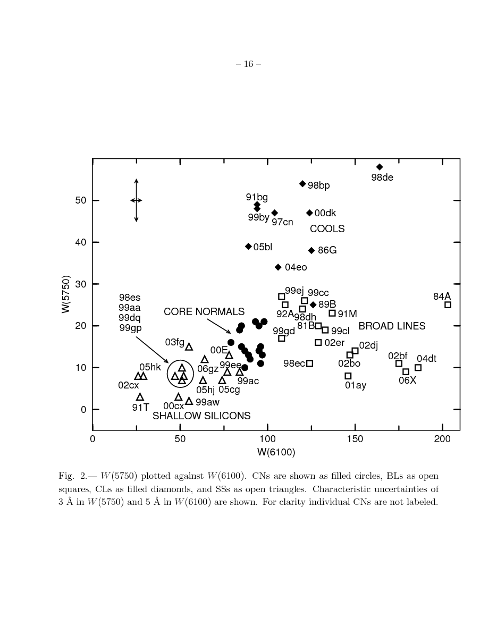
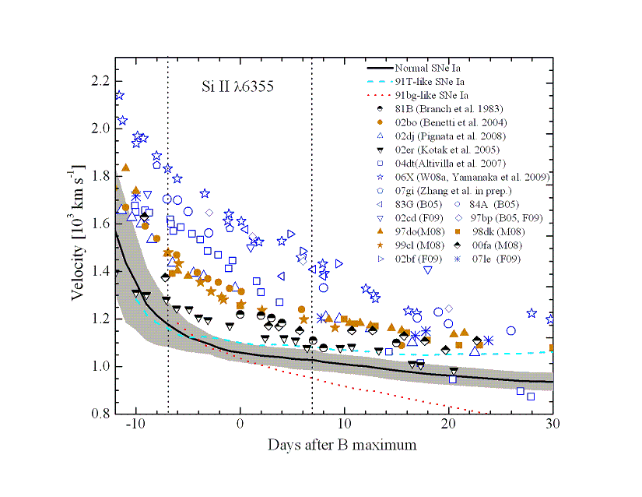
6. The Environment and the Progenitor (Benetti et al. 2005; Branch et al. 2006; Wang et al. 2009; Wagers et al. 2011)
Wagers, Wang, Asztlos, 2011

Slide 7
3. The High and Normal Velocity (Benetti et al. 2005; Branch et al. 2006; Wang et al. 2009; Wagers et al. 2011)
(Wang et al. 2009)

Slide 8
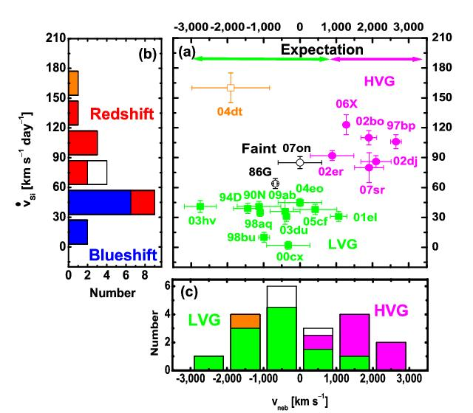
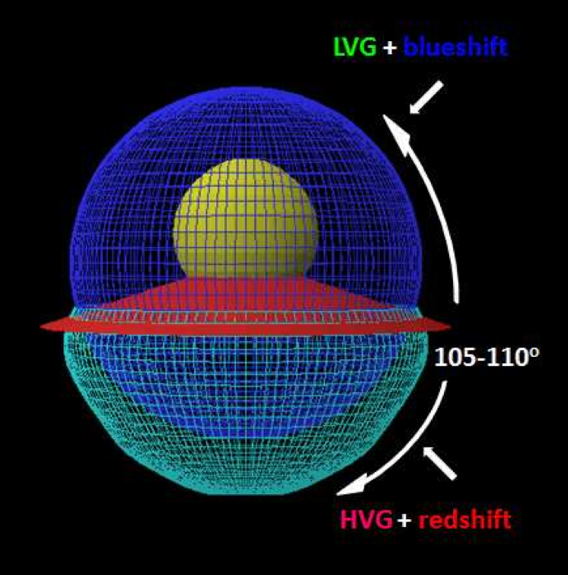
4. Geometric effect?
Maeda et al. 2010,nature

Slide 9
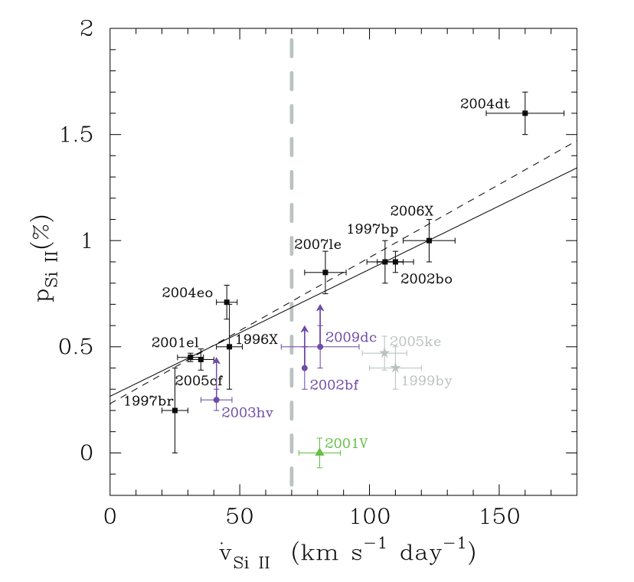
5. The Unification
All SNIa are identical, but asymmetric and the difference is only because of the viewing angle
High Velocity Si – red-shifted Ni core
Maeda et al. 2010
Maund et al. 2010
Would be nice if true!

Slide 10
Not Quite …
High Velocity SNIa are intrinsically different from normal velocity SNIa.
→There are at least two populations of Type Ia
→→ High velocity Si SNIa are associated with significant amount of cirmstellar matter
- Single white dwarf with non-degenerate companion (Wang et al. 2013, Science)?
→→ Normal velocity Si SNIa are associated with no detectable CSM
SN2011fe
Historical Supernova Remnants in the Milky Way
Light Echoes in LMC (Schaefer et al. Nature)
- Double White Dwarfs?
Wang et al. 2013, Science

Slide 11
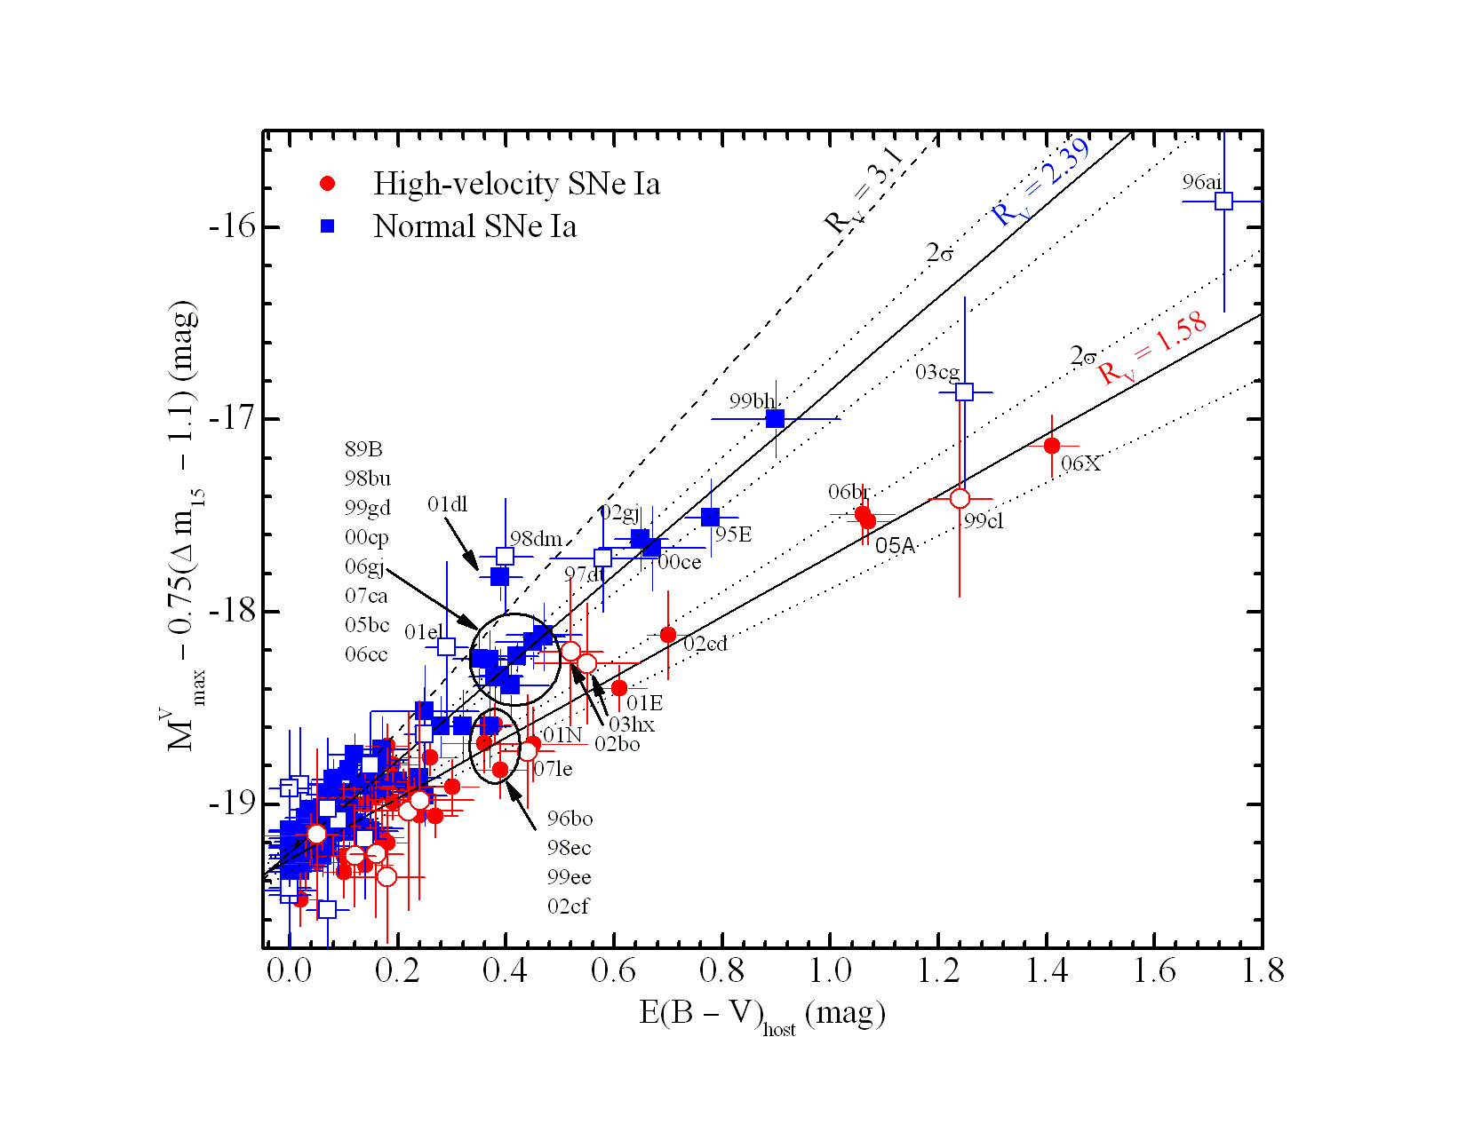
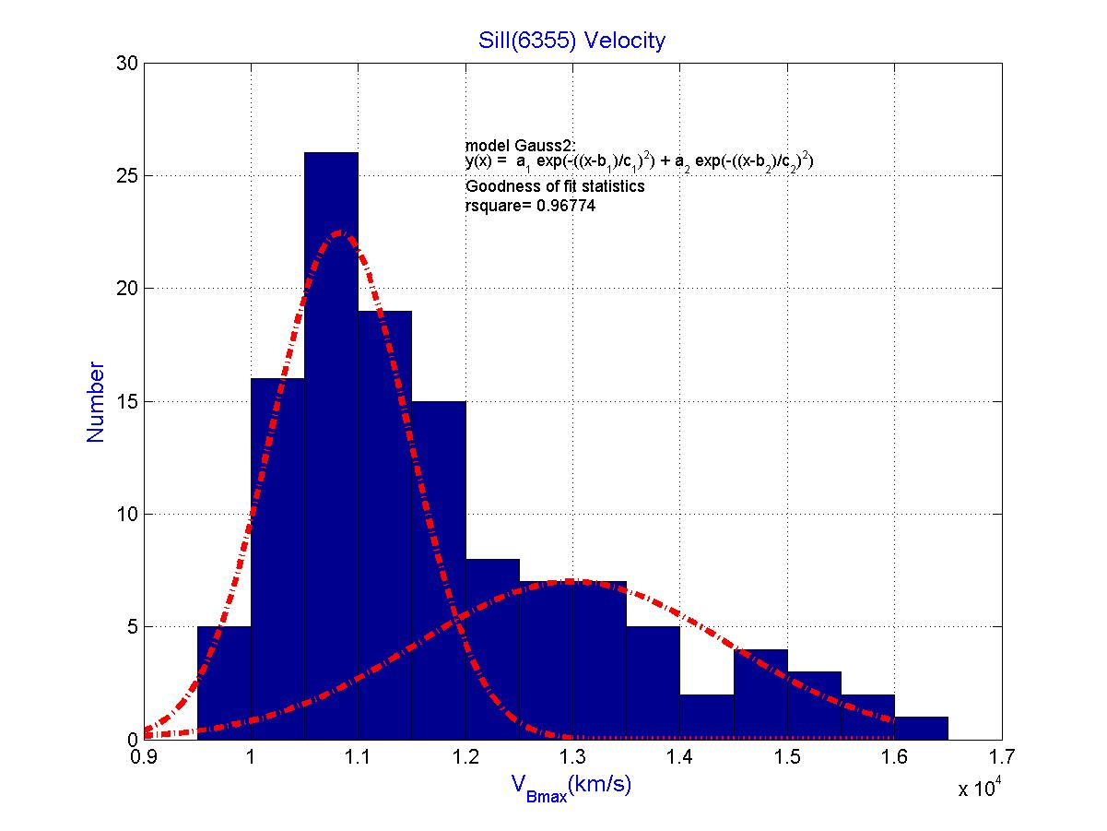
Two SN Ia populations?
Wang, X. et al. 2009

Slide 12
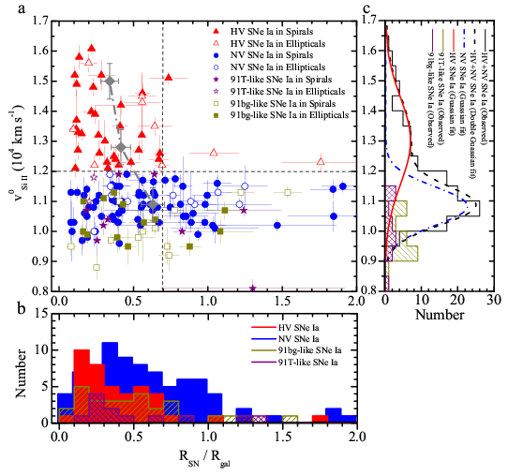
Radial Distribution of SNe Ia in host galaxies
Wang X. ,Wang L. et al. 2013
Science

Slide 13
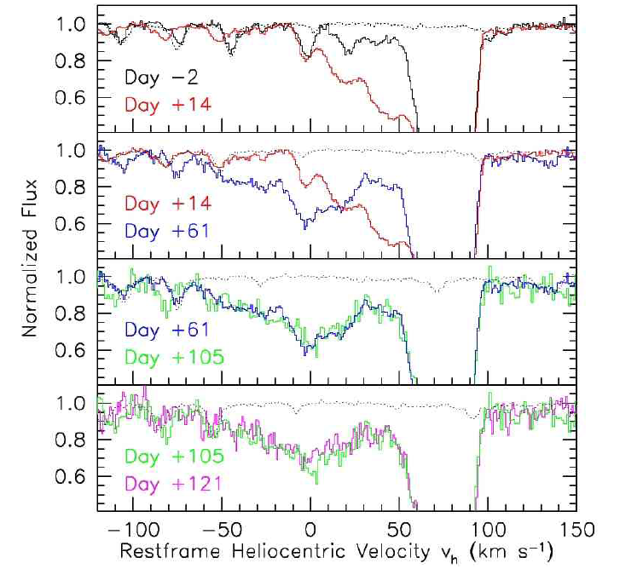
7. Circumstellar material around SN 2006X → SD?
Changes in CSM
Ionization due to variable SN
radiation field
Patat et al. 2007, Science

Slide 14
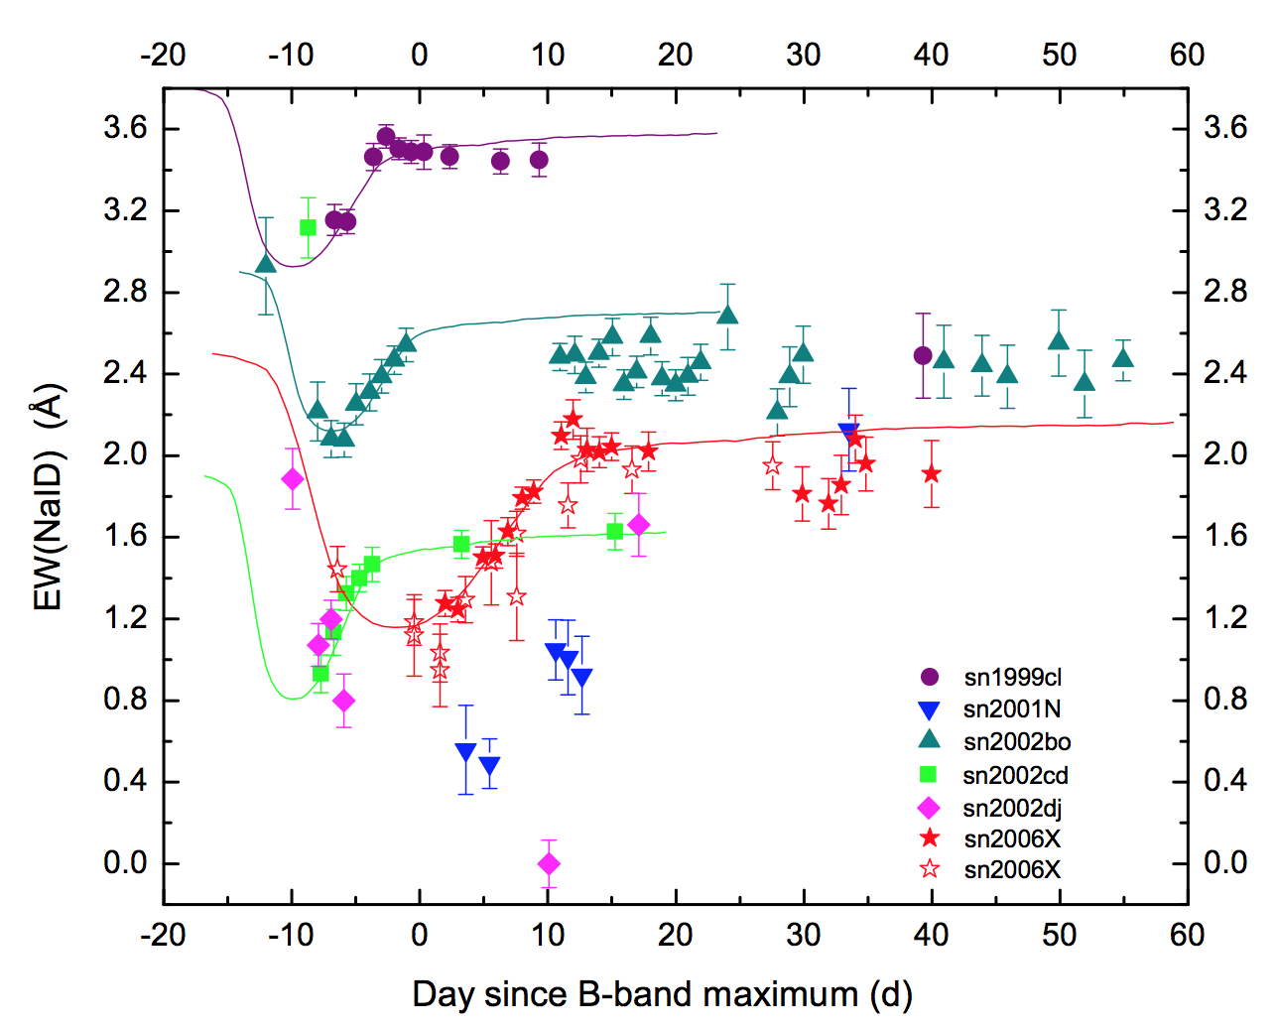
The Smoking Gun – Na ID Line Evolution
Some are single
CSM, ionized by
supernova explosion
SN
Chen, Wang X., Wang, L.
2013, Nature, to be
submitted

Slide 15
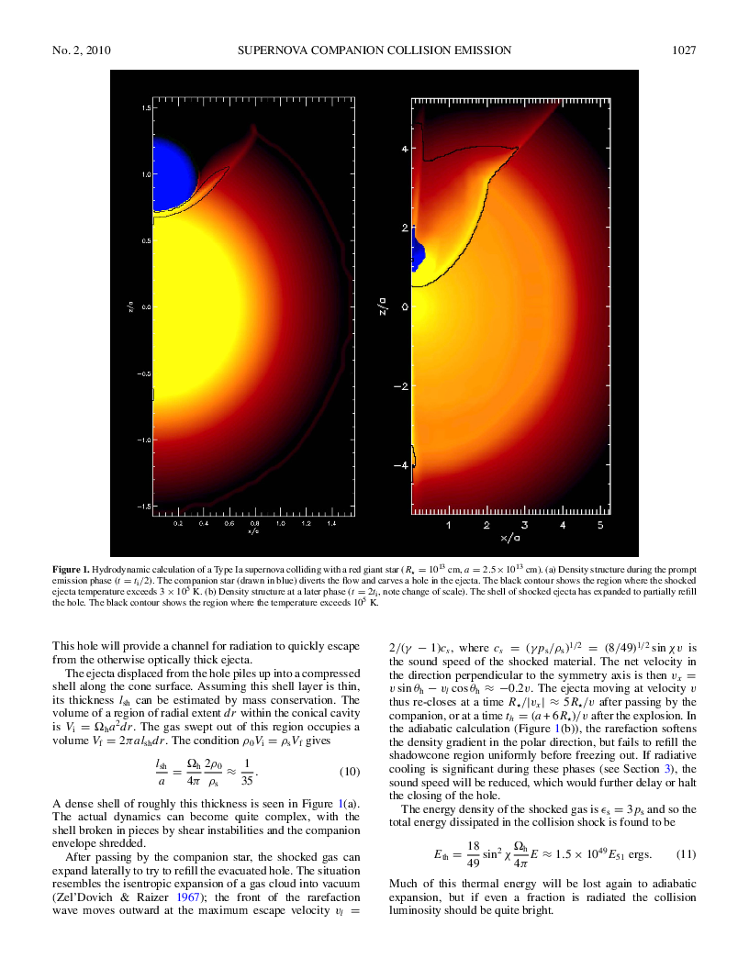
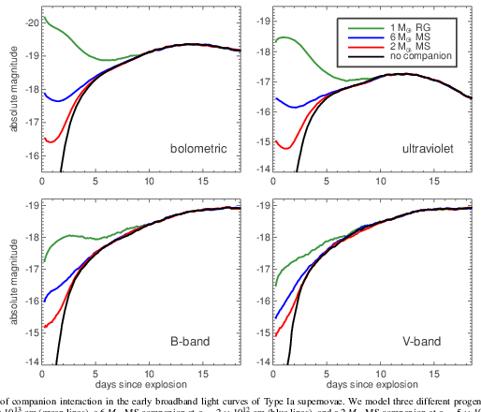
8. Clash between the ejecta and the companion
Kasen 2010

Slide 16
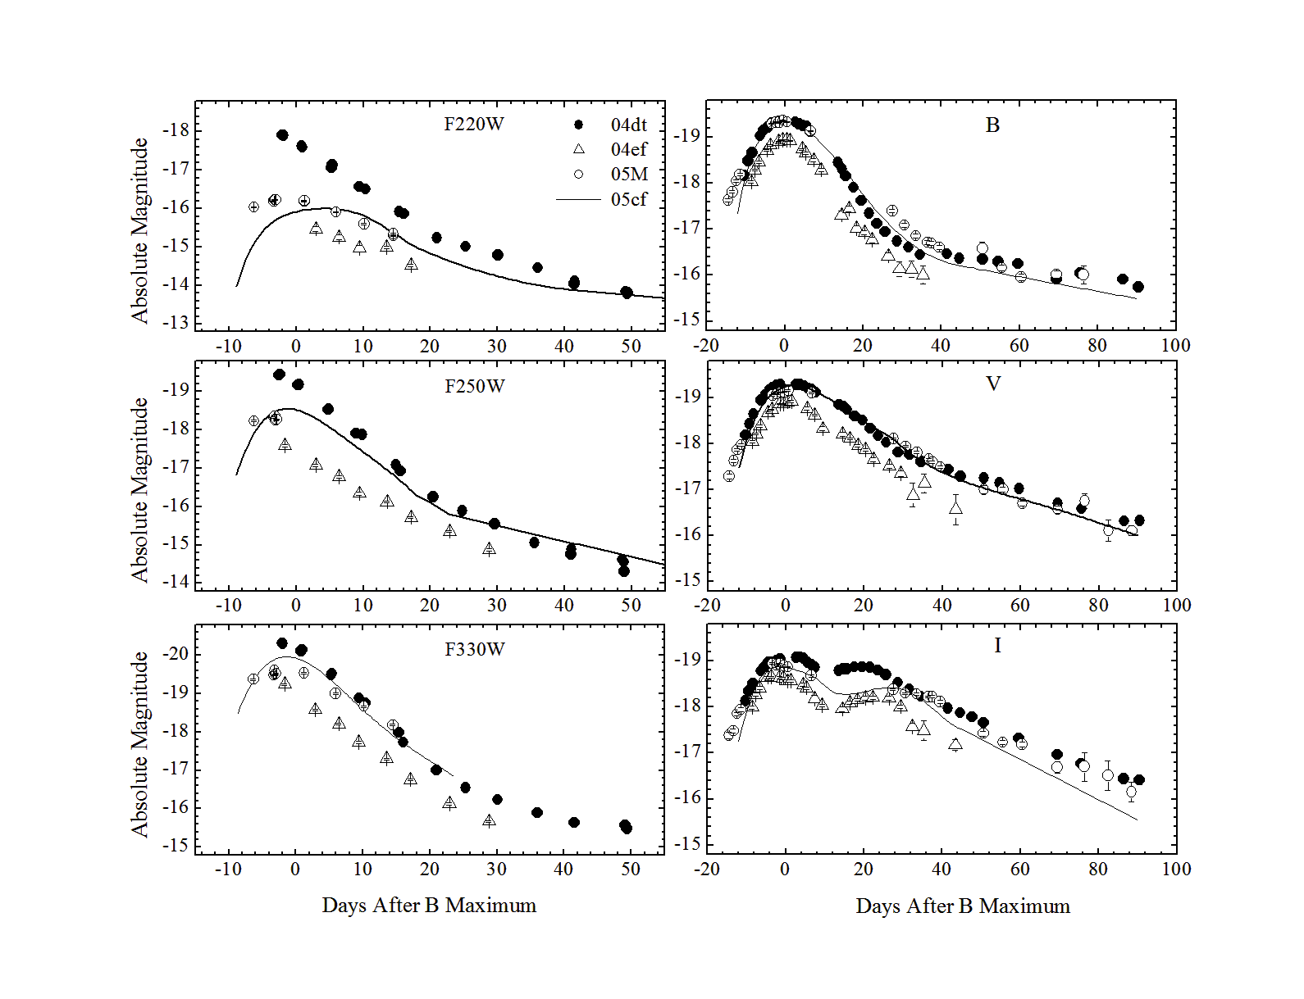
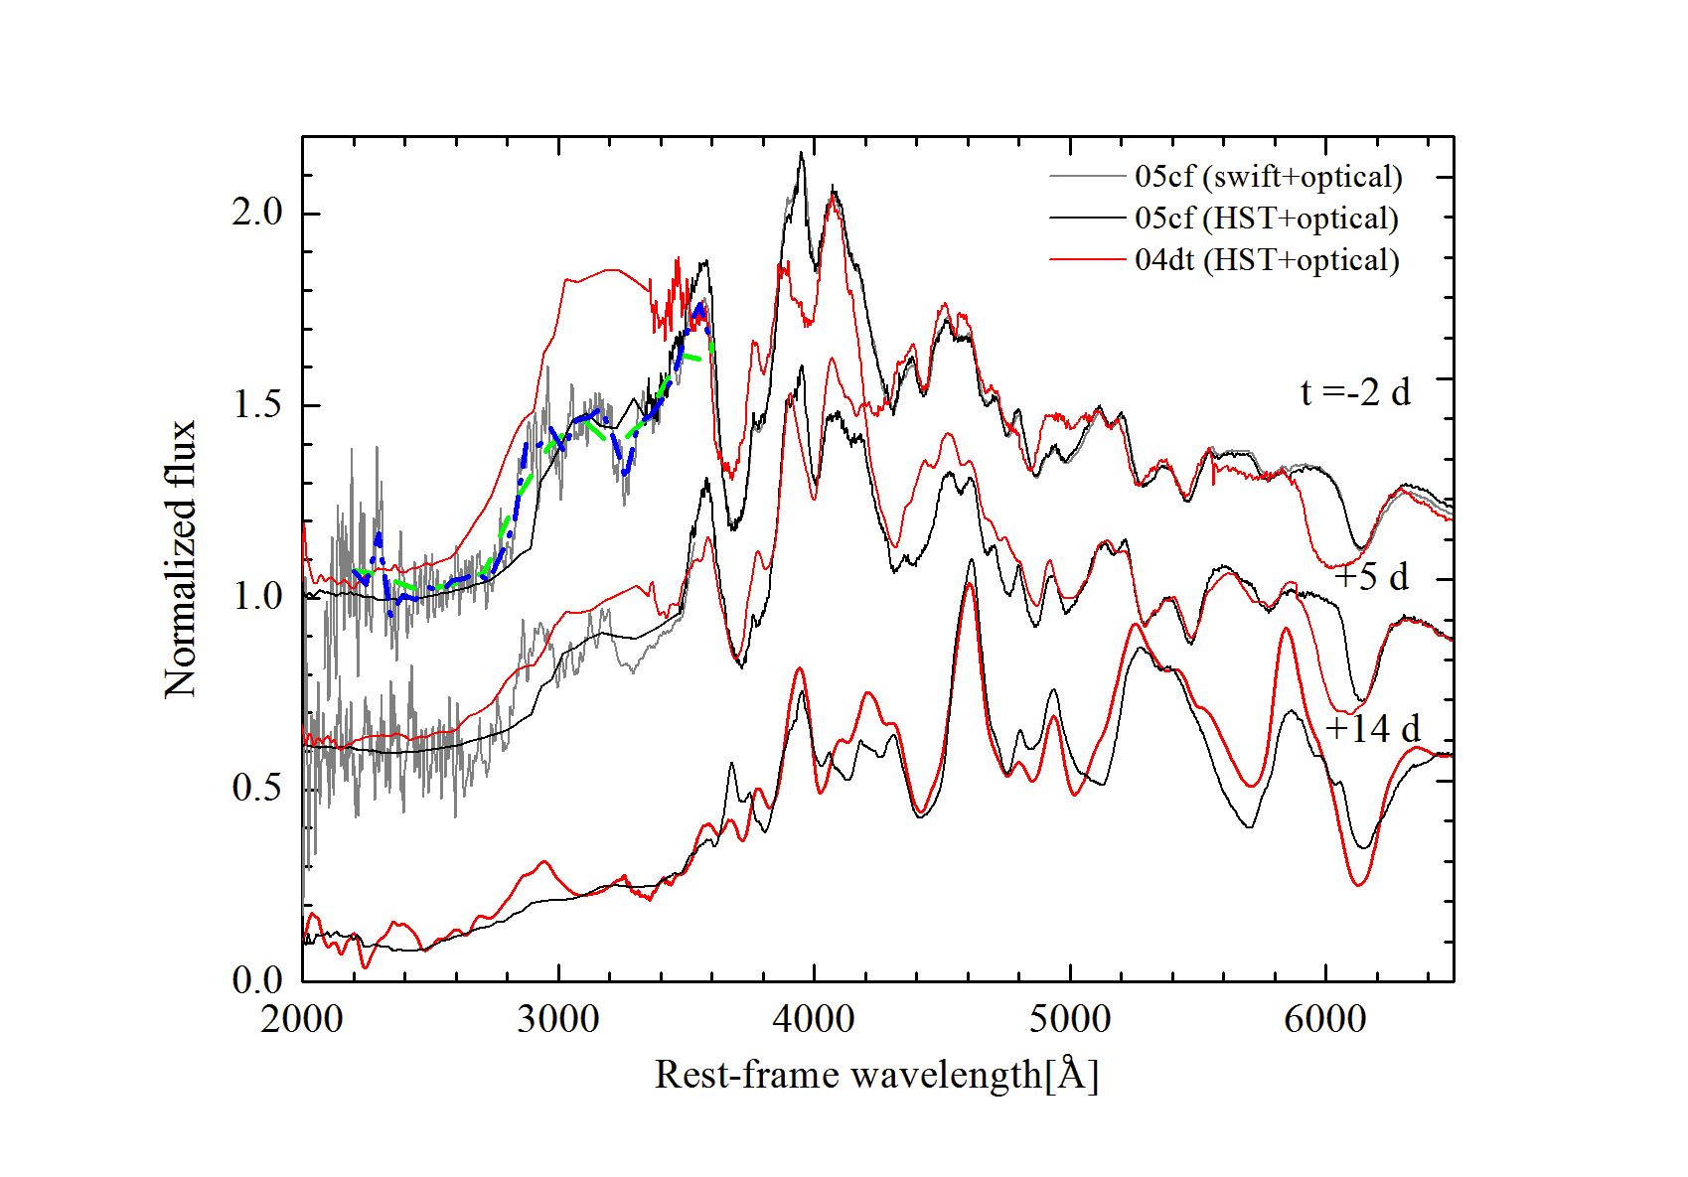
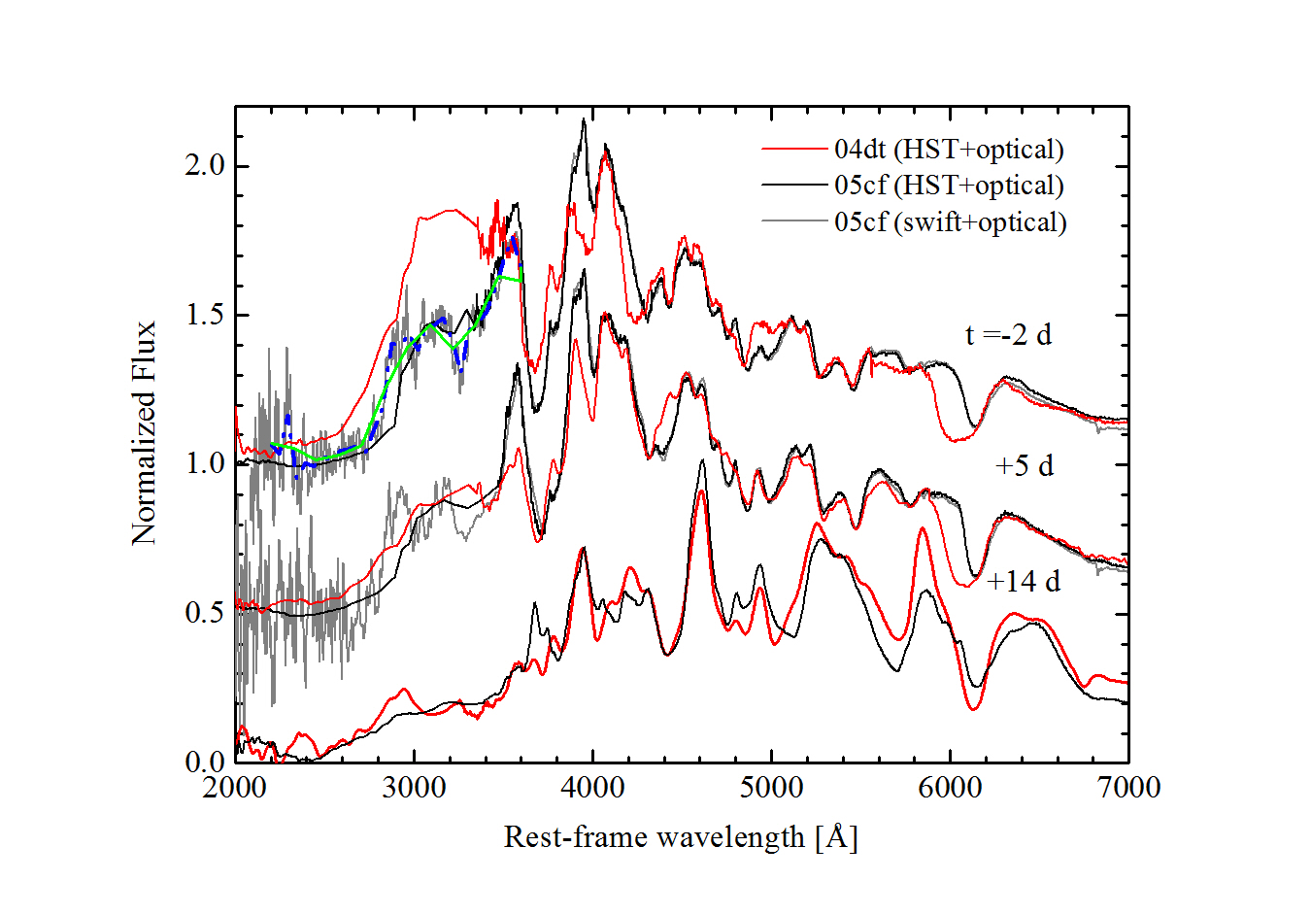
UV excess of SN 2004dt (HV subclass) → a larger companion?
Wang, X., Wang L. et al. 2012, ApJ, 749, 126

Slide 17
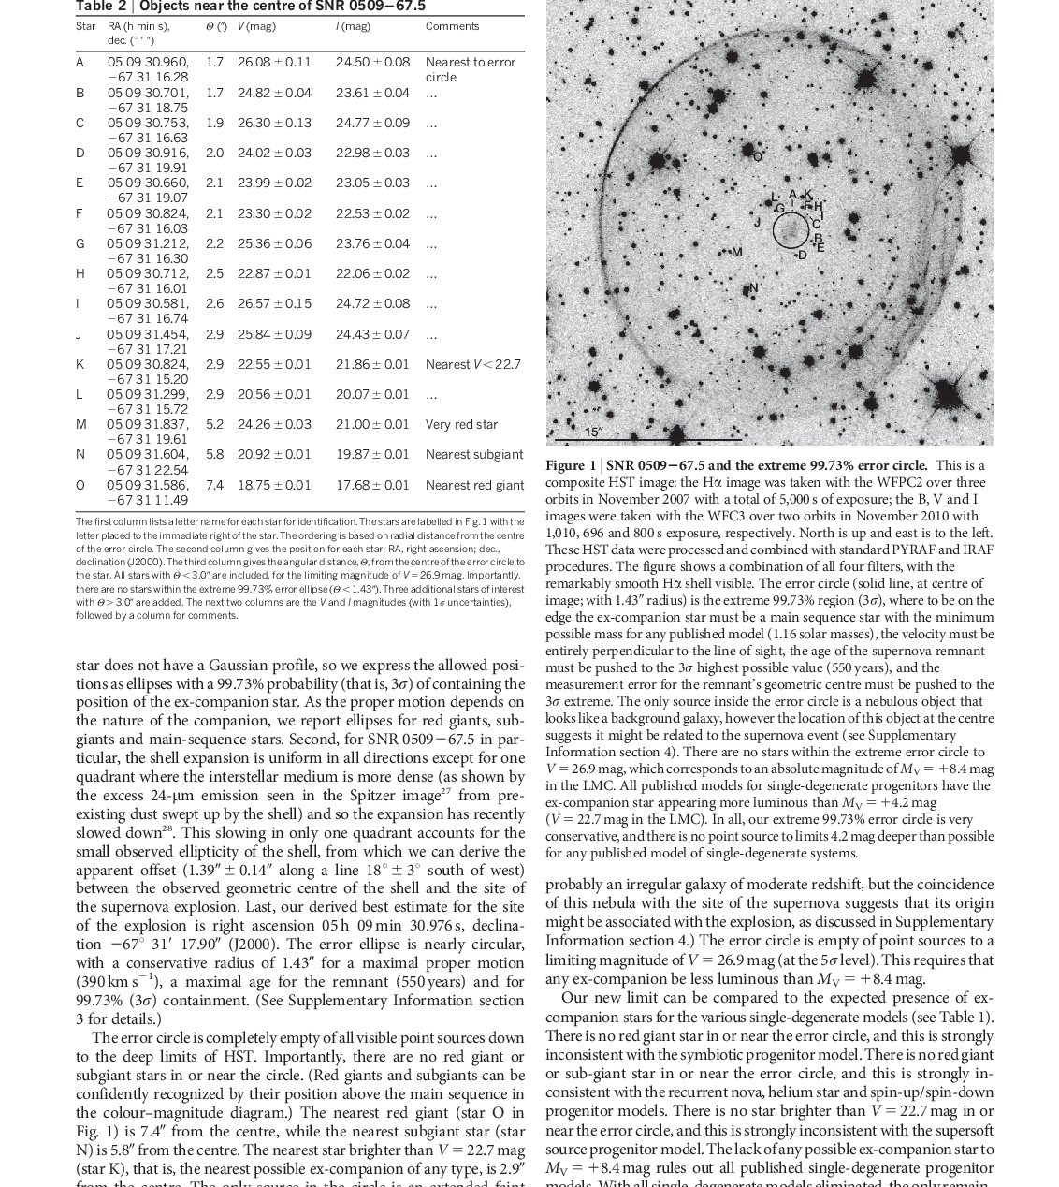
But the companion is still not found: An absence of ex-companion stars in the type Ia supernova remnant SNR 0509-67.5 → DD ?
Some are double!
B.E. Schaefer & A.Pagnotta 2012, Nature

Slide 18
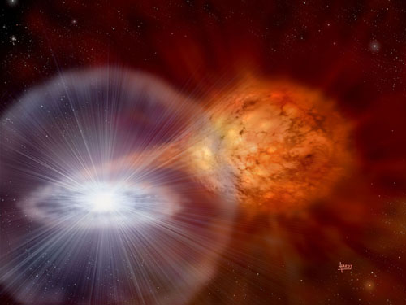
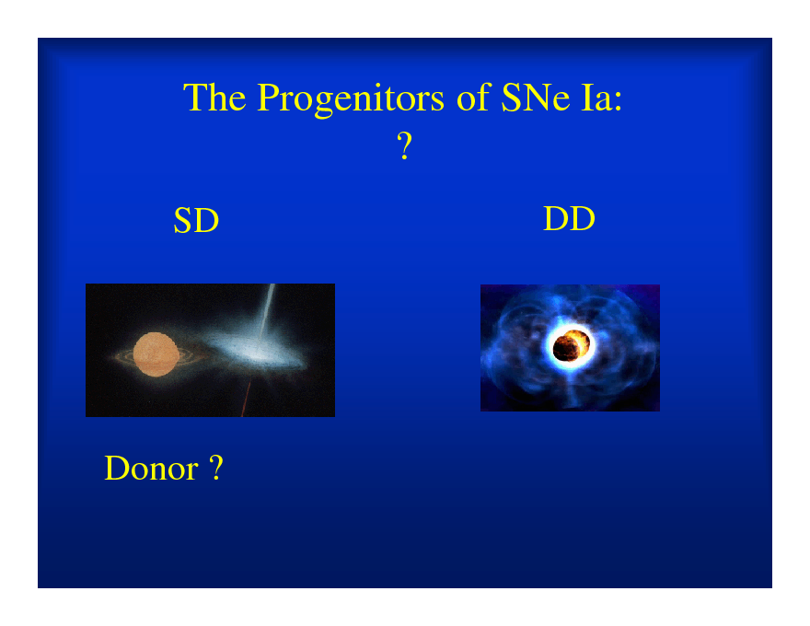
9. SN Ia progenitor
Single
Degenerate → HV SNe Ia ？
Double
Degenerate → NV SNe Ia？

Slide 19
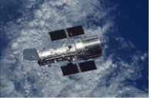
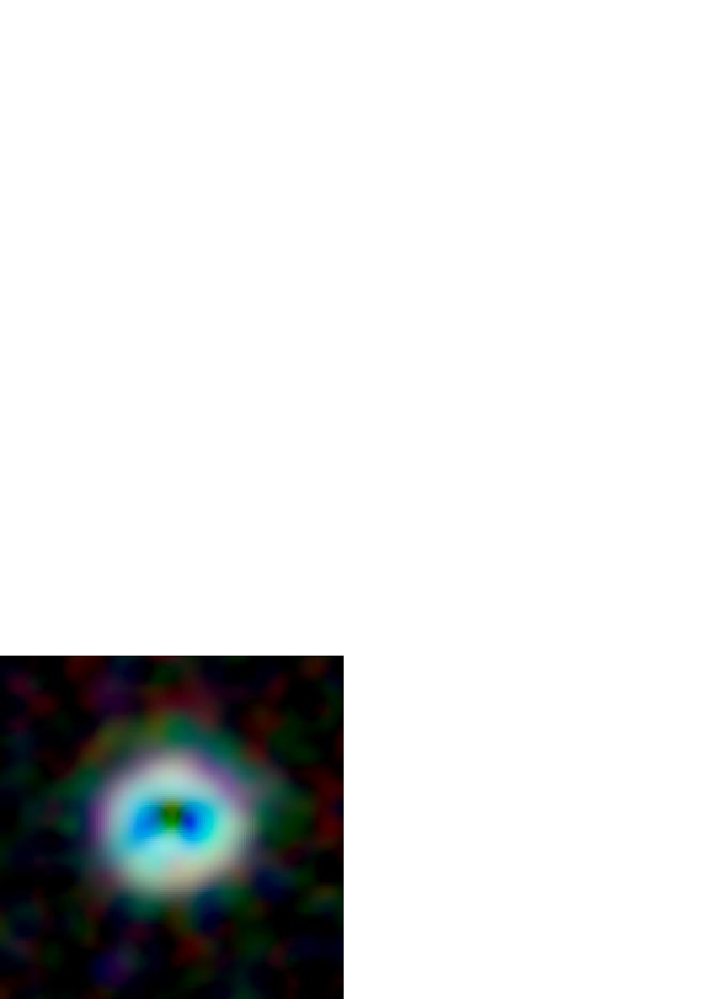
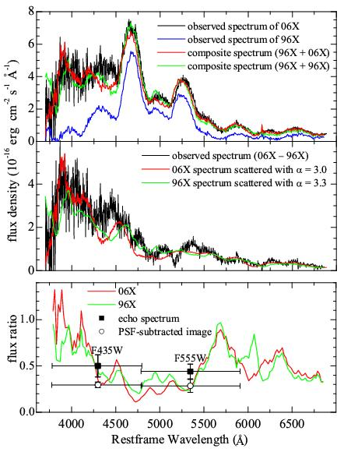
10. Light echo around SN Ia: 2006X (Wang, et al. 2008)
HST imaging at t ~300 days after
the explosion:
Very blue echo spectrum indicated
by the Keck-1 10 m telescope;
Dust with grain size between
0.01-0.1μm is required

Slide 20
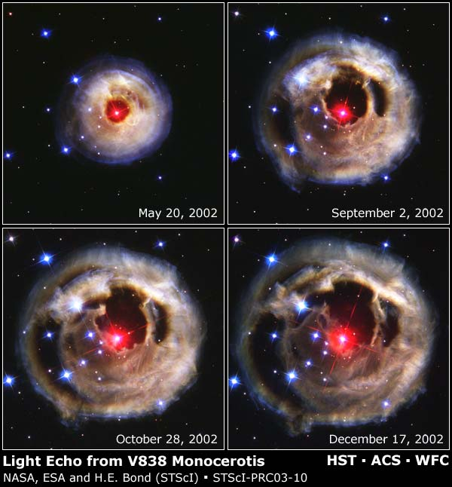
Light Echoes

Slide 21
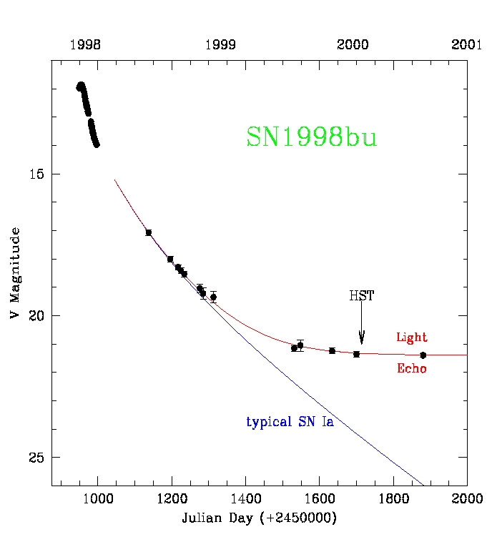
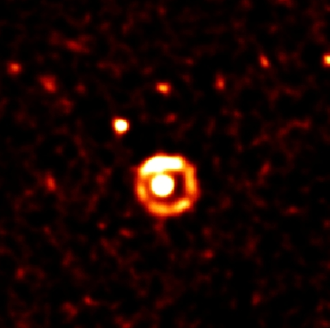
Light echoes
The SINS collaboration
The inner echo is from dust at
a distance < 10 pc from the SN.
The SN has a red color of
B_{max}-V_{max}= 0.38, which indicates
E(B-V) of around 0.4.
The outer echo is from dust at a distance ~ 120 pc from the SN.

Slide 22
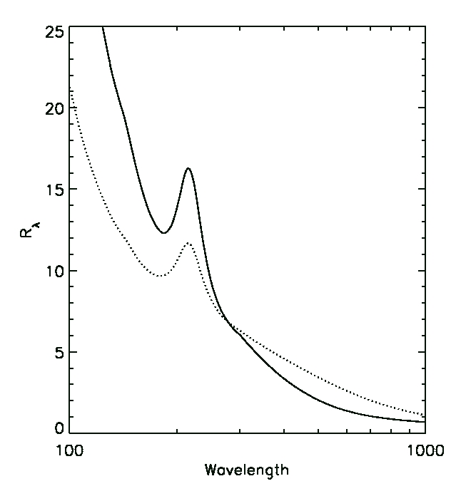
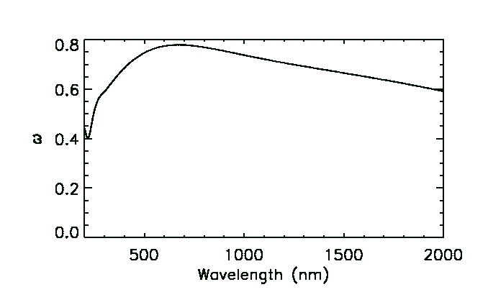
11. Extinction The effective R_{λ} when scattering is included
Calculated assuming LMC dust
Case B: With scattering
Albedo
Case A: No scattering
to observer
Weingartner & Draine (ApJ, 548, 296, 2001)
Wang (ApJL, 2005)
R_{λ} is significantly smaller than given
by the standard interstellar extinction
law in the optical, if all the scattered
photons escape and can be observed.
R_{λ}=Α_{λ}/(Α_{Β}−Α_{V})
B
(nm)

Slide 23
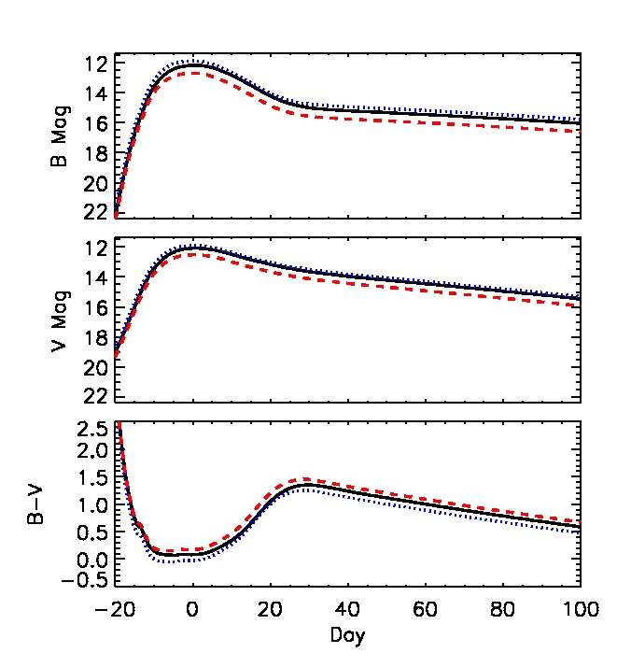
The effect of CSM dust on the light curves
Absorption+
Scattering
Absorption only
Unextincted
E(B-V) = 0.2
(τ_{B}=0.755 and
τ_{V}=0.571)
Wang (ApJ, 2005)

Slide 24
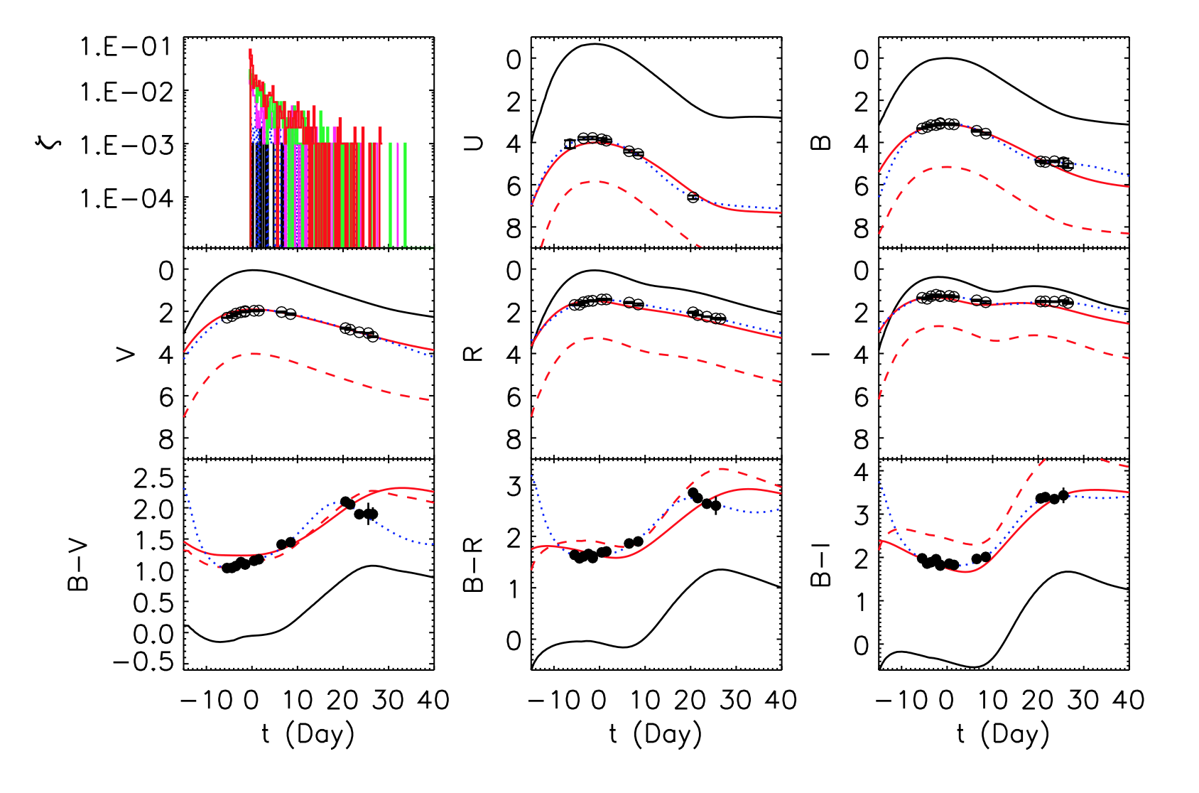

Slide 25
Summary of Topics
SNIa Sub-Groups
Ejecta Geometry
High and Low Velocity
Viewing angle
CSM Environment
The Clash between the Ejecta and CSM/Progenitor
Light Echo
Extinction

