Slide 1
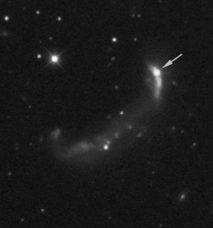


DUST FORMATION AND EXTINCTION IN SNe
PROJECTS AND IDEAS
Christa Gall
Aarhus University,
Department of Physics and Astronomy

Slide 2
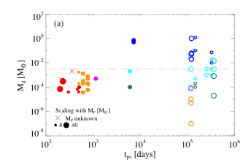
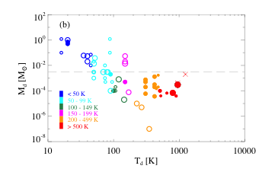
Core Collapse Supernovae
Observational evidence of dust from supernovae
Gall et al. 2011, A&ARv

Slide 3
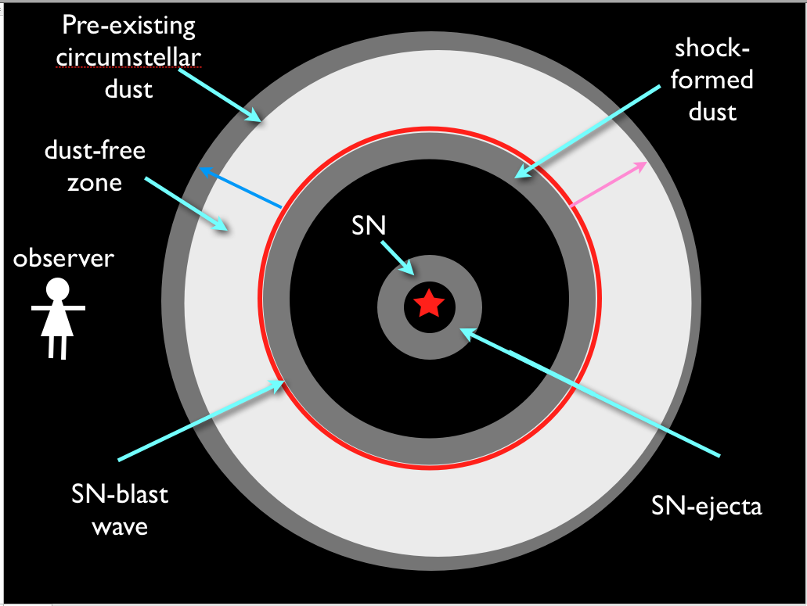
Dust Formation in a Type IIn Supernova

Slide 4
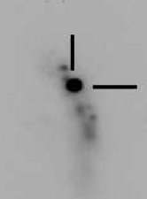
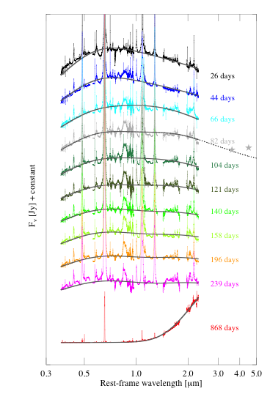
VLT/X-shooter, SN 2010jl
Type IIn SN 2010jl
UGC 5189
Redshift of SN
z = 0.01058
Date of discovery:
Nov 3.5 (Newton & Puckett 2010),
classified as Type IIn SN Nov 5 (Benetti et al. 2010),
early detection Oct 9.6 UT 2010,
peak Oct 18.6 UT 2010 (Stoll et al. 2010)
Papers already published:
Stoll et al. 2012, Andrews et al. 2011,
Patat et al. 2011 Smith et al 2012,
Zhang et al. 2013, Maeda et al. 2013

Slide 5
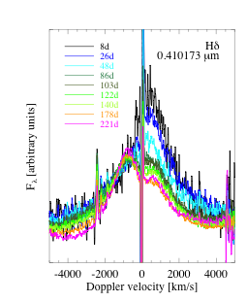
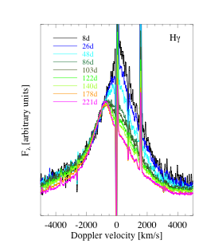
Lineprofiles
Line | Wavelength [Å]
Hδ | 4101.734
Hγ | 4340.472
Hβ | 4861.35
He I | 5875.621
Hα | 6562.79
He I | 7065.2578
Pδ | 10049.8
He I | 10830.199
Pγ | 10938.17
Pβ | 12818.072
Brγ | 21655.268
0.41 μm
0.43 μm

Slide 6
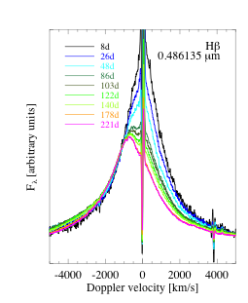
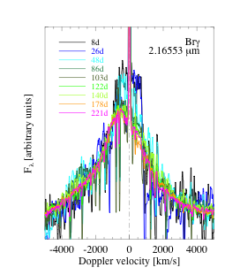
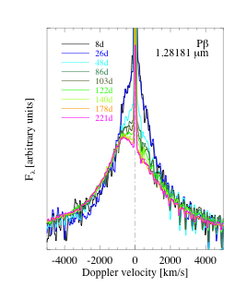
Lineprofiles
0.48 μm
1. 3 μm
2. 16 μm

Slide 7
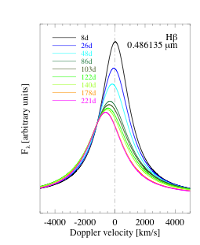
Lineprofiles
Original line
Lorentzian fits

Slide 8
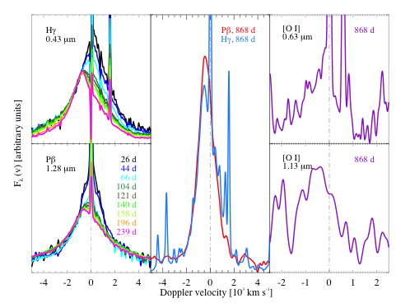
Lineprofiles

Slide 9
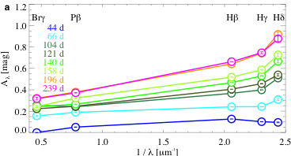
Supernova extinction curve

Slide 10
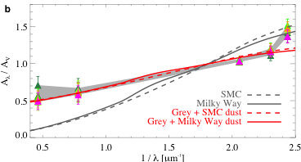
Supernova extinction curve
R_{V} = 2.9 (SMC)
R_{V} = 3.1 (MW)
R_{V} ≈ 6.4

Slide 11
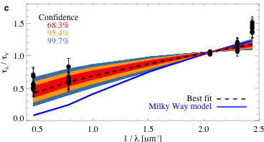
Supernova extinction curve
R_{V} ≈ 6.4

Slide 12
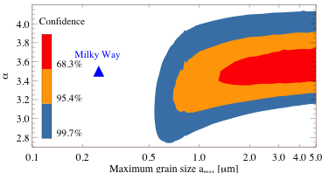
Large grains
Best fit: α = 3.6, a_{max} = 4.2

Slide 13
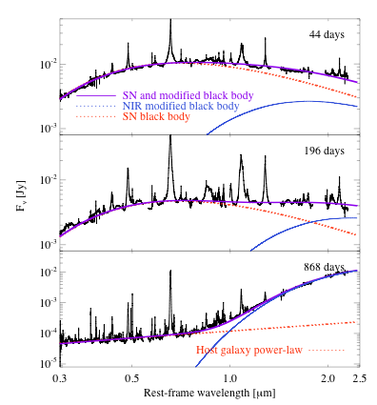
Dust emission
T_{SN} ≈ 7300 K,
R_{SN} ≈ 2.5 – 3 × 10¹⁵ cm,
T_{d} ≈ 2300 - 1600K,
R_{BB} ≈ 1.0 – 2.5 × 10¹⁶ cm
T_{d} ≈1100K, R_{BB} ≈ 5.7 × 10¹⁶ cm

Slide 14
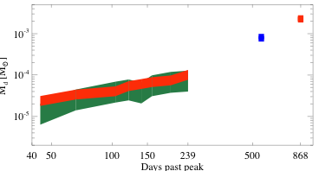
Dust mass estimates
Maeda et al. 2013
Emission dust mass
Extinction dust mass

Slide 15
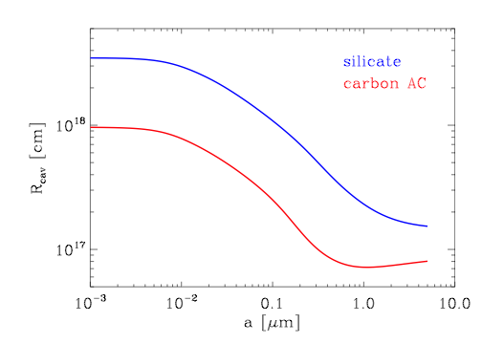
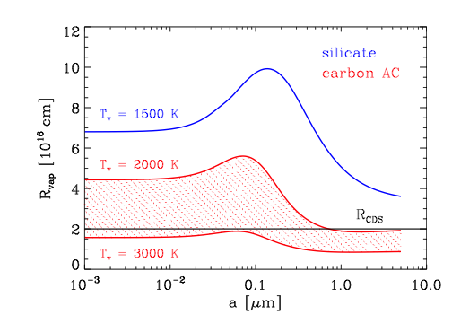
Vaporization radius

Slide 16
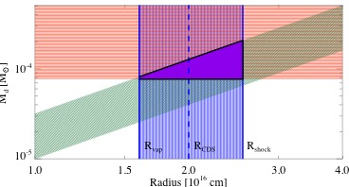
Location constraints

Slide 17
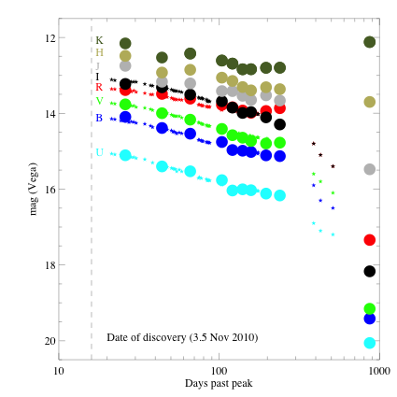
Supernova lightcurve
Nov 5
Nov 5
Zhang et al. 2013, corrected U-band!!!

Slide 18
Type Ia projects
No observational evidence for dust formation in
Ia SNe, dust circumstellar?
Possible projects:
Study optical and NIR properties, reddening effects
Extinction properties, source of extinction
Dust properties
Destructive processes: formation, growth, shattering, etc
Extinction correction methods for Ia SNe
Suggestions welcome!!!!!!!

Slide 19
THANK YOU

Slide 20
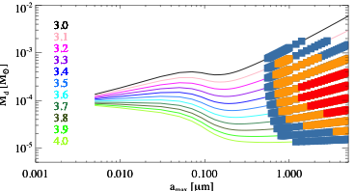
Extinction dust mass

Slide 21
More similar Type IIn SNe !!
SN 2009ip
see paper by Margutti et al. 2013, X-shooter spectra taken
SN 2013L
Similar to 10jl, X-shooter spectra taken
5.2 hour X-shooter time available in ongoing period P92 for similar campaign + one late time spectrum for SN 2010jl

Slide 22
Location of dust formation
SN 2010jl exploded ~ 50 days before discovery
time until shock hits the CSM Δt ~ 100 - 120 days
initial forward shock velocity v_{ini} 3 x 10⁴ km/s
R = v_{ini} Δt ➔ R_{hot} ≈ R_{BB}
LBV eruption?
for v_{shell} ~ 500 km/s
➔ few years prior explosion
Critical density to form dust ~ 10¹⁰ cm⁻³
Forward shock in the CSM v_{s} ~ 2000 km/s
High column density from X-ray observations (Chandra et al. 2012) along line of sight
suggesting large amounts of material and metals available
rapid increase of density and fast cooling
density of the CDS up to ~ 10 ¹⁰⁻¹³ cm⁻³
takes a few days to grow large dust grains

Slide 23
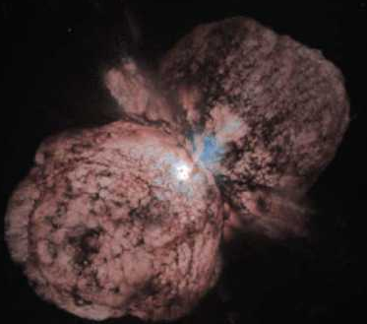
Promising Dust Source: Type IIn SNe?
SN Type | Characteristics | Progenitor M⊙ | Progenitor Type
II-P (plateau) | Hydrogen present | (7) 8 - 25 | RSG
II-L (linear) | Blue | ~ 15 – 25 | YSG
II-n (narrow line) | Narrow emission lines, broad base | ~ 8 – 10 > 25 – 30 | SAGB LBV
II-b | Little hydrogen | > 25 - 30 | WR, binary
Ib | Helium rich | > 25 | WR
Ic | Helium deficient | > 25 | WR, binary
Dust signature in IIn SN: e.g, 2005ip, 2006jc, 2006tf
Smith et al. 2008a,b, Fox et al. 2009
Dust from Supernova progenitors
LBVs: e.g., η Car : ~ 0.4 M of dust (Gomez et al. 2010)

Slide 24
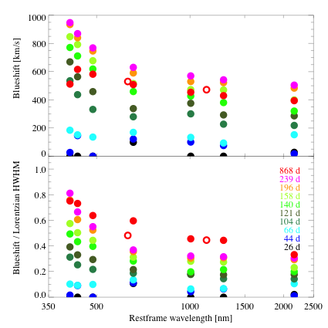
Blueshift evolution

Slide 25
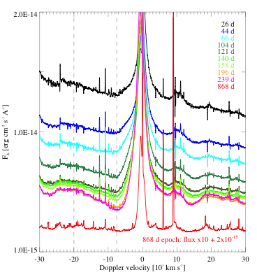
Ejecta velocity

Slide 26
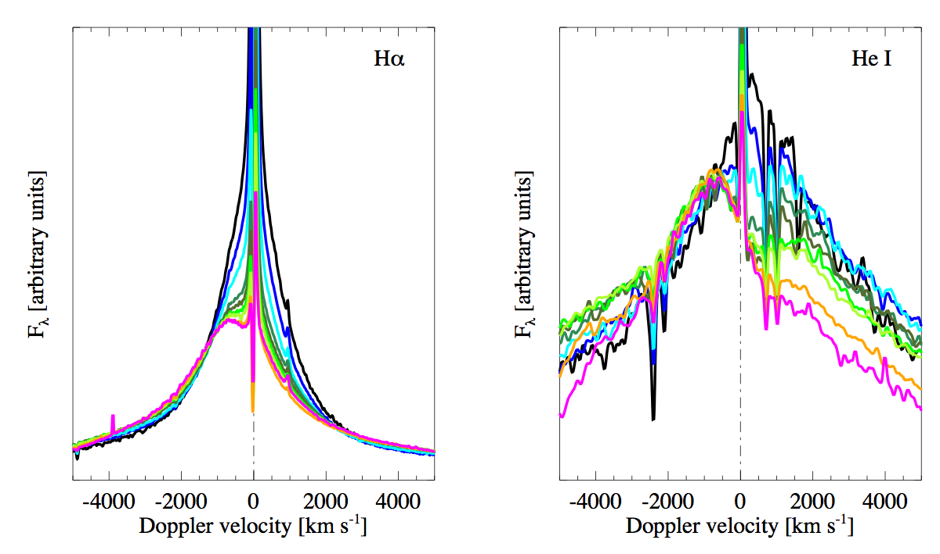
Lineprofile

Slide 27
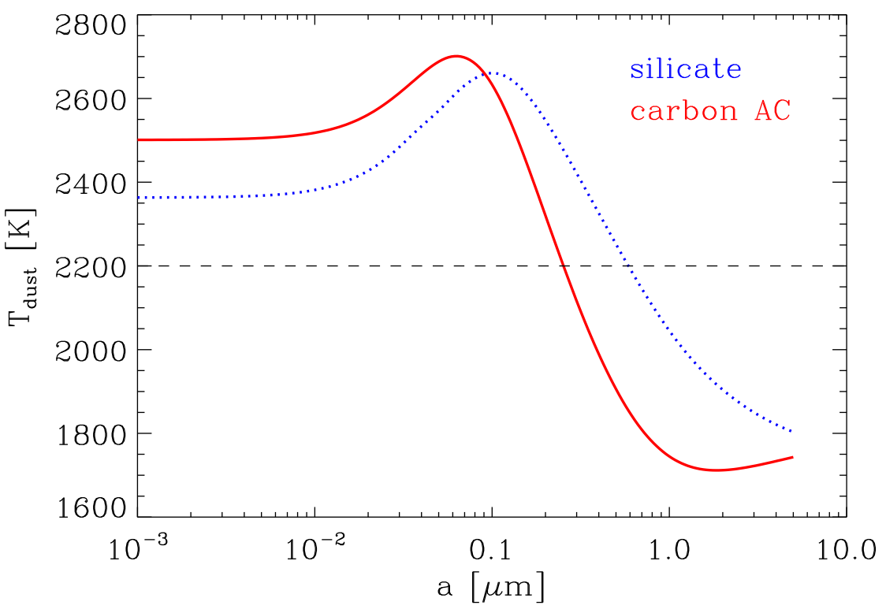
Temperature of the dust in the CDS

