Slide 1
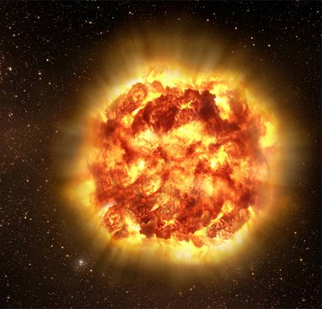
NIR Spectroscopy of Supernovae
New Perspectives on Evolution,
Environments, & Explosions
1

Slide 2
You already know that
supernovae are cool.
Why is the NIR so important?
  Chemical structure
    Easier to observe in the NIR: He, C, O, Mg, CaII
    Outer layers – high velocity regions
    Fe features – pseudo emission features
  Progenitors: composition & evolution
  Explosion processes
  Improve SN cosmology
    Better standard candles in the NIR
    K-corrections for higher redshift
  Understand the physics of NIR light curves
    Double peaks – Fe III > Fe II recombination
  New Instruments increase observational capacity

Slide 3
State of NIR observing
Current catalog > 120 NIR spectra from SN Ia
Access to spectroscopy is improving
  At Magellan – FIRE, MMIRS
Coordination of data is improving
  Combined optical+NIR spectroscopy
  NIR photometry
We’re data rich and theory starved
  Need help with analysis and observing strategies
Improved data reveal new questions
  Eric’s paper has 3 important new results
3

Slide 4
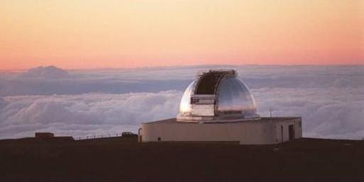
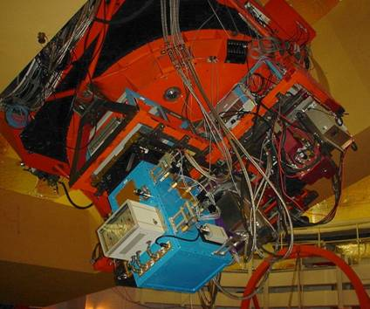
The SpeX Instrument on the IRTF
Covers 0.7-2.5 µm
in a single exposure
Reaches J~17.5 enabling early or scheduled observations
IRTF software & infrastructure facilitate
ToO observations

Slide 5
NIR Spectra Catalog
> 120 SNe Ia
IRTF SNe Ia
  88 normal
  5 superluminous
  6 subluminous
IRTF Other
  13 Ib
  5 Ic
  3 II
Other Sources
  9 Rick Rudy
  11 Rubina Kotak
  70? CSP archives
Now +120 / year

Slide 6
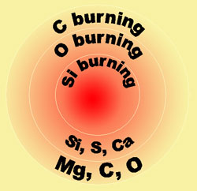
Spectra from Supernovae
Light is produced by ⁵⁶Ni in the core
As SNe expand, geometrical dilution reveals progressively deeper layers
A time series of spectra reveals the chemical structure of the explosion
Observed Doppler velocities locate the explosion products in radial space
Early data probe the outer layers
Fe/Co/Ni

Slide 7
The Importance of NIR Spectra
O and Mg are carbon burning products
Explosion diagnostics:
C burning occurs at lower temperatures and densities
in the outer layers of the progenitor.
Fe/Co/Ni
C & O do not produce
strong lines at optical wavelengths
Mg II is heavily blended

Slide 8
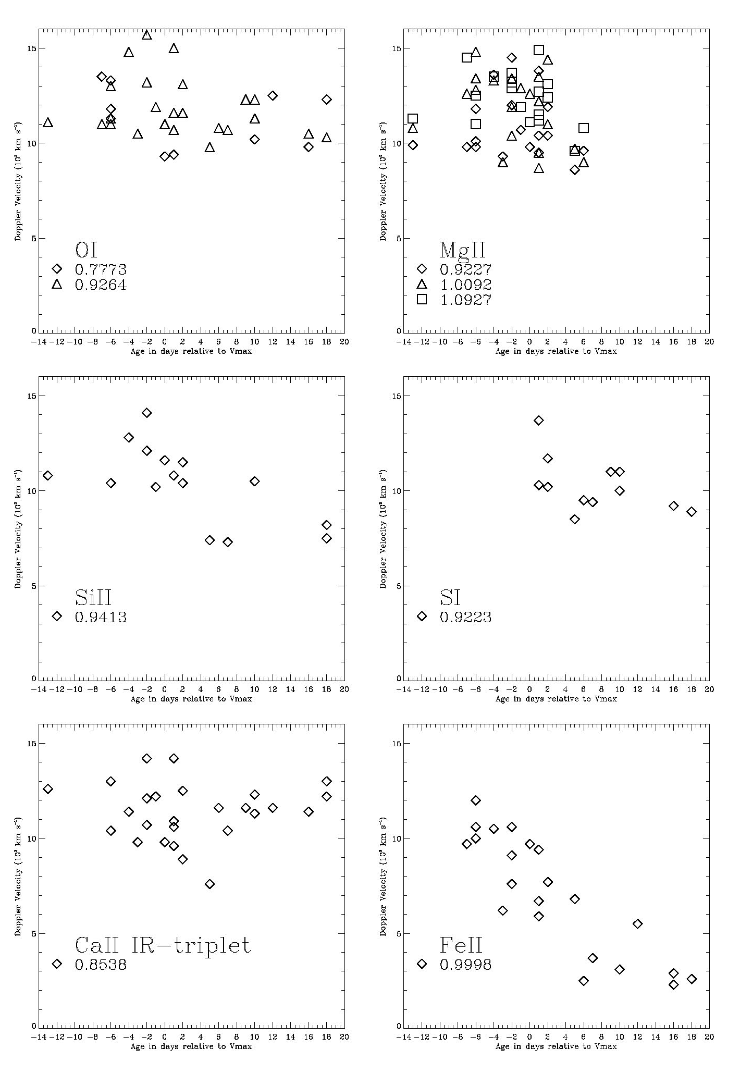
Distinct minimum velocities shows that burning products are found in distinct layers
No large scale mixing
Composition of layers is predicted by DD models
Marion, et al.,
2009, AJ 138, 727

Slide 9
SN 2011fe
Hsiao et al. (2012)
Mg II velocities

Slide 10
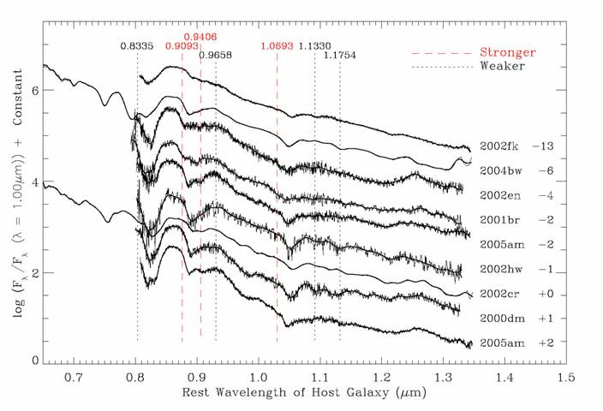
Carbon is not detected down to very low limits.
Mg and O are found in same physical space.
This suggests that the entire progenitor is burned.
CI lines marked at v_{exp}= 11,000 km/s
Marion, et al. 2006,
ApJ 635, 1392

Slide 11
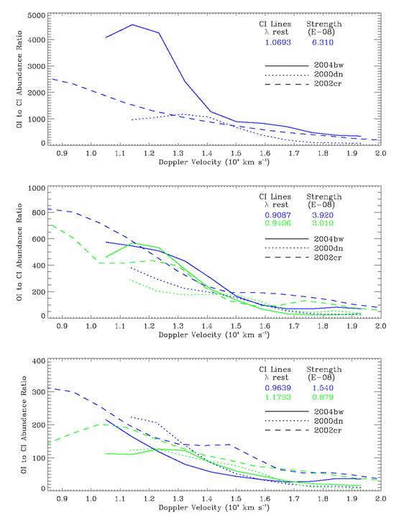
Oxygen abundance
is greater than
carbon abundance
by factors of 10² – 10³
The lower limit for
the O to C ratio
remains well above unity to velocities in excess of 18,000 km/s.
Marion, et al. 2006,
ApJ 635, 1392

Slide 12
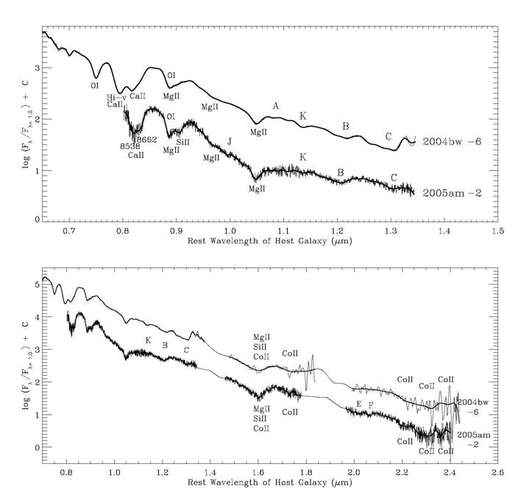
Absorption features in early spectra
of SN Ia
MgII from 1.0927 µm
MgII
1.0927 µm
Relatively unblended
Covered by
all spectra
in our sample
Top: λ = 0.65 – 1.35 µm
Bottom: λ = 0.7 – 2.5 µm

Slide 13
Mg II 1.0927 μm
features in
53 NIR spectra
of 31 SNe Ia
Marion et al. (2012)
Note C I features

Slide 14
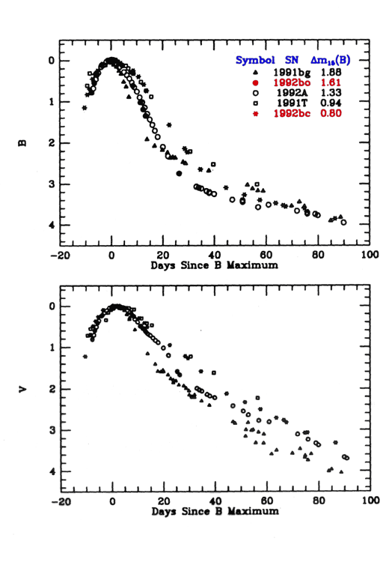
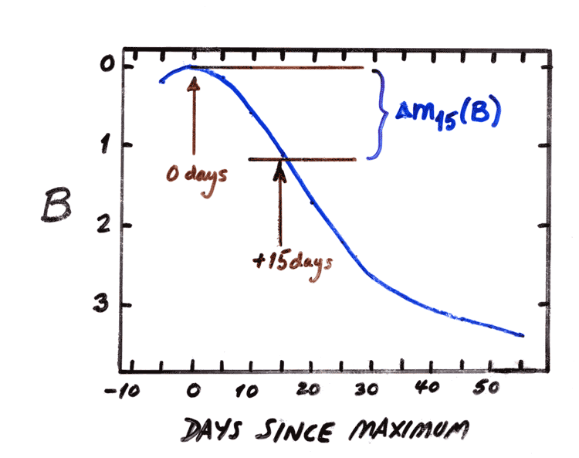
Suntzeff (1996)
Δm₁₅
decline in brightness
after 15 days
Related to absolute brightness and used to reduce dispersion of observed brightness
MLCS2k2 parameter Δ
Stretch factors
Phillips (1993)

Slide 15
Mg II 1.0927 μm
No obvious correlations between Mg II features and velocity
A correlation between
Mg II velocity and Δm15 is expected.
(see Hsiao, et al.)

Slide 16
Mg II 1.0927 μm
Equivalent Width
and Δm15 correlate
Red dots are -15d to -4d.
Blue are -3d to +3d.
Green open circles +4d to +6d.

Slide 17
Mg II 1.0927 μm
Correlations also
found between
Line Depth, FWHM
and Δm15
Red dots are -15d to -4d.
Blue are -3d to +3d.
Green circles +4d to +6d.

Slide 18
Marion et al. (2012)
The strongest correlation is between the ratio
(W_{e}/FWHM) and Δm15(B).

Slide 19
Marion et al. (2012)
⬅ Brighter
Fainter ➔
This means that intrinsically brighter SN Ia
have weaker Mg II absorption features

Slide 20
Ca II does not exhibit this correlation
(O & Si burning product)

Slide 21
Other carbon burning products: OI and MgII show the same pattern.
Line depth increases as Δm₁₅ (B) increases.
The carbon burning
layer is apparently more opaque in dimmer SN Ia.
More unburned/paritial burned >> Less ⁵⁶Ni?

Slide 22
Ten years of “Snapshot” NIR spectra reveal patterns of spectral evolution associated with the chemical structure
Limited overlap with
NIR photometry and optical spectra
Difficult to model

Slide 23
SN 2011by
coordinated
NIR + optical spectroscopy
This sequence covers the time period from before the primary
to after the
secondary peak

Slide 25
SN 2011iv post-max
H-band development
(2nd best damn NIR sequence?)

Slide 26
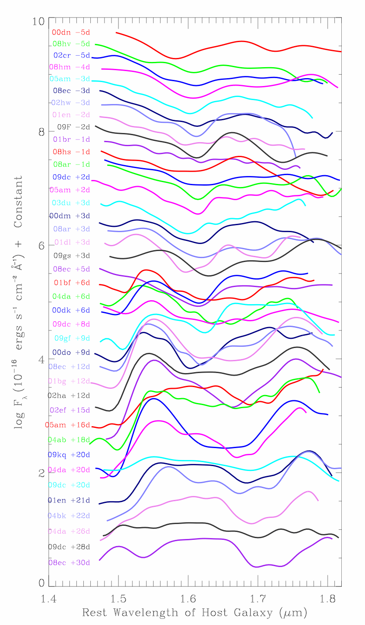
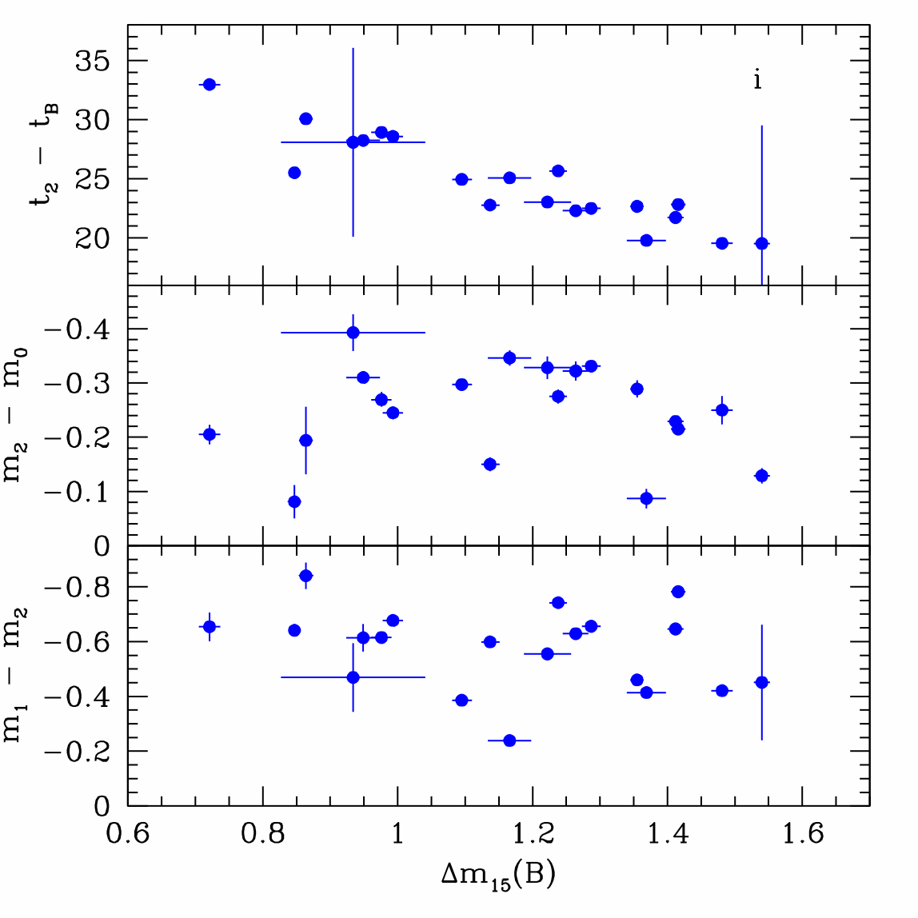
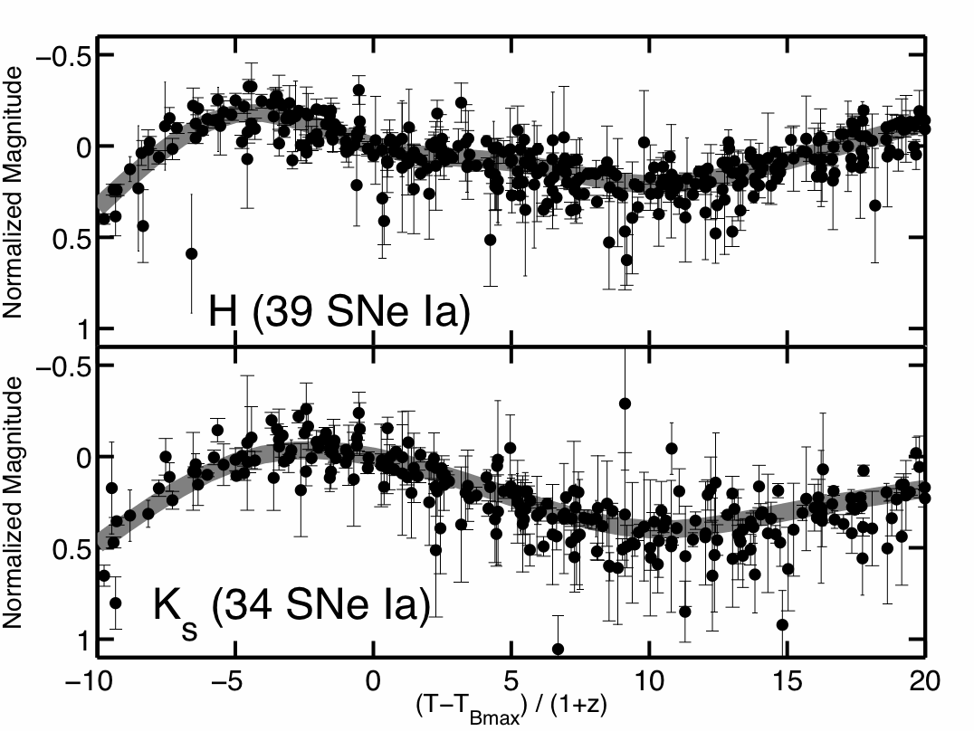
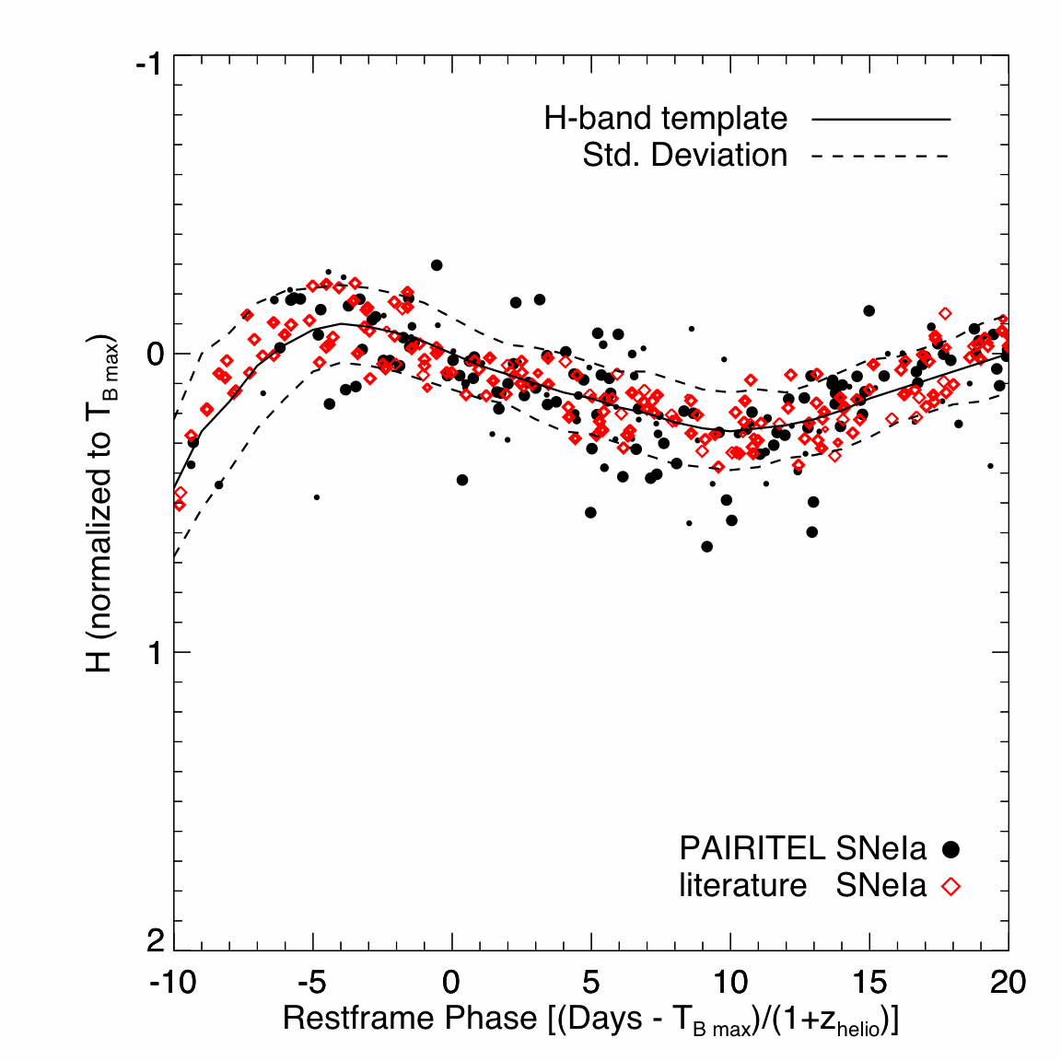
Hsiao et al.
H-band break
R₁₂ ratio
Coordinate NIR spectra with NIR photometry to bracket the NIR peaks.
We may be able to test if the secondary maximum NIR flux is due to Fe III > Fe II transitions
as the supernova expands and cools.
IRTF H-band data

Slide 27
Magellan/FIRE enable late-time NIR

Slide 28
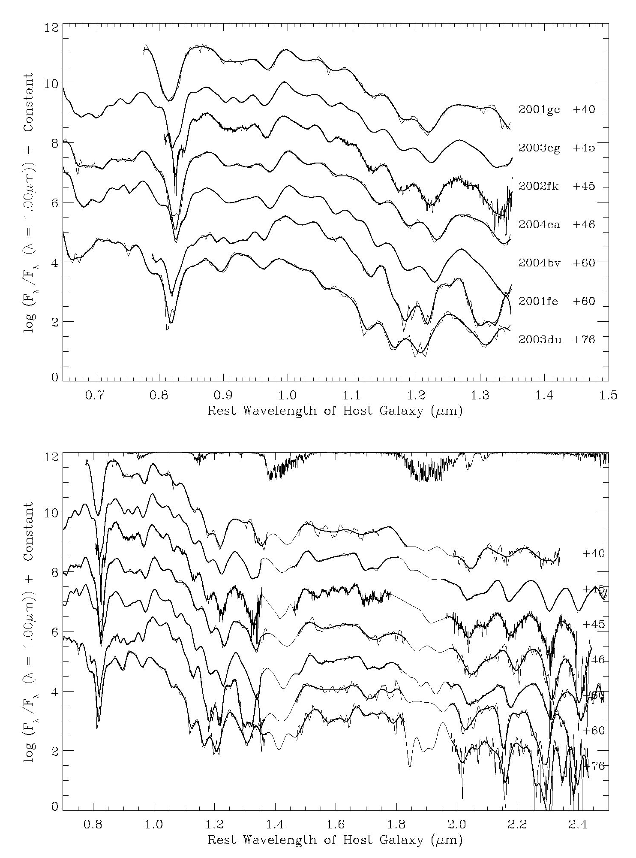
Transition Phase Spectra
(+40d to +76d)
No longer a defined photosphere, except where line-blanketing forms a pseudo-photosphere.

Slide 31
SN 2011fe
OIR spectrum
+300 days
HET IRTF

Slide 32
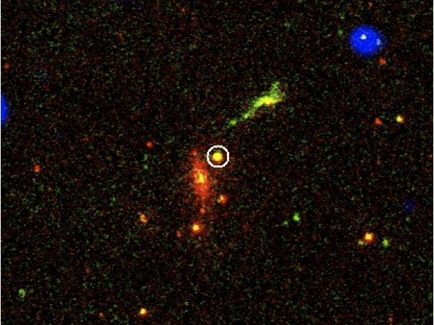
The exceptional characteristics of SN 2009dc
Suggest the possibility of a super-Chandrasekhar mass progenitor as has been proposed for SNe 2003fg, 2006gz, & 2007if.
What are the observational signatures of DD mergers?
What are other diagnostics?
Such an event may result from the double-degenerate
merger of two white dwarf stars.
Swift Images
UVOT-B = red
UVOT-UVW2 = green
XRT = blue
Paper in prep.
Brown - 02/11

Slide 33
DD merger? SN 2009dc

Slide 34
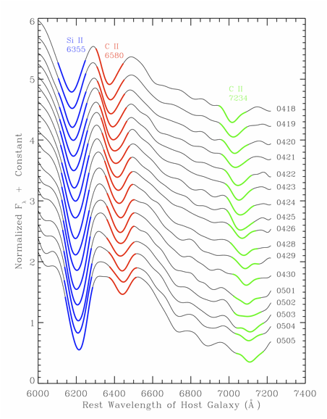
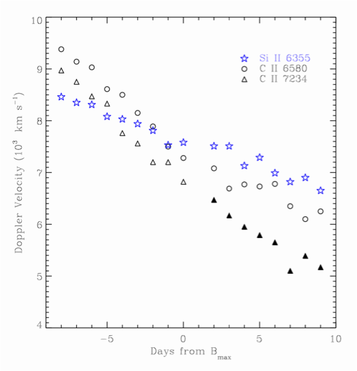
SN 2009dc produced the strongest and most persistent carbon features ever observed in SNe Ia.
C II lines from both 6580 and 7234 Å are detected
in the earliest spectra (-8d) and continue through +9d.

Slide 35
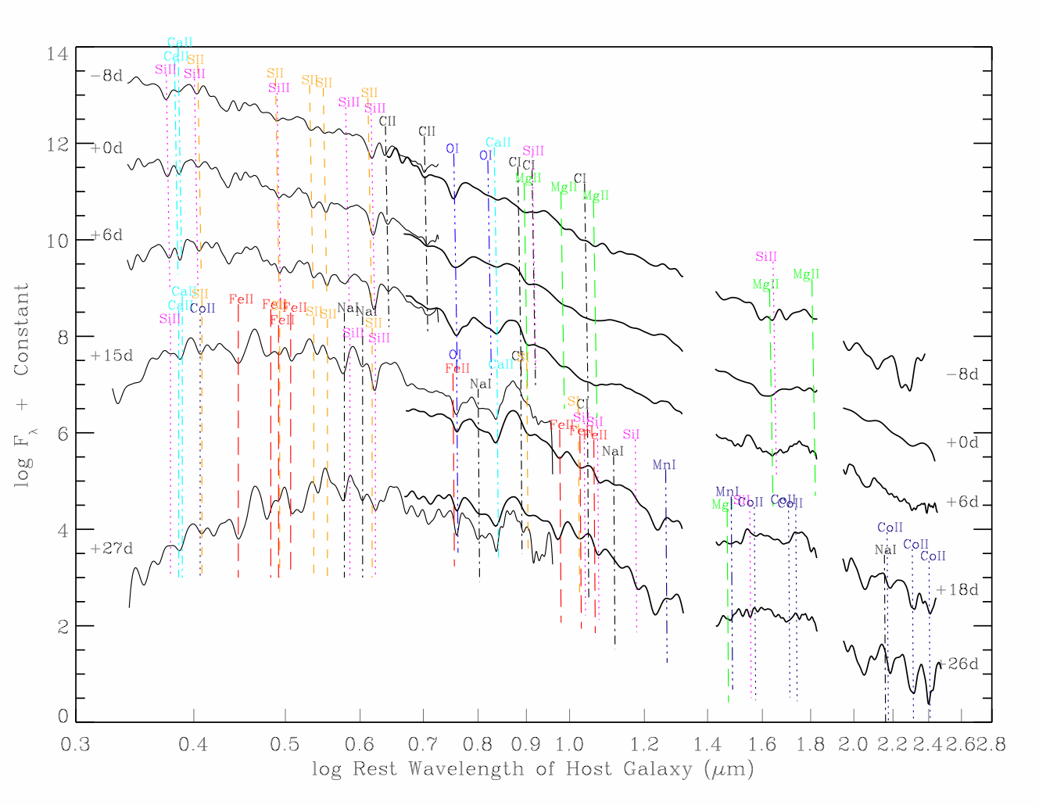
SN 2009dc: C I is absent at all epochs C II present from -8d to +9d

Slide 36
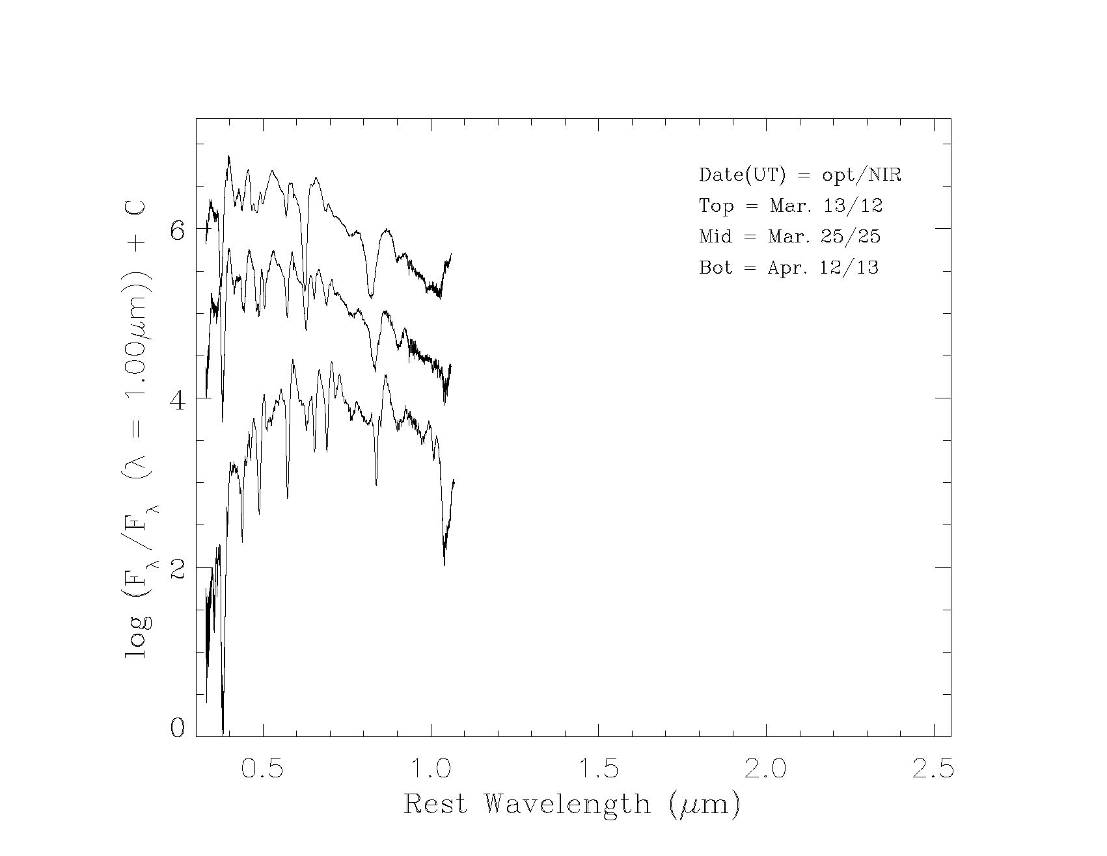
Optical spectra from Type Ib
Few days
Two weeks
Six weeks
Figure from Chornock, et al. (UC Berkeley)

Slide 37
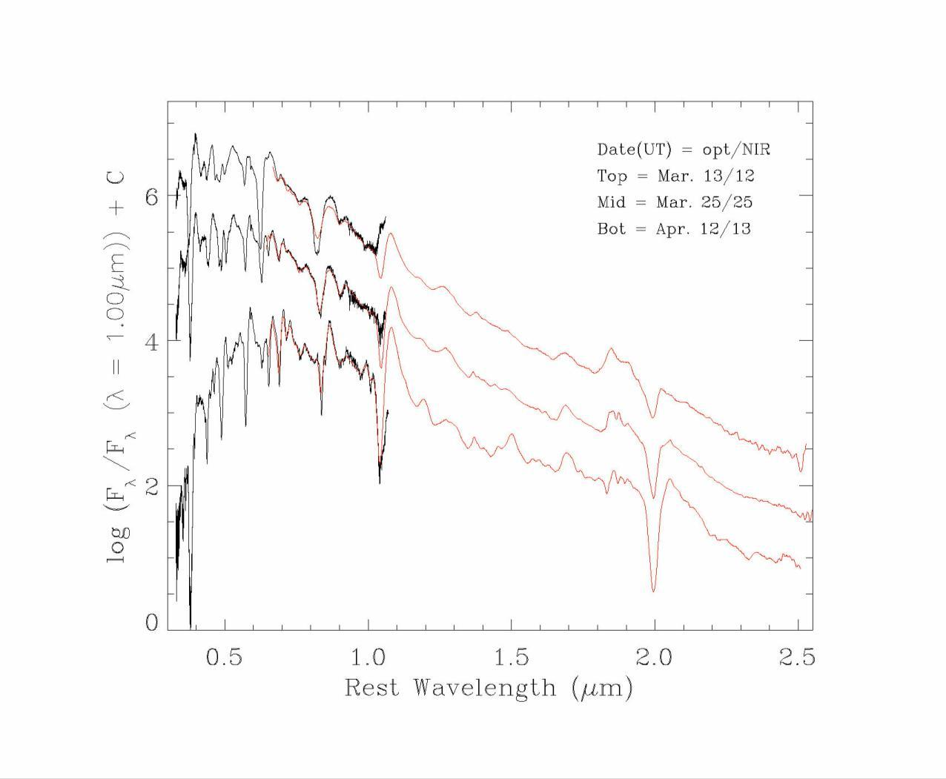
Add NIR spectra confirms HeI early

Slide 38
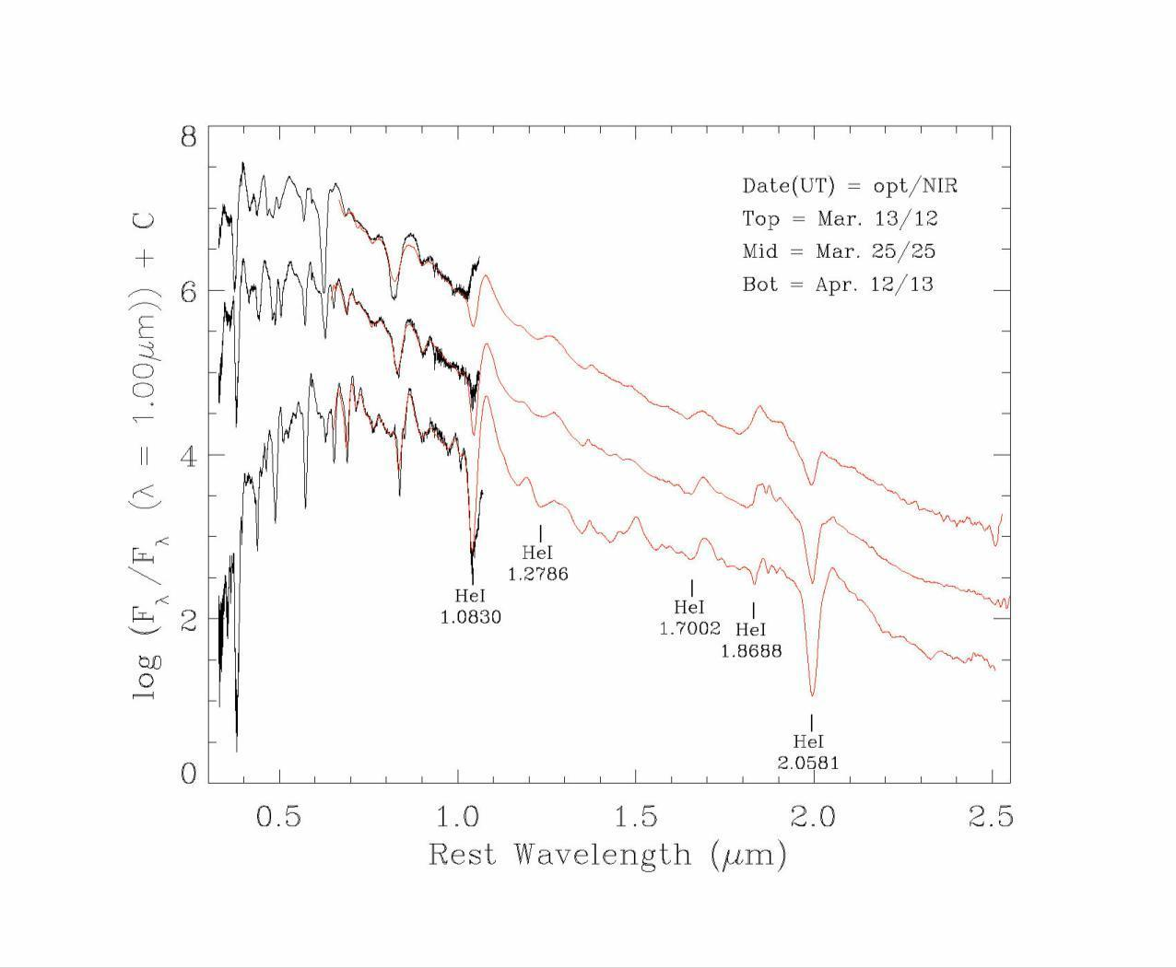
Type Ib SN 2008ax with HeI lines marked

Slide 39
SN IIb 2011dh
NIR identifies the emergence of Helium
NIR fits temperature profiles
SN IIb 2011dh: NIR + optical
Marion et al. (2012)

Slide 40
UVOIR
Coordinated data
provide a
more complete
physical picture
NIR accounts
for about 30%
of the energy
SN IIb 2011dh

Slide 41
Stripped-envelope,
Core-collapse SNe
Matheson, et al. (2001) suggest that helium lines are not thermally excited but that gamma-rays from freshly synthesized ⁵⁶Ni accelerate electrons that in turn excite the helium.
⁵⁶Ni may be directly mixed into the helium line-forming region or the gamma-rays may reach the HeI from a non-local source as the optical depth declines.

Slide 42
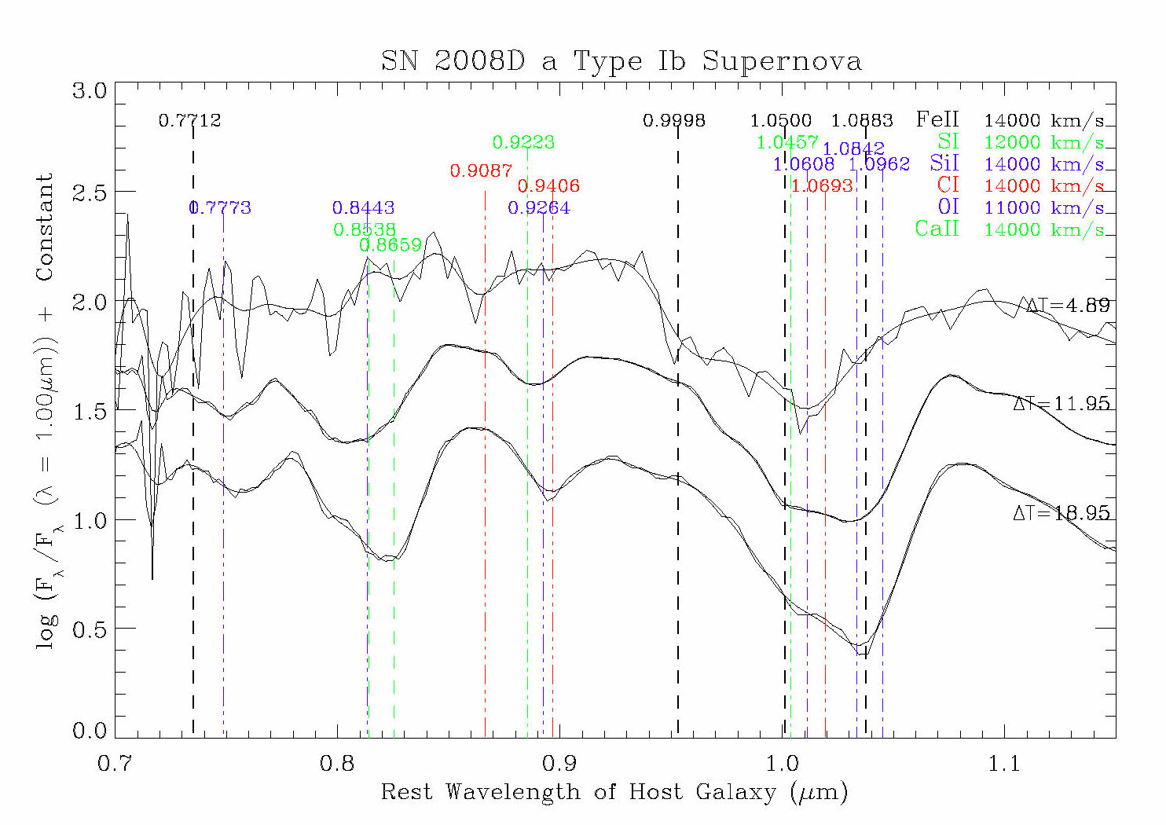
SECC events typically show a
big absorption feature near 1.04 μm.
Clearly not due to a single source (disagrees with Dessart).

Slide 43
Type Ib - SN 2008D
Associated with XRF 080109
“Here we discuss how the valuable NIR spectra of SN Ib 2008D contribute toward resolving the debate of the SN Ib vs. Ic classification scheme.”
“In conclusion, SN 2008D gives supporting evidence to the argument that the broad absorption at 1.04 μm is a poor diagnostic for helium….”
“Thus, we recommend that in future searches for helium in SNe Ic, both
J-band and K-band spectra should be obtained to test for the presence of the two strong He I 1.083 μm and
He I 2.058 μm lines.”
Modjaz, et al. (2009)

Slide 44
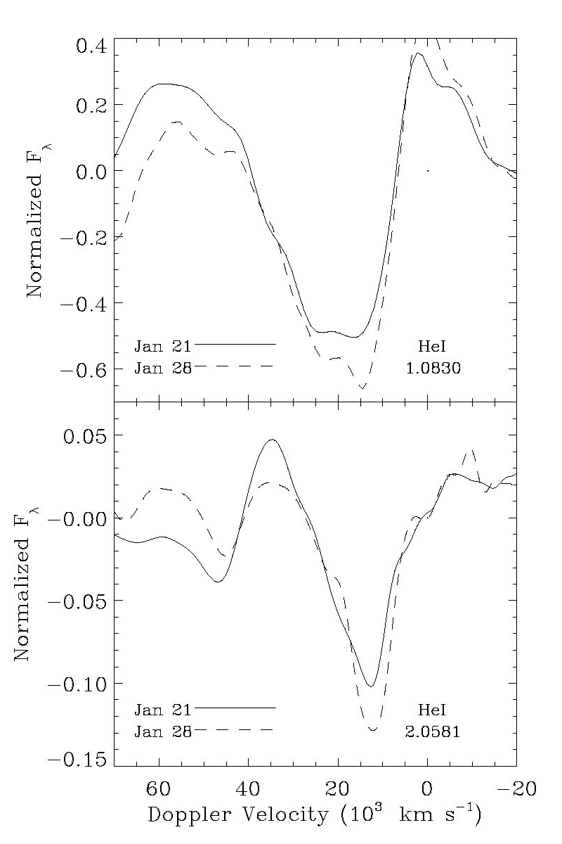
Comparison of
HeI line profiles
in early data from a
Type Ib supernovae
Modjaz, et al. (2009)

Slide 45
Another
Type Ib event
SN 2008ax
Chornock, et al. (2011)

Slide 46
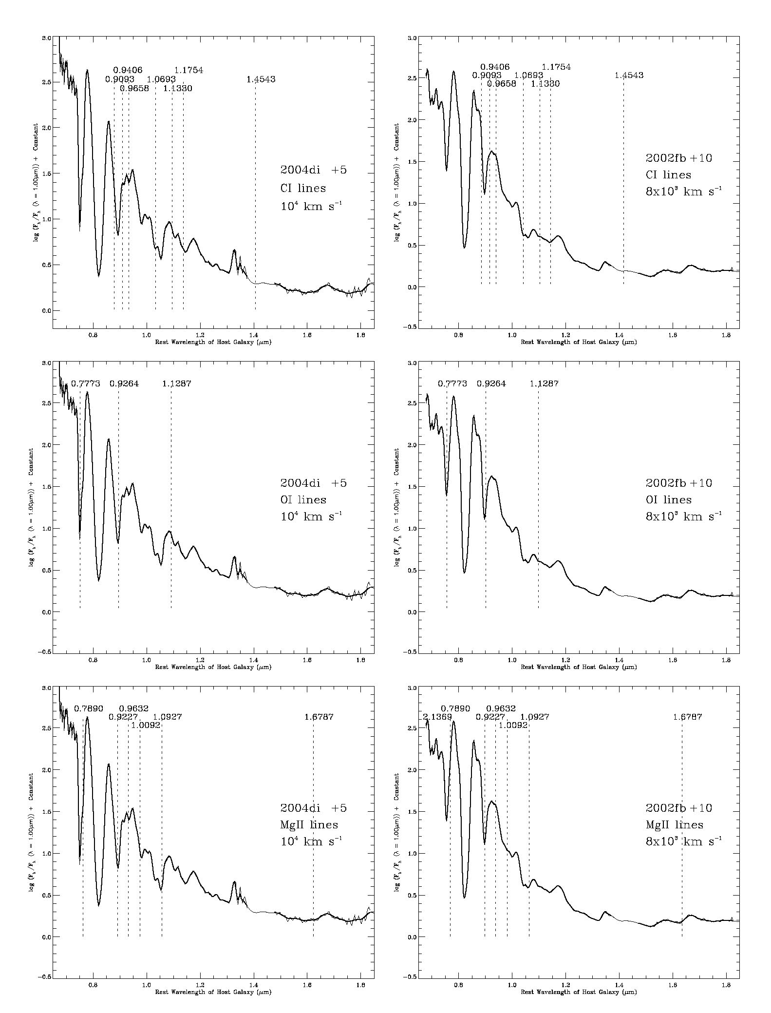
SN 2004di SN 2002fb
Subluminous SNe Ia
in the NIR
CI
λ = 0.7 – 1.8 μm
OI
MgII

Slide 47
NIR Light Curves
From Andy Friedman’s AAS poster (2010)
“We confirm and strengthen the claim that SNe Ia are more standard in NIR luminosity, less sensitive to dust extinction, and crucial to reducing systematic distance
in SN Ia cosmology.

Slide 48
NIR light curves
Coordinate NIR spectra with photometry
to bracket the NIR peaks.
Test whether the secondary maximum NIR flux
is due to Fe III ➔ Fe II transitions
as the supernova expands and cools.
Friedman et al. 2012, in prep.

Slide 49
SN Ia are better standard candles in the NIR than they are in the optical
Kasen 2006
Wood-Vasey 2008
Observed H-band scatter is consistent with theoretical predictions, and is comparable to the scatter in optical data after correction for light curve shape.

Slide 50
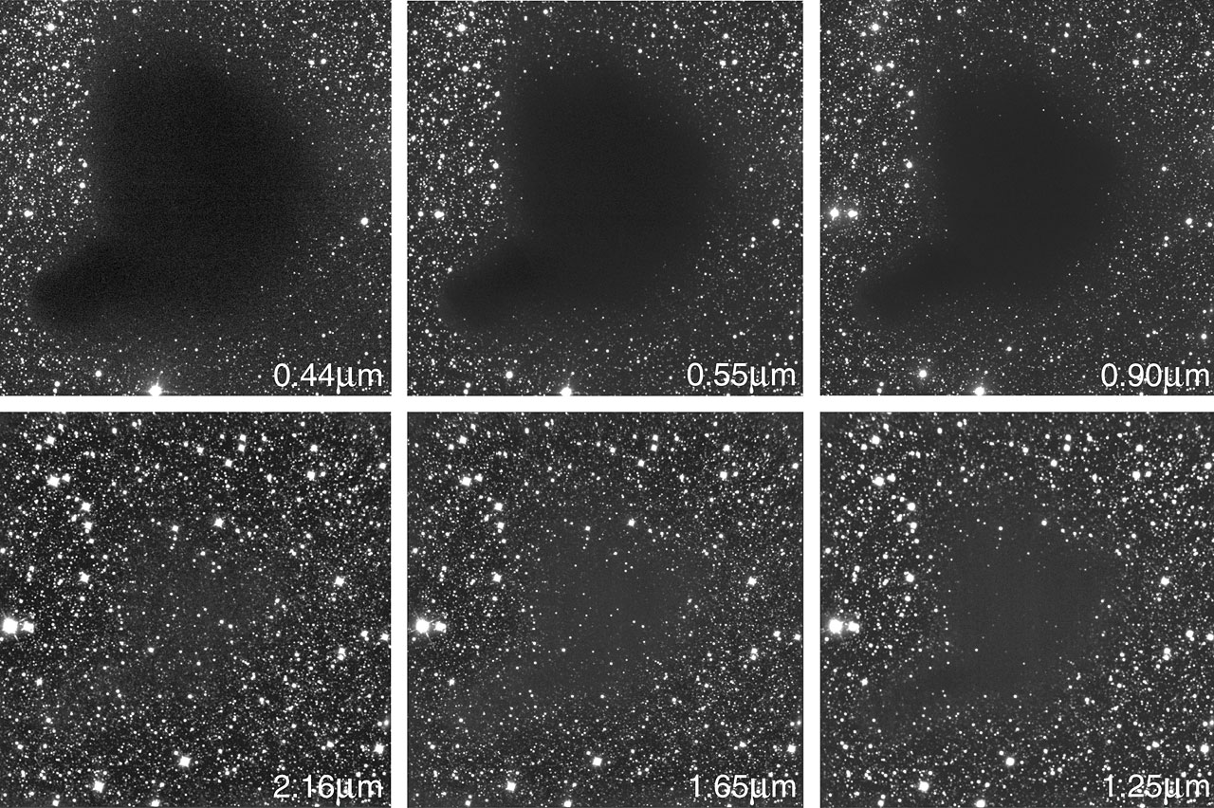
Seeing Through The Dirt
_{B}
_{V}
_{Z}
_{K}
_{H}
_{J}

Slide 51
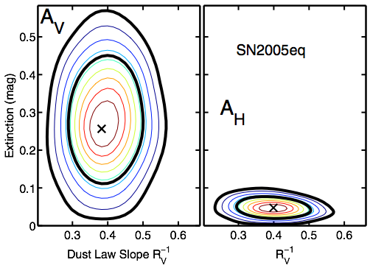
Smaller Extinction Errors in IR
Mandel et al., 2011

Slide 52
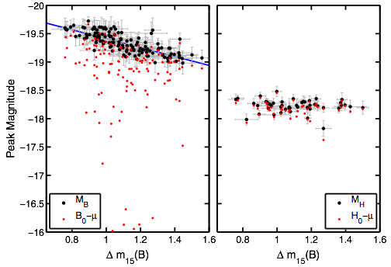
Smaller Light Curve Corrections in IR
Mandel et al., 2011

Slide 53
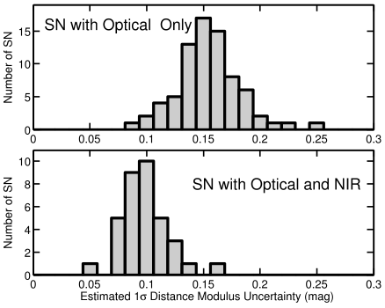
Smaller Total Errors in IR

Slide 54
Adding NIR light curve data
reduces dispersion in Hubble diagram
Mandel et al. 2009 & 2011

Slide 55
Figure from Mandel et al. (2009) showing maximum likelihood constant light curve templates (gray curves) with PAIRITEL H and Ks band data.
The H and Ks normalized light curves from diﬀerent SNe Ia
are very similar between -10 and +20 days.

Slide 56
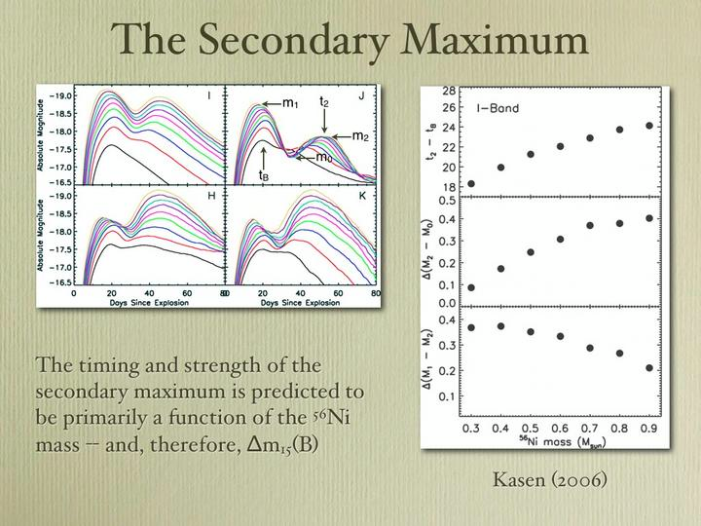
Folatelli (2010)
Fe Opacities?
See also: Krisciunas (2006), Folatelli (2010)
Mark Phillips’ slide from KITP SN conf.

Slide 57
NIR K-corrections for SNe Ia
Gooding, et al. in prep. & Boldt, et al. in prep.
The K-correction “corrects” for the fact that
sources are observed at different redshifts.

Slide 59
Light Curve Templates
Eric Hsiao, UVic, now LBL
NIR based on 41 spectra from Marion, et al. (2009)
Third max?

Slide 60
Evidence that High-Velocity Line Forming Regions and Circumstellar Material are Common in Type Ia Supernovae
22 spectra obtained
Between -14d and +0d
λ = 3,200-9,000 Å
Data from telescopes:
Hobby-Eberly
MMT 6.5m
Keck I
Lick 3m
Swift
Marion, et al., in prep.
60

Slide 61
SN 2009ig
HV Ca II (IR3)
Found before max in
most SN Ia
20 spectra from other SN Ia
obtained between -11d & -2d
A detached HV line-forming region near 22,000 km s⁻¹ is very common in SN Ia
A gap of ~ 7,000 km s⁻¹
exists between HV & PS
features in most SN Ia
61

Slide 62
Si II 6355 Å
SN 2009ig
Si II 6355A
Similar results for
Si II, S II, Ca II, & FeII
Kinematic Tests
The outer part of the HV line-forming region will be slowed by interaction with CSM.
The blue wings slow down and form steeper blue sides of the absorption feature with an abrupt transition between the feature and the continuum (rather than a smooth Gaussian).
62

Slide 63
Measured Doppler velocities SN 2009ig
Ca II very low excitation
All HV products found
in the same LFR
HV does not merge
with PS
PS velocities consistent
A gap in velocity space is apparent between
14,000–22,000 km s⁻¹
63

Slide 64
HV Ca II
is not ubiquitous
Spectra from
SNe 2008ec & 2010ai
Show no evidence for HV features from Ca II
in data obtained
as early as -9d
SN 2008ec shows blueshifted NaI.

Slide 65
NIR observations of Supernovae
are the New Frontier
Eric’s Paper makes 3 important points
That we can explore/confirm with archival data:
  Presence of C I near max
  Mg II velocities
  H-band break (R₁₂ ratio)
Coordinated UVOIR datasets of suitable targets
will open new modeling opportunities

