Slide 1
The CfA Supernova Group
Edo Berger, Laura Chomiuk, Ryan Chornock, Peter Challis,
Ian Czekala, Jason Dittman, Maria Drout, Ryan Foley,
Andy Friedman, Bob Kirshner, Ragnhild Lunnan, Kaisey Mandel, Raffaella Margutti, Howie Marion, Sam Meyer, Dan Milisavljevic, Gautham Narayan, Nathan Saunders, Alicia Soderberg,
Chris Stubbs, Ashley Zauderer
Alumni
Stephane Blondin (CPPM), Peter Garnavich (Notre Dame), Malcolm Hicken, Saurabh Jha (Rutgers), Bruno Leibundgut (ESO), Tom Matheson (NOAO), Maryam Modjaz (NYU), Armin Rest (STScI), Adam Riess (STScI),
Brian Schmidt (RSAA), Chris Smith (CTIO-NOAO)
Colleagues
Eric Hsiao, Jerod Parrent, Jozsef Vinko, Craig Wheeler
1

Slide 2
The F. L. Whipple Observatory
6.5m MMT/BlueChannel (3200-8600 Å, R~5000)
PS1 follow-up, RAISIN targets, faint SN
1.5m/FAST (3400-7600 Å, R~3000)
Classification, spectral sequences
1.2m/KeplerCam – uBVri photometry
Now robotic
1.3m PAIRITEL - JHKs photometry
Robotic

Slide 3
The F. L. Whipple Observatory
MMT/BlueChannel (3200-8600 Å, R~5000)
8 intermediate redshift SN, 4 nearby SN per night
Also 1200 line-grating, R~12000
1.5m/FAST (3400-7600 Å, R~3000)
12-15 nights per month
Jan 2011 – July 2012: 694 spectra from 201 SN
1.2m/KeplerCam – uBVri photometry
Jan 2011 – July 2012: 9370 images, 2285 epochs, 235 SN
1.3m PAIRITEL - JHKs photometry
~300 observations of ~25 SN/year

Slide 4
MMT
Type Ia
at z~0.43
PS1 target
SN 2009ip
MMT
Hi-res: R~12000

Slide 5
SN 2009ip
SALT
SALT
??
??
SALT
SALT
FAST
FAST
MMT hr
FAST
FAST
FAST
FAST

Slide 6
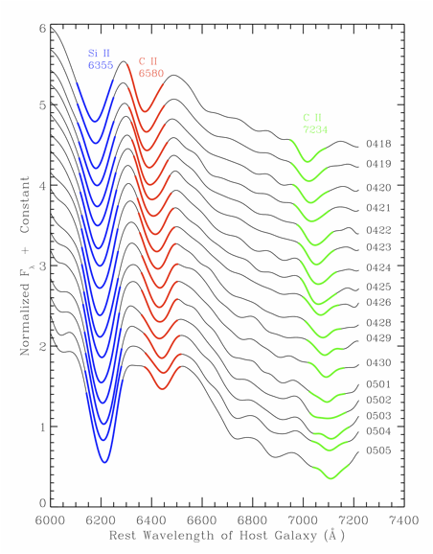
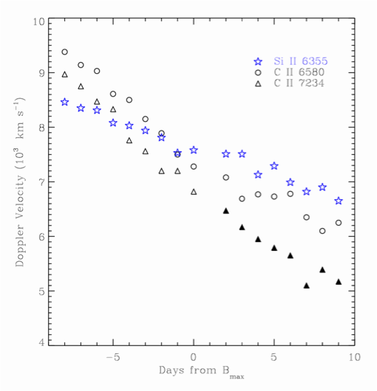
SN 2009dc produced the strongest and most persistent carbon features ever observed in SNe Ia.
C II lines from both 6580 and 7234 Å are detected
in the earliest spectra (-8d) and continue through +9d.

Slide 7
Hα in SN2010jl
2 years of FAST data
R~3000
HET/HRS
FLWO 1.5m/TRES
R~30,000

Slide 8
SN 2010jl FLWO photometry

Slide 9
SN IIb 2011dh
UVOIR
Coordinated data
provide
a more complete
physical picture
NIR accounts
for about 30%
of the energy
SN IIb 2011dh

Slide 10
Bolometric LC
of SN IIb
u'BVr'i'JHKs bolometric LC of
SN 2011dh is filled circles
Middle other LC's are modified to include NIR
Bottom LC results with modified diffusion model using different parameters
SN 1993J (squares)
Richmond et al. 1994
SN 2008ax (inverted triangles)
Pastorello et al. 2009
SN 2011dh (upright triangles)
Bersten et al. 2012

Slide 11
Combined Data Sets
Optical
Spectroscopy – series
Light Curves – early and late
NIR
Spectroscopy – series (Hsiao, et al.)
Light Curves – more consistent
UV
HST
Swift

Slide 12
Other SN Types
NIR identifies the emergence of Helium
NIR fits temperature profiles
SN IIb 2011dh: NIR + optical

Slide 13
SN 2012cg
BVriJHKs LCs Fitting with BayeSN

Slide 14
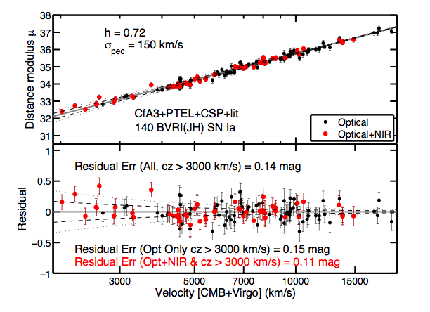
BayeSN – simultaneous fits to optical and NIR LC
Reduces scatter in the Hubble Diagram

Slide 15
SN 2012cg – Possible Interaction with Companion?

Slide 16
SN 2012cg

Slide 17
Other Observing Resources
Pan-Starrs – 150 transients per month
HST – 3 Active Programs
Magellan
FIRE, FourStar, Megacam, MMIRS
HET/LRS (4000-10000 Å, R~2000)
117 spectra from 28 SN
Also HRS R~30,000
SALT – 2 active programs
~ 4 spectra per month
ROTSE – finds ~20 SN per year

Slide 18
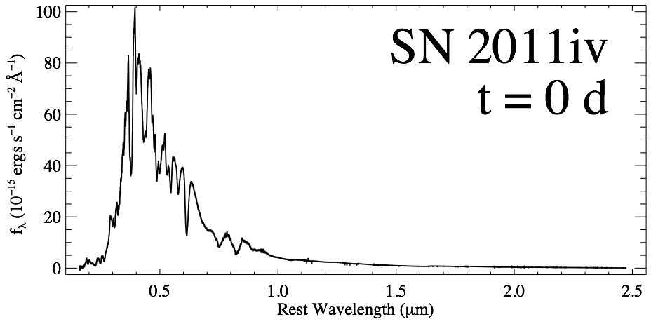
Supernova SED
Hubble
UV/Optical
Magellan FIRE
NIR
Foley et al., 2012a

Slide 19

Supernova SED
10,000 K Blackbody
Line Blanketing
Flux
Absorption Lines
Wavelength

Slide 20
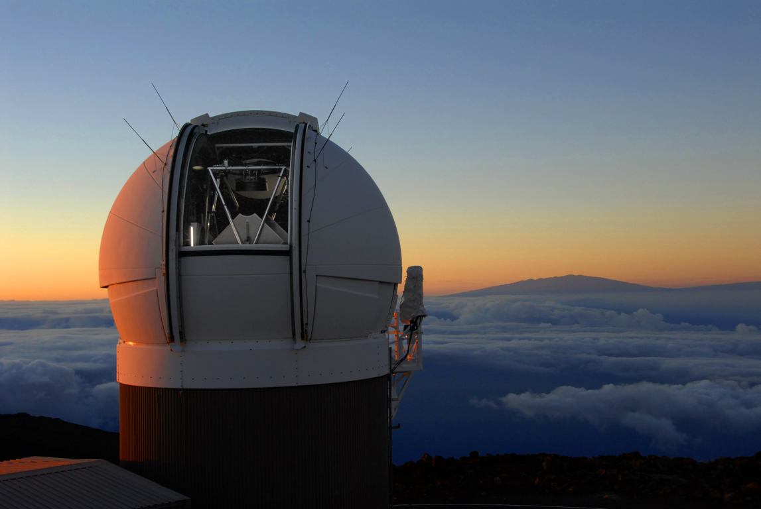
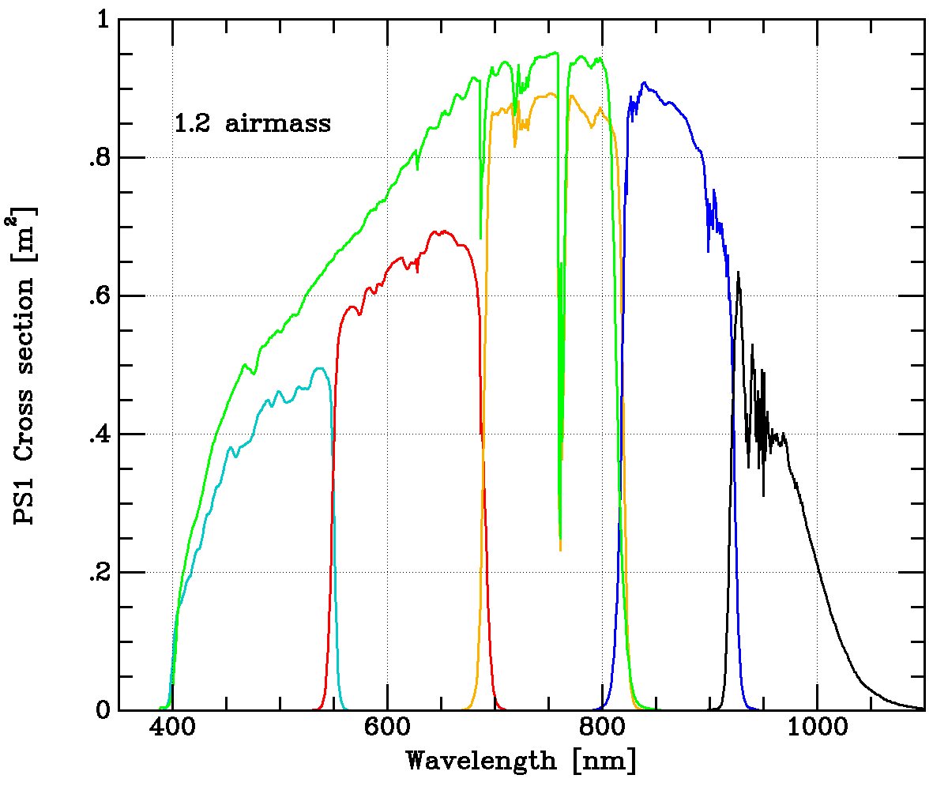
Pan-STARRS1
1.8 m telescope on Haleakala, Maui
1.4 Gigapixel camera
7.2 sq. deg. (0.258”/pix)
Median image FWHM~1.1”
Full survey operations began in May 2010
g
r
i
z
y
Tonry, Stubbs, et al.

Slide 21
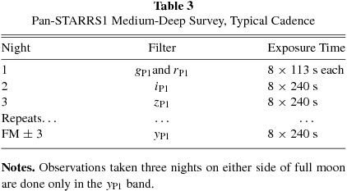
Medium Deep Survey (MDS)
PS1 – 150 transients per month
~30 really good SN candidates 0.1 < z < 0.6
MMT follow-up monthly
10 fields across sky (each 7.2 sq. deg.)
4-5 observed nightly
~3 day cadence for each filter
Limiting mag ~24 in griz

Slide 22
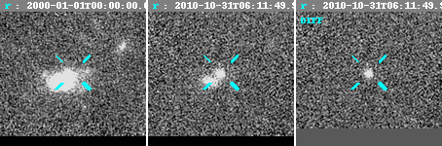
Harvard/JHU Transient Pipeline
Template
Image
Difference
Nightly MDS stacks downloaded from IfA
Subtractions vs. template images performed using photpipe
Typical limiting mag of ~23.5 AB (in difference images)
In 2011: 1,450 likely SNe, 160 spectroscopically confirmed

Slide 23
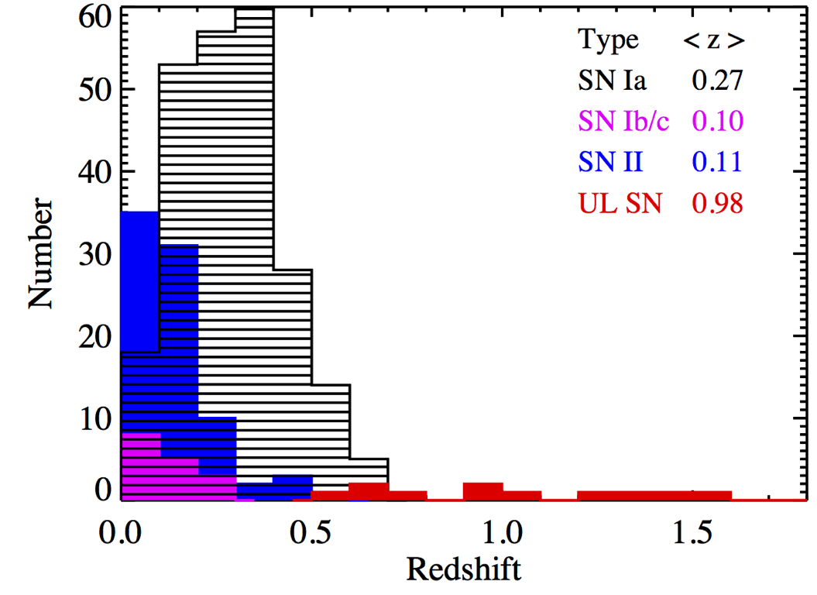
PS1 – 150 transients per month
~30 really good SN candidates 0.1 < z < 0.6
MMT follow-up monthly
~350 spectroscopically confirmed supernovae so far (2/3rds SNe Ia)
Most spectroscopic followup from MMT/Blue Channel and Hectospec (PI: Berger), also Magellan and Gemini

Slide 24
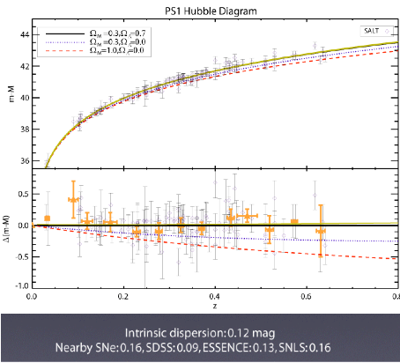
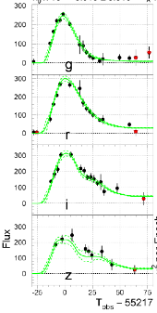
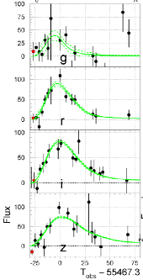
SN Ia Cosmology
z=0.244
z=0.635
Preliminary!!
Rest et al., in prep.
Cosmology from first ~120 SNe Ia coming soon!

Slide 25
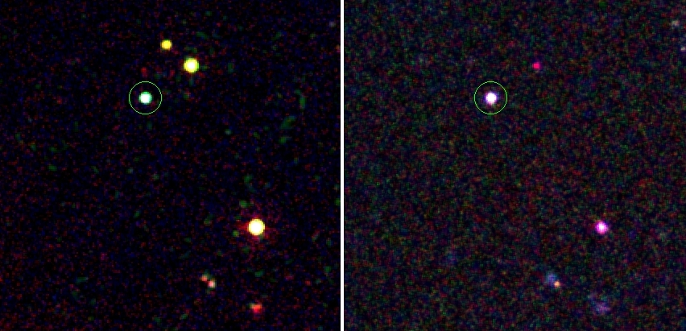





SN 2010kd: a SLSN from ROTSE
a twin of SN 2007bi?
Swift OPT
2010-12-19
Swift UV
2010-12-19
J. Vinko (Univ.of Szeged / Univ.of Texas)

Slide 26
Spectroscopy with HET + Swift UVOT photometry
hot, blue continuum (Tbb = 13,000 ± 1000 K)
weak CII, NII, OI, OII features (SYNOW)
UV-drop can be explained with CoIII

Slide 27
Spectroscopic evolution
SYNOW model
cooling continuum
emerging broad CaII, MgII, SiII, FeII (carbon-burned)
strong, persistent OI features

Slide 28
Can it really be a pair-instability explosion ?
(as proposed for SN 2007bi by Gal-Yam et al. (2009) )
better pre-maximum
coverage
better constrained
LC parameters
t_{diff} ~ 50 days
M_{ej} ~ 20- 30 M_{o}
M_{Ni} ~ 10 M_{o}
limit for PPI: 65 M_{o} Mej ~ 100 M_{o} would need t_{diff} > 100 d

Slide 29
Research Areas
SN in Radio/X-ray
Raffaella Margutti
Alicia Soderberg’s group
Progenitors and environments
Interaction Physics
GRB’s
Edo Berger’s group
SN/GRB connections

Slide 30
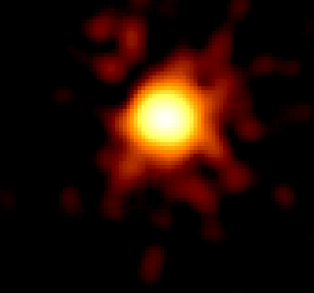
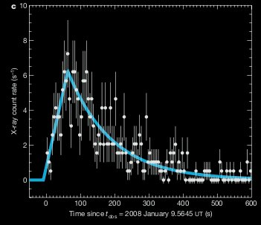
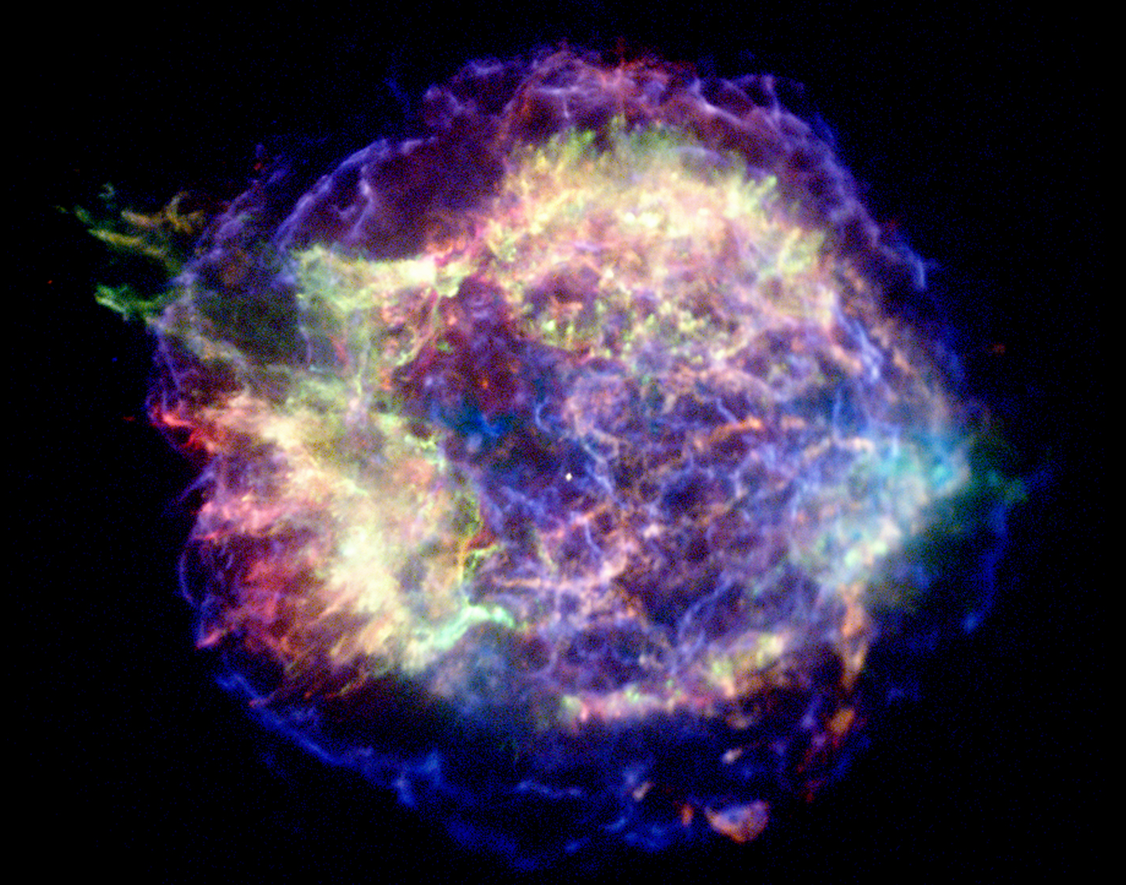
X-rays-UV
X-rays-UV
X-rays- RADIO
Shock break out
Shock interaction with the companion
Shock interaction with the ambient medium
Very EARLY stages (t<hr)
Short lived (Δt < hr)
-SNe
-GRBs
-SNRs
(due to DIFFERENT emission processes)
Longer lived (t> days)
SN2008D
Primary star
Secondary star
0.3-10 keV
Soderberg 2008
Cas A
Kasen 2010

Slide 31
ρ
SN Interaction with the ambient medium
Donor Star
X-rays
Radio
Using X-rays and radio emission we can constrain the environment around the progenitor star
X-rays
10¹⁴
10¹⁵
e⁻
10¹⁶
R
e⁻
e⁻
Shock
e⁻
Photosphere
e⁻
X-rays
X-rays
Radio
Using the radio emission we can also estimate the velocity of the SN shock = constrain the presence of a central engine
Radio
Notes:
The environment around the progenitor has been previously shaped by the mass loss history of the star before explosion. Studying the X-rays and radio emission we can constrain the mass loss in the immediate years before explosion.

Slide 32
Research Areas
Cosmology
30% of SN Ia are not “normal”
Bayesian Analysis
NIR better standard candles
Better models
SNIA in the IR = RAISIN
Observables
Combined data sets
Patterns in data
Physics
Models (Theory and fitting)

Slide 33
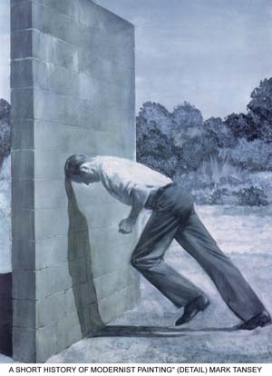
The biggest uncertainties come from dust

Slide 34
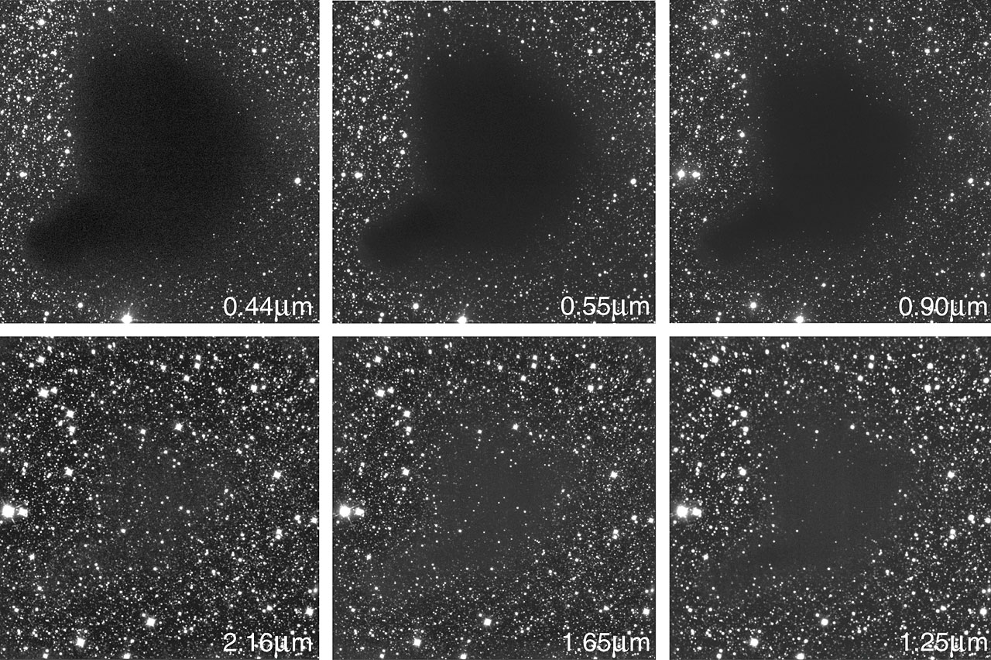
Seeing through the dirt
_{B}
_{V}
_{Z}
_{K}
_{H}
_{J}

Slide 35
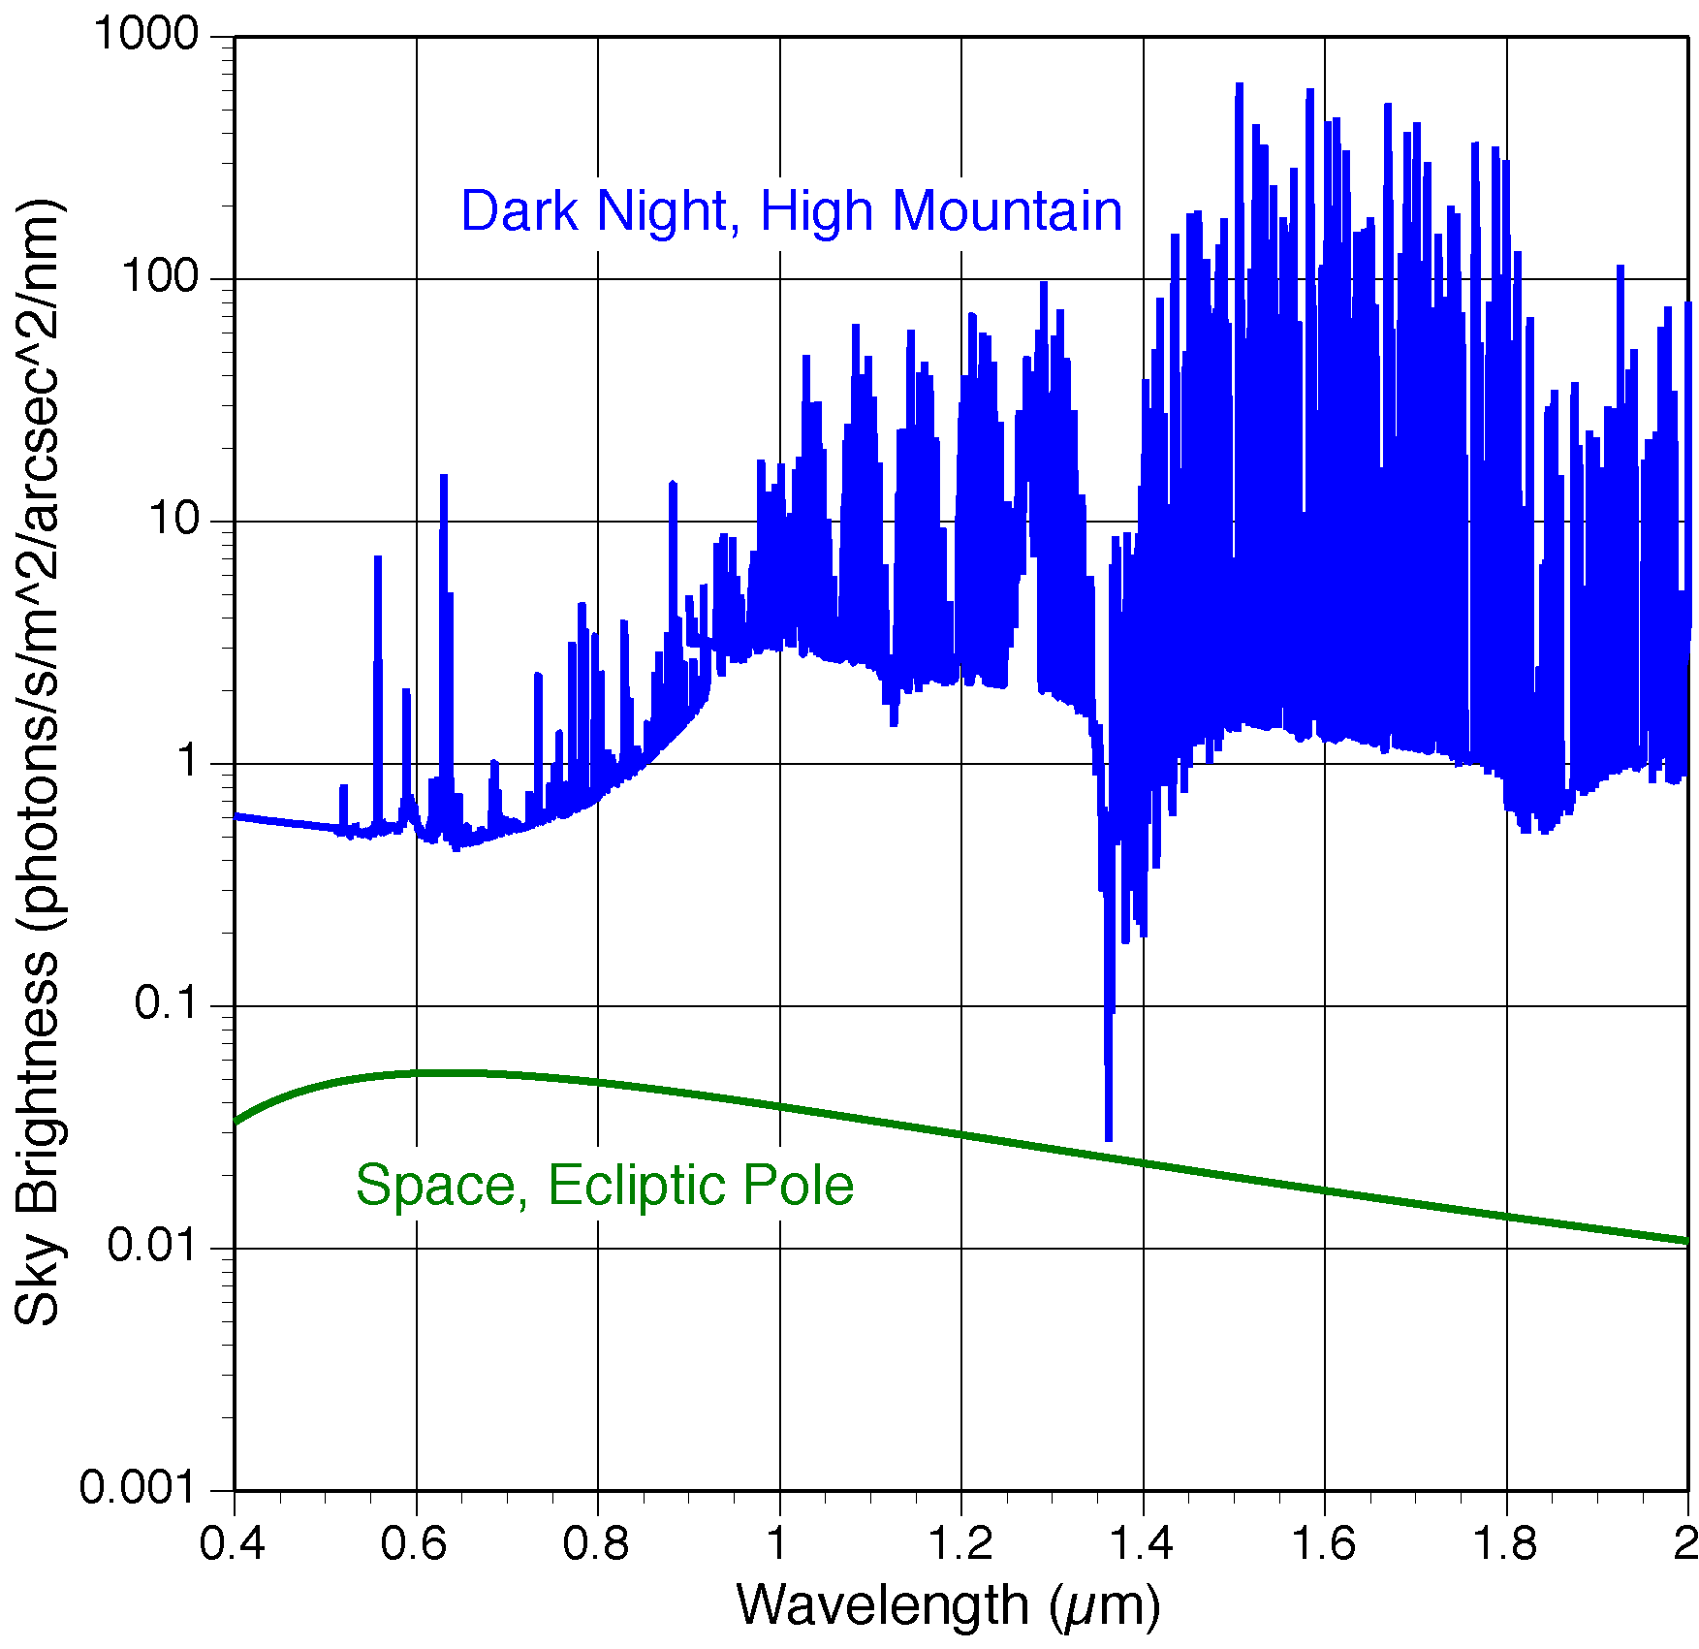
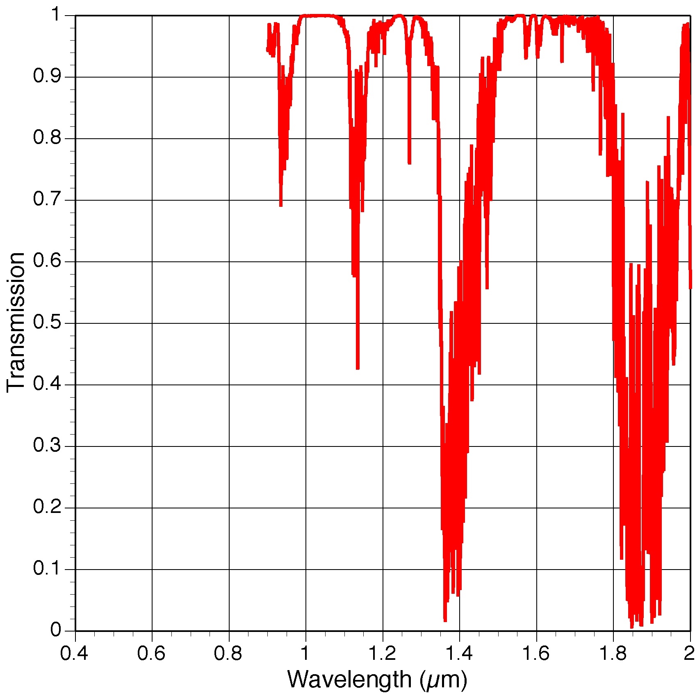
Only in space!
Rest frame IR measurements of z~1 supernovae are not possible from the ground
Go as far into the IR as technically feasible!
Sky is very bright in NIR: >100x brighter than in space
Sky is not transparent in NIR: absorption due to water is very strong and extremely variable
Notes:
High-z SN observations uniquely requires a space mission. The ground IR sky is several orders of magnitude brighter than in space, and some bands are completely unavailable. Destiny focuses solely on the NIR where space has a tremendous throughput advantage.

Slide 36
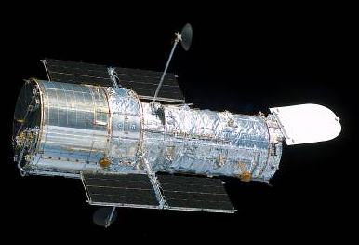
Use WFC3 to get rest frame IR of moderate redshift SN Ia! SNIA in the IR = RAISIN 100 orbits in Cycle 20: 25 SN

Slide 37
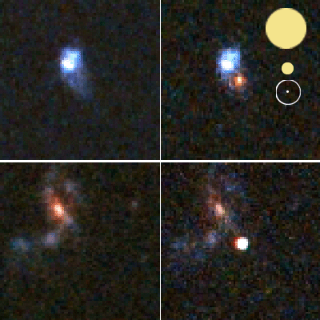
SN Ia & Cosmic Expansion History
Better resolution helps distinguish a supernova from its host galaxy
_{0.5′′ seeing}
_{HST 1.5μm}
_{GMT AO}

Slide 38
Jerod Parrent (LCOGT)

Slide 40
Research Areas – Data Mining
Optical Spectra
Stephane Blondin’s work
SECCSN (SN Ibc)
Modjaz et al. (2012) CfA archival spectra
Marion et al. (2013) CfA archival LCs
Optical LC
CfA5 in progress
NIR Light Curves
Friedman et al. (2012) will have 90-100 SN Ia

Slide 43
Research Areas
Superluminous SN
SN Iax
SECCSN continuum IIb > Ib > Ic ??
SN Ia progentors
Single or Double Degenerate?
Interaction with companion?
SN remnants
Spectro-polarimetry

Slide 44
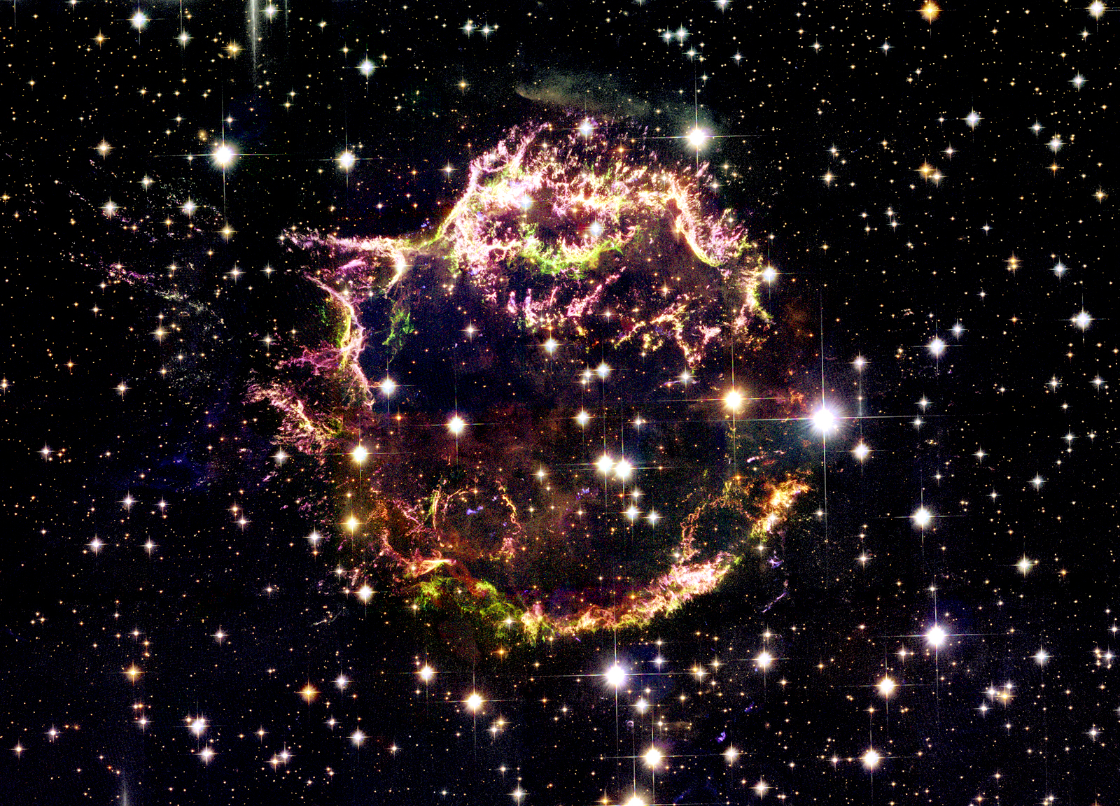
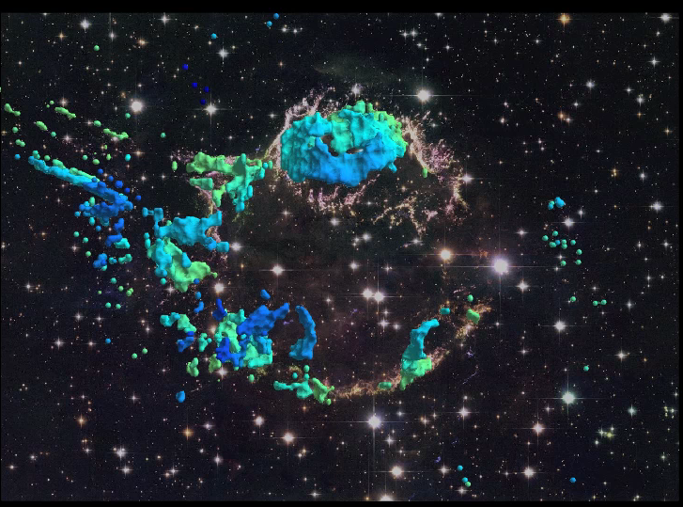
Cas A in 3D: A Blueprint for Type IIb Supernova Explosions
Dan Milisavljevic
Harvard-Smithsonian Center for Astrophysics

Slide 45
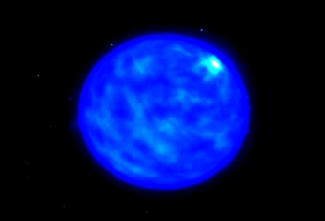
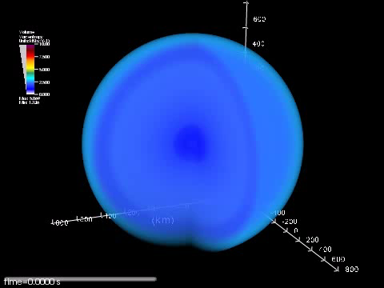
Core-Collapse Explosion Mechanisms
Current front-runners are contributions from neutrinos, fluid instabilities, rotation, and magnetic fields, but their relative importance is debated.
Magnetorotational Jets/Collapsar
Neutrino Driven/SASI
MacFadyen et al. (1999)
Marek & Janka (2009)

Slide 46
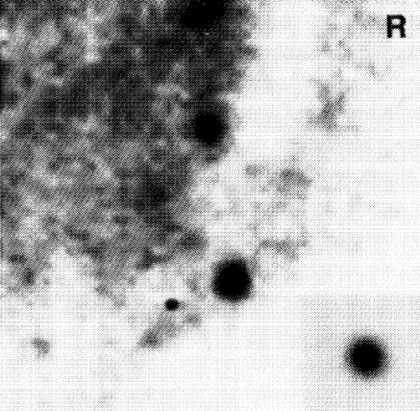
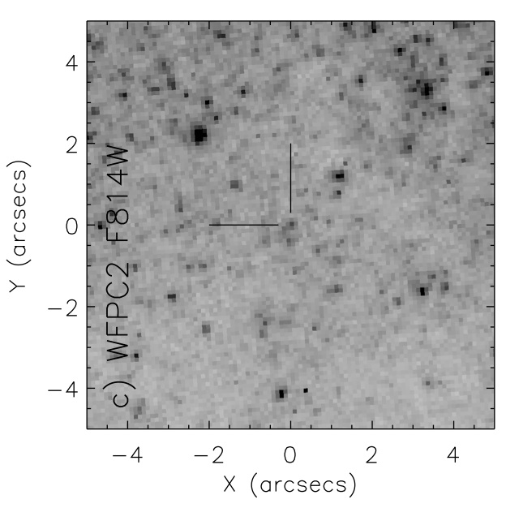
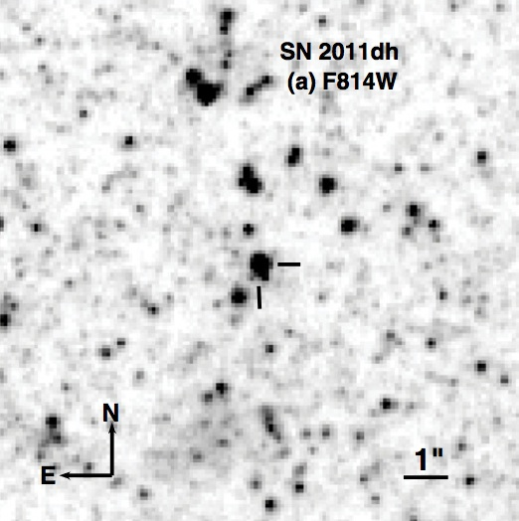
Supernova Progenitors
What are the progenitor systems of Type IIb/Ib/Ic supernovae?
We have no confident pre-explosion imaging of SNe Ib/Ic.
SN 1993J: K0 Supergiant with binary companion
SN 2008ax: Wolf Rayet? Binary?
SN 2011dh: Yellow giant? Binary?
Aldering+1994
Maund+04,
Maund+Smartt09
Crockett+2008
Van Dyk+2011
Maund+2011
Arcavi+ 11, Soderbert+ 12, Murphy+ 11, Bersten+ 12, Benvenuto+ 12, Maeda 12, …

Slide 47
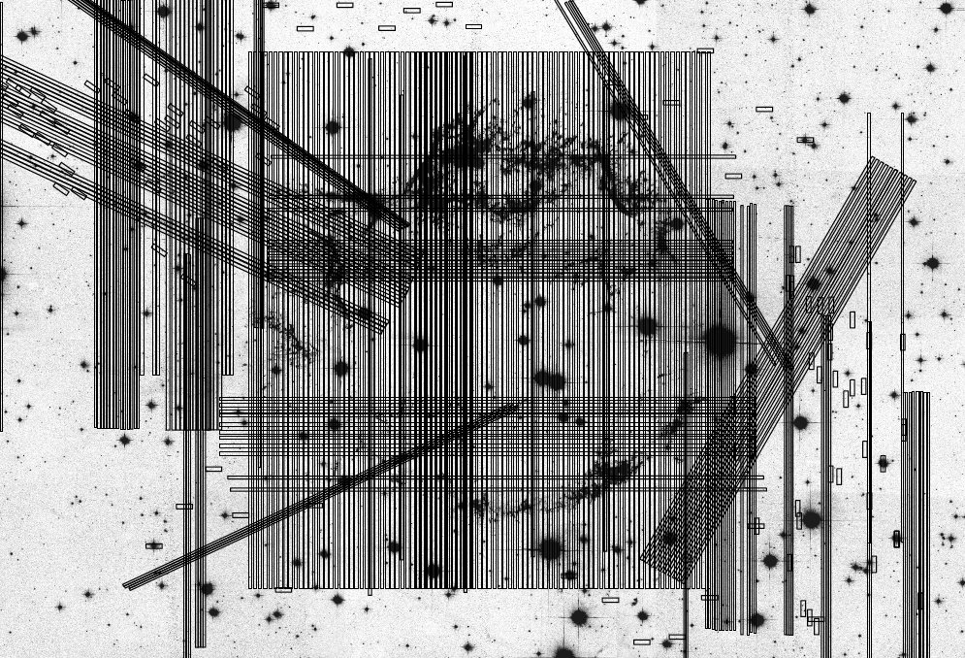

Slide 49
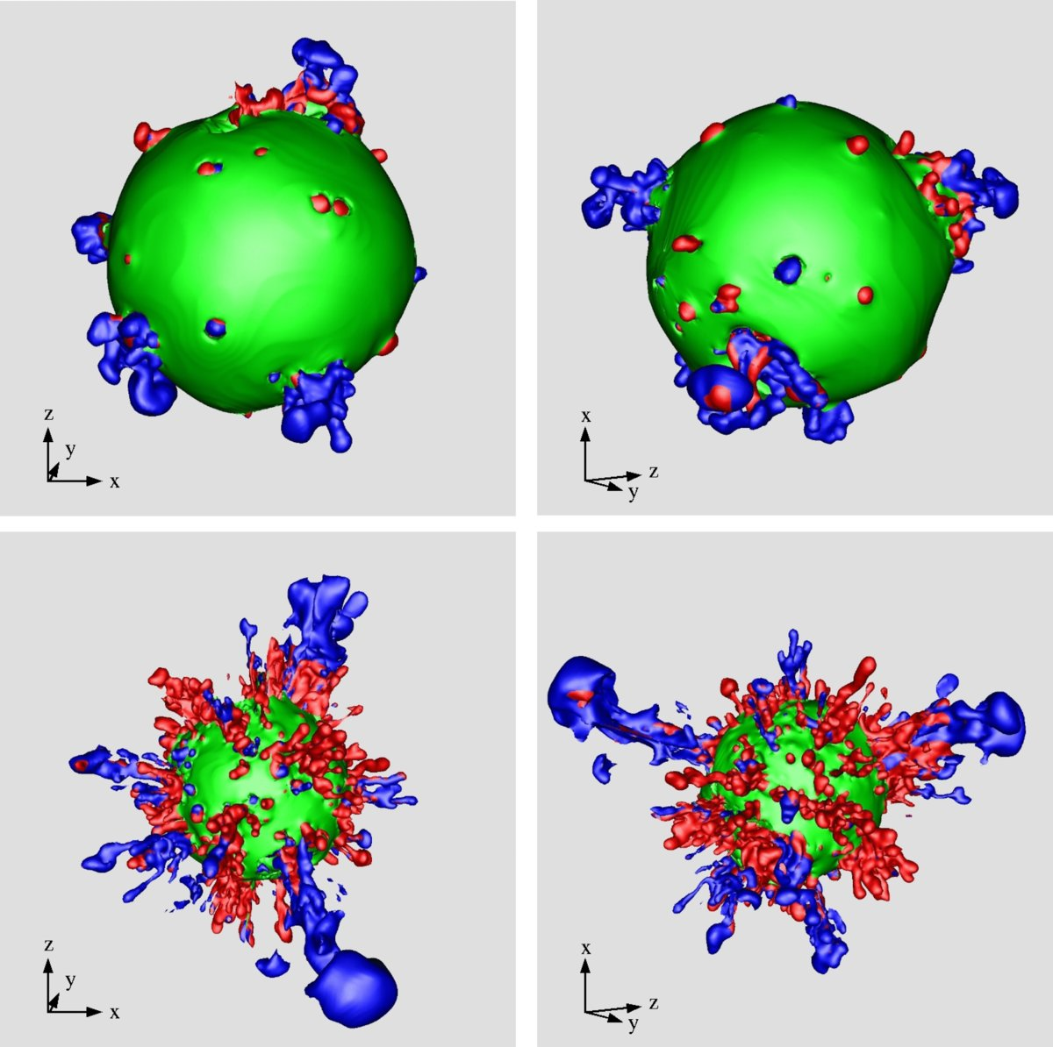
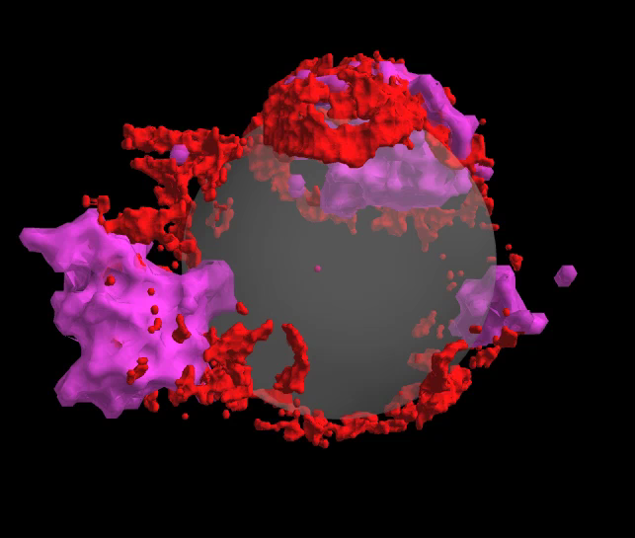
Clues to the Explosion Mechanism
⁵⁶Ni Outflows Bubbles Rings
Carbon
Nickel
Oxygen
Sulfur+Oxygen
Iron
Cassiopeia A
Hammer, Janka, Muller (2010)

Slide 50
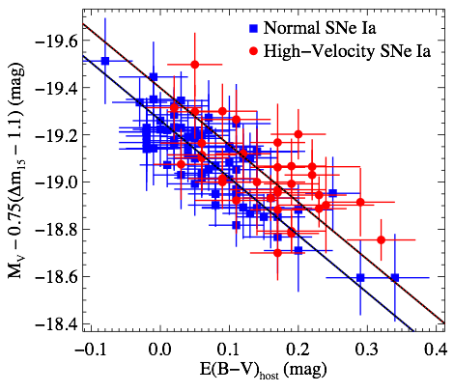
High-Velocity Supernovae Are Redder
Ryan Foley
CfA Clay Fellow
Foley & Kasen 2011

Slide 51
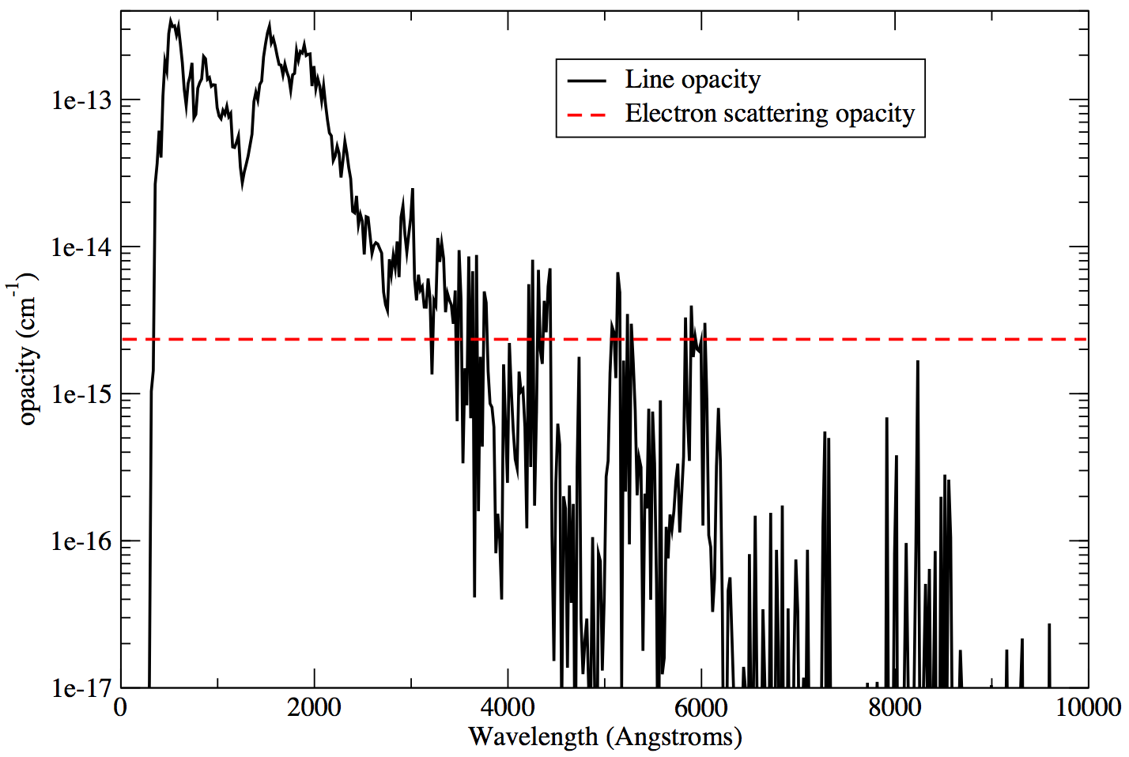
Opacity Depends on Velocity
B
V
Ellis et al. 2008

Slide 52
Two Groups or Continuum?
Foley & Kasen 2011

Slide 53
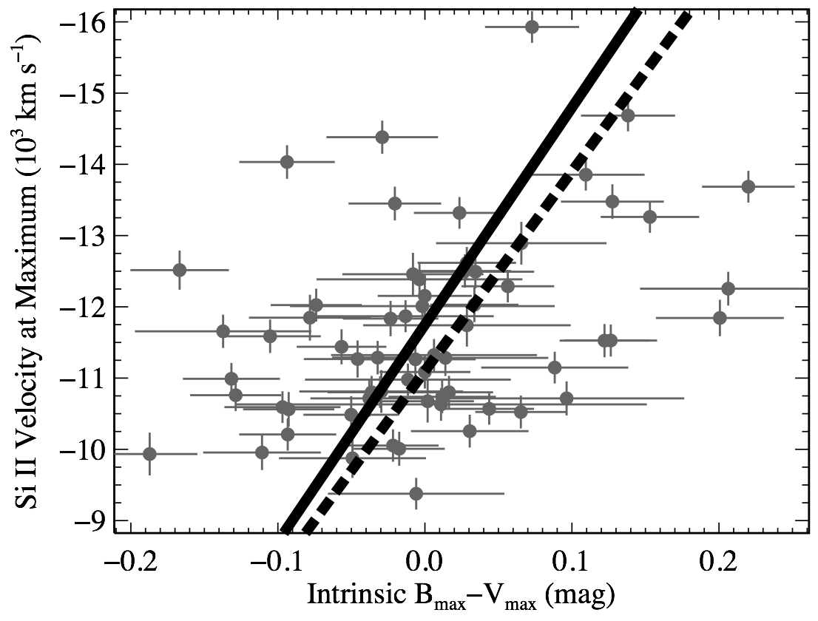
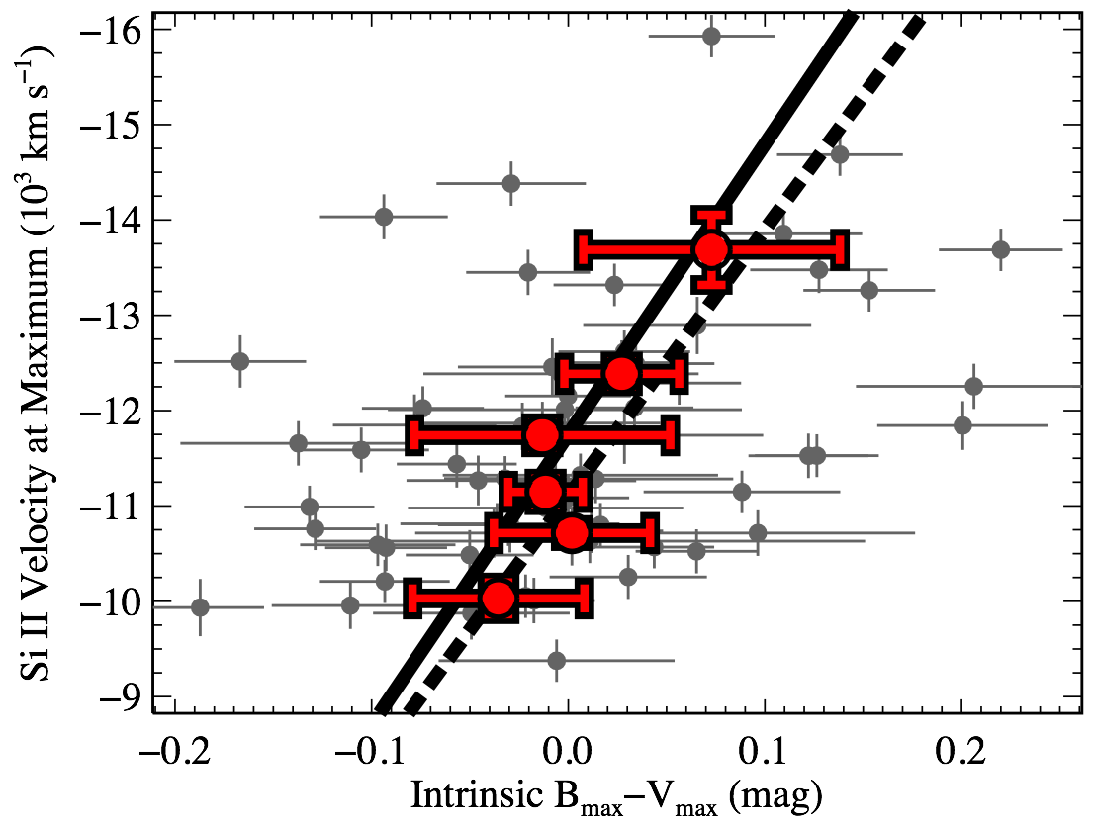
Intrinsic Color Depends on Velocity
Monte
Carlo
Simulation
99.949%
Negative
Slope
Foley, Sanders, & Kirshner 2011

Slide 54
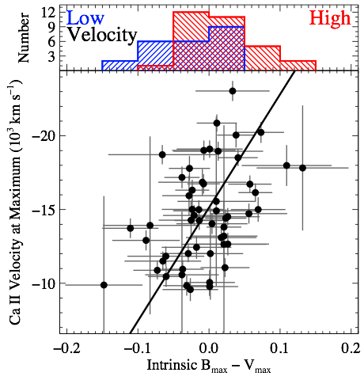
Color-Velocity Relation at High Redshift
Foley 2012c

Slide 55
What is a Type Iax Supernova?
Thermonuclear Deflagration in the Helium Layer of a
C/O White Dwarf that accretes matter from a
Helium Star. At least some of the time, The Explosion Does Not Disrupt the White Dwarf.
And Are More Common
Than SNe Ic

Slide 56
Class Summary
1. Low Luminosity
2. Low Velocity
3. Low KE/m
4. Sometimes He
5. Similar to Type Ia Supernovae
6. C/O Burning (Lots of Carbon)
7. Not Very Massive Star
8. Spherical Explosion
9. No X-ray/Radio Emission
10. Never Nebular?
11. Strong Forbidden Fe in Some
12. Ca Interior to Fe
13. Produces More Stable Ni
(per mass) than SNe Ia
14. Late-Type Hosts
15. Large Variation in ⁵⁶Ni, Luminosity,
Ejecta Mass, Etc
16. Low Ejecta Mass
17. 20-30 per 100 SNe Ia
Thermonuclear Deflagration in the Helium Layer of a
C/O White Dwarf that accretes matter from a
Helium Star. At least some of the time, The Explosion Does Not Disrupt the White Dwarf.
And Are More Common Than SNe Ic

Slide 57
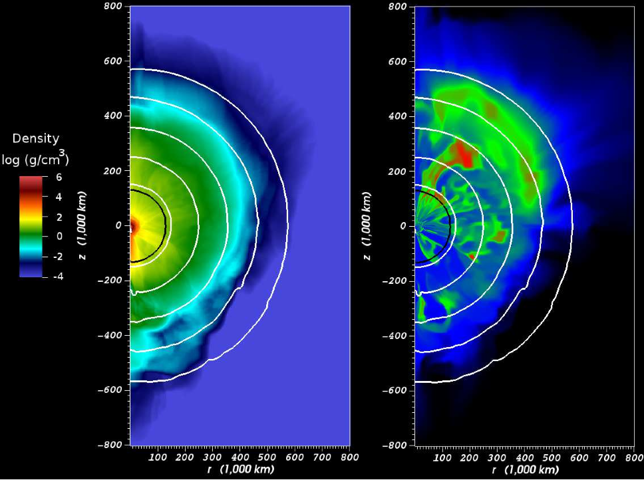
Failed Explosion Models Reproduce Data
0.1-0.3 Msun Ejecta
Low velocities
down to 500 km/s
Star Remains
Lots of Unburned Material
Jordan et al. 2012
Also See Markus Kromer’s paper

Slide 58
Research Areas
NIR !!!!
K-corrections
Explosion Physics
Extent of Carbon Burning
Chemical distribution of burning products
He I lines in SECCSN
Mg II & C I

Slide 59
Coordinated Data Sets
Optical Spectra SN 2009ig
Lick & Keck = blue
HET = green
MMT = red
Swift grism = cyan

Slide 60
Si II 6355A
Si II 6355 Å
Separate HV features found for
Si II, S II, Ca II, & FeII
Kinematic Tests
The outer part of the HV line-forming region will be slowed by interaction with CSM.
The blue wings slow down and form steeper blue sides of the absorption feature with an abrupt transition between the feature and the continuum (rather than a smooth Gaussian).
60

Slide 61
Measured Doppler velocities SN 2009ig
VHV Ca II only
All HV products found
in the same LFR
HV does not merge
with PS
PS velocities consistent
A gap in velocity space is apparent between
14,000–22,000 km s⁻¹
61

Slide 62
SN 2011by
coordinated
NIR + optical spectroscopy
This sequence covers the time period from before the primary
to after the
secondary peak
HET = green
FAST = blue
IRTF = red

Slide 63
SN 2011dh

