Slide 1
LIMSAT (Hopefully a revolution in 2 ways)
S. R. Kulkarni
on behalf of LIMSAT team
& Iair Arcavi, Eran Ofek

Slide 2
Some thoughts on Darwinian evolution

Slide 3
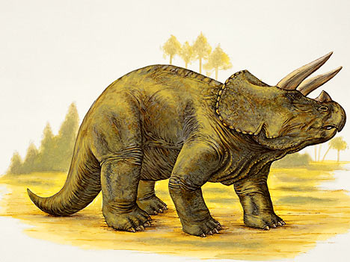

Slide 4
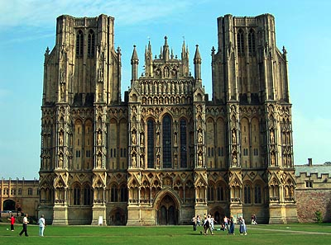

Slide 5
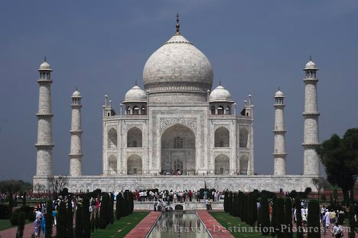

Slide 6


Slide 7
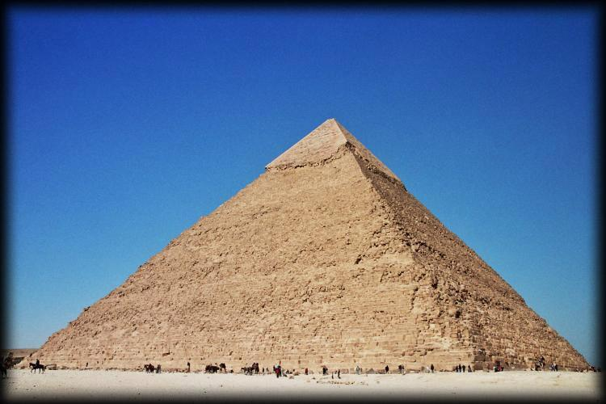

Slide 8
Shock breakout

Slide 9
Shock breakout / Intro
First photons emerge from the SNe
when the photon diffusion time scale
become shorter than the hydrodynamical
time scale (i.e., photons are diffusing faster than the ejecta).
Time scale and luminosity sensitive probes
of progenitor radius. The same applies to shock cooling radiation
e.g., Colgate 1974; Matzner & McKee 1999
Nakar & Sari 2010; Rabinak & Waxman 2011
Obs: Soderberg+2008,…

Slide 10
Early Emission from SN
R*/c
SN
t^{-4/3}
L~R*²
diffusion
log t

Slide 11
PTF: SN Early Emission

Slide 12
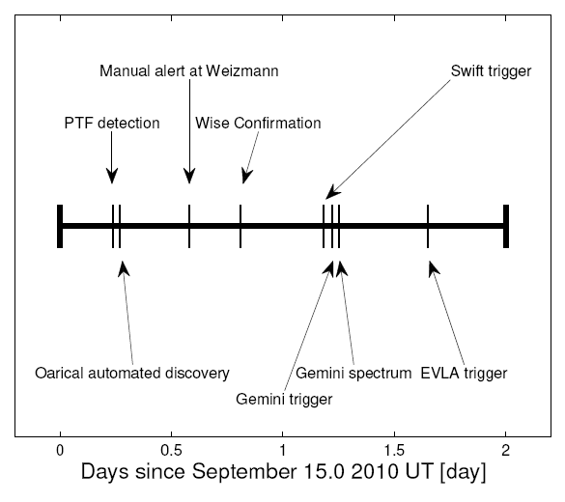
Early SN Emission | Followup techniques case study
PTF10vdl / Gal-Yam et al. 2011
Notes:
Also Carma and Galex triggered

Slide 13
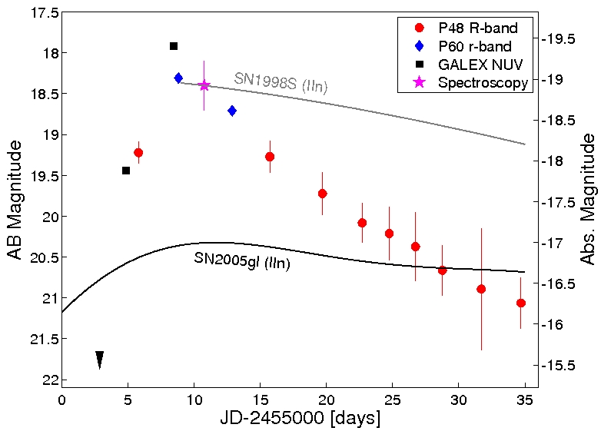
Early SN Emission | Dense CSM [week]
PTF09uj / Ofek et al. 2010
Notes:
Progress is now being made in detecting these shock breakout events by designed experiments. One line of action is followed by Gezari and co-workers (e.g., Gezari et al. 2008, ApJ, 683, L131; 2010, ApJ, 720, L77). This activity is based on using the GALEX UV space telescope in conjunction with moderately deep optical surveys (SNLS, PS1). A large number of relatively distant SNe are detected by these surveys, and an attempt is made to locate UV emission detected by GALEX just prior to the optical emission. The weakness of this method is that events occur at relatively distant galaxies (typically z≥0.1) and thus the UV shock-breakout signal is difficult to measure and interpret (e.g., see Gezari et al. 2008 vs. Schawinski et al. 2008, Science, 321, 233). We at the PTF project have followed a different path. As the GALEX observing program is known in advance, we tune the PTF sky coverage to monitor the area observed by GALEX (for any purpose), and search for SNe occurring there. We then identify these events and search for UV detection in GALEX data. Since this method is not limited to certain deep fields but covers instead a large fraction of the sky, the typical events discovered are closer and the GALEX shock breakout signal is exquisite (e.g., Ofek et al. 2010, ApJ, in press, arXiv/1009.5379). In addition, in some cases (explosions of extended red-supergiant progenitors) where the radiative cooling phase is prolonged and emitted radiation extends far enough to the red, high cadence PTF monitoring (carried out in the r-band) also provide useful detections (Arcavi et al. 2010, see Fig. 1 in part B1).
Ofek et al. 2010: Fast UV rise indicates SB from dense CSM: 10^10 cm^-3 and implies a high mass loss rate (0.1 M_sun/year) for a few years.

Slide 14
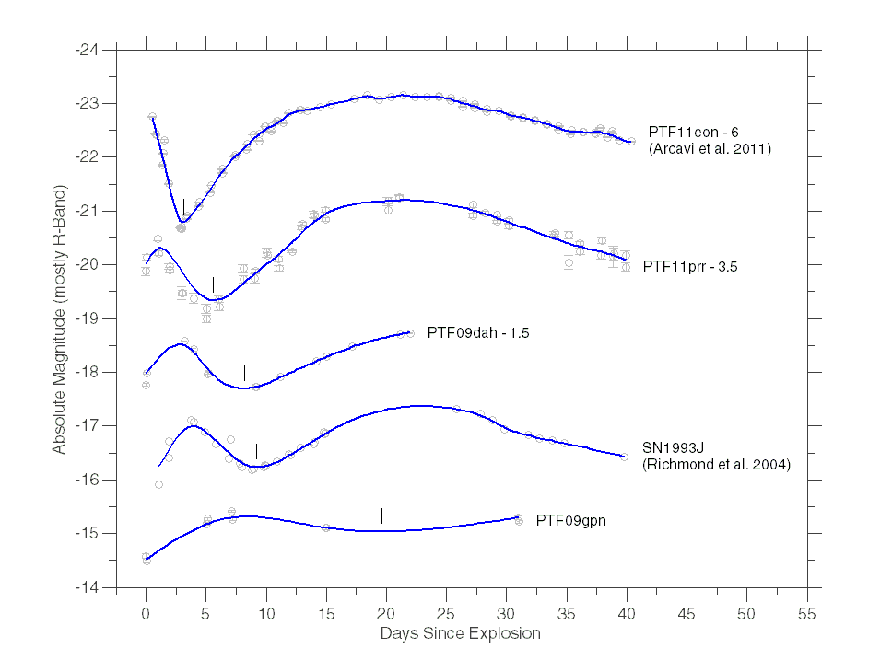
Early SN Emission | Partially stripped H envelope [days]
Shock cooling time
⬄
H envelope size/mass
?
?
Arcavi et al. in prep

Slide 15
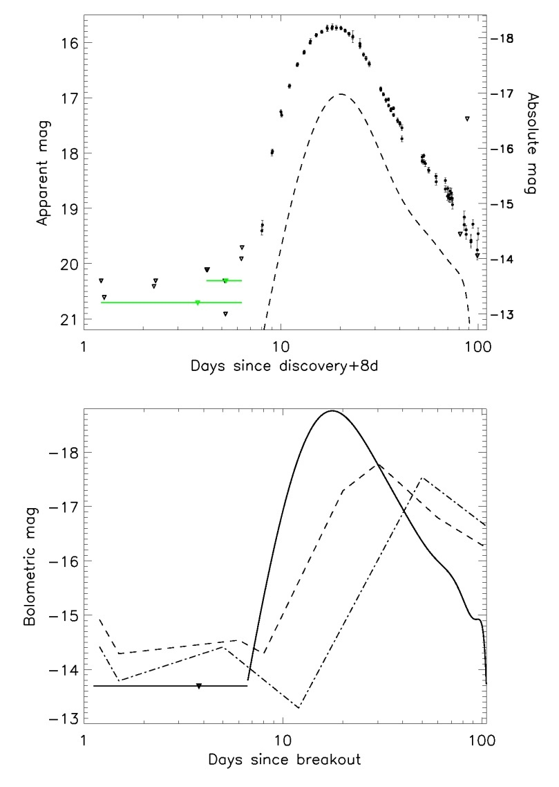
Early SN Emission | Fully stripped H envelope [hours]
Rule out early plateau
PTF10vgv / Corsi et al. 2012
Notes:
In recent numerical simulations of core-collapse explosions of single and binary progenitors
of SNe IIb/Ib/Ic, Dessart et al. (2011) predicted the existence a ∼ 10-day-long (∼ 10 times shorter
than in SNe II-P) post-breakout3 plateau, with a luminosity of (1 − 5) × 107 L⊙ (∼ 10 times smaller
than in SNe II-P). This plateau has the same origin as that observed in SNe II-P4, but in the case of
SNe IIb/Ib/Ic it is predicted to have a smaller duration and luminosity because of a more compact
progenitor.
For PTF 10vgv we can exclude the presence of a post-breakout plateau with luminosity greater
than the one of the compact progenitor model Bmi25mf5p09z1 (Figure 2, lower panel). We thus
derive R . 4.4 R⊙ for the radius of PTF 10vgv progenitor. However, the stellar models analyzed
by Dessart et al. (2011) have EK/Mej lower than we derive here, and a high surface He fraction.
So the bound on the progenitor radius derived from the comparison with these models is likely
over-estimated.
Similar limits (R . 5 R⊙) can be derived using the predictions by Nakar & Sari (2010; black
line in their Figure 3). But this model is accurate only up to . 11 hr after the explosion, since
recombination is not treated.
Using Mej,10vgv = (1.5 ± 0.3)M⊙ and EK,10vgv = (0.9 ± 0.3) × 1051 erg, as derived above, the
tightest constraint, R . 0.7 R⊙, is obtained from the C/O model of Rabinak & Waxman (2011),
that accounts for the dependence of the opacity on the envelope composition. The same model, for
an envelope composed of mostly He, gives us R . 1.3 R⊙. Thus, R . 1 R⊙ is a reasonable estimate
(considering that progenitors of type Ic SNe may contain a small fraction of He in the outer layers;
Georgy et al. 2009).

Slide 16
Early SN Emission | SN Ia WD progenitor [hours]
PTF11kly (SN2011fe) / Nugent et al. 2011, Bloom et al. 2012
Notes:
Size constraints:
R<0.02R
Coupled with the carbon in the very-early spectra, progenitor must have been a CO white dwarf

Slide 17
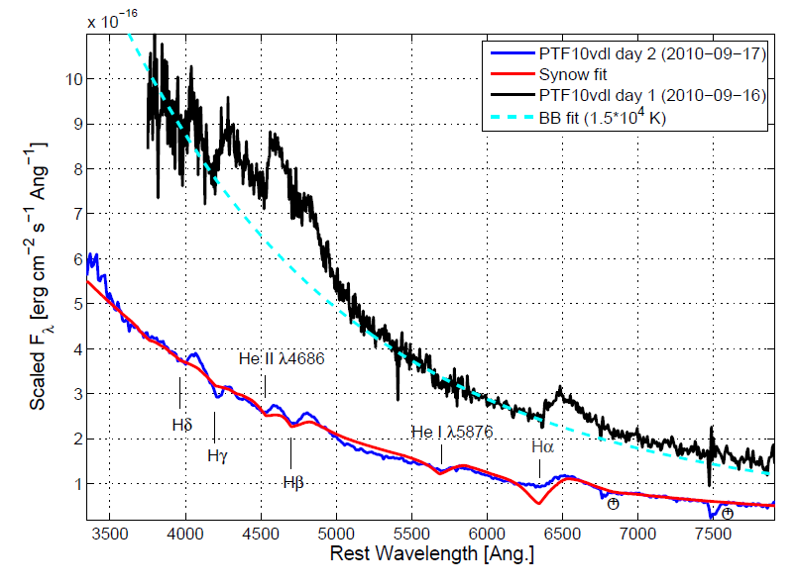
Early SN Emission | Extended H envelope cooling
Can measure early time temperature changes
PTF10vdl / Gal-Yam et al. 2011

Slide 18
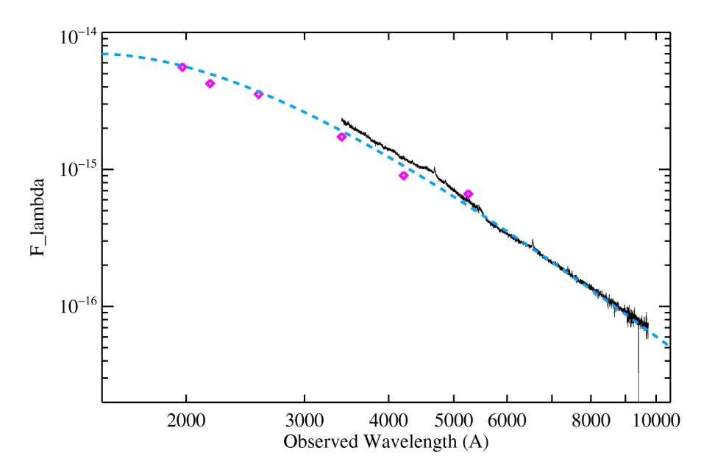
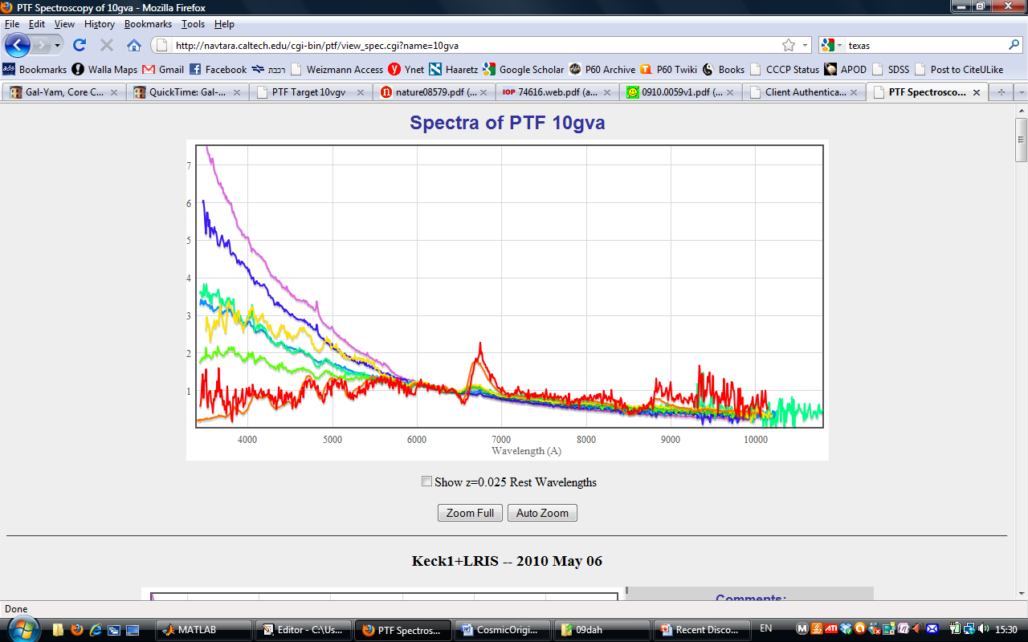
Early SN Emission | Extended H envelop cooling
Can measure early time temperature changes from UV
to optical
PTF10gva / Cenko et al., in prep.
Notes:
PTF10gva
Top: The optical-UV spectral energy distribution of PTF10gva from a combination of a Keck spectrum obtained shortly after discovery (same night; black) combined with rapid ToO Swift photometry (magenta diamonds; from Cenko et al. 2010). Our data show an extremely hot (~24,000 Kelvin, dashed cyan curve), yet thermal spectrum; even earlier spectra should reveal non-thermal components expected by recent theoretical work (Katz et al. 2010; Nakar & Sari 2010), should such components exist.

Slide 19
The LIM EFFORT

Slide 20
LIMSAT Philosophy
Our default plan is a satellite in the mass range 50 to 100 kg and which can undertake high impact science for even one goal. However, we are open to ideas involving multiple (and unrelated) space craft (e.g. good for sky coverage) or a loosely bound cluster (e.g. low frequency radio astronomy). The key is to fly a mission every three years using as much as possible the same line of systems and sub-systems.

Slide 21
LIM Group
Caltech, US
Kulkarni, Phinney, Harrison
Weizmann, Israel
Waxman, Gal-Yam, Ofek
India
Paul, Murthy, Bhattacharya
Canada
van Kerkwijk, Kaspi

Slide 22
LIM Activities
Initial study funding was from KISS (early 2010) for Caltech and foreign participation and the Weizmann Institute for activities in Israel
First two meetings in 2010 (Caltech and WIS)
For the next 14 months we brain stormed about small satellites (<64 kg, science payload)
Equal Opportunity for Each Band & Subject (but restricted to astronomy)
Near IR, Radio, X-ray, Optical, UV

Slide 23
LIMSAT Discussion
We reviewed past mini-satellites and formed our opinion of “lessons learnt”
CHIPSAT, MOST
We reviewed astronomical small satellites around the world
IKARUS (Japan)
BRITE (Austria)
MIRAX (Brazil)
Our strategy was informed by lessons learnt

Slide 24
LIM Strategy
Israeli Bus
Israel is a leader in miniaturization for military drones and satellites
India Launch
PSLV is a reliable and low cost provider for LEO
PSLV routinely launches piggy back satellites
[DOD launches]
Canadian Instrument
US Data Center
Proven Leader in this field (ex. IPAC)

Slide 25
The Work Began

Slide 26
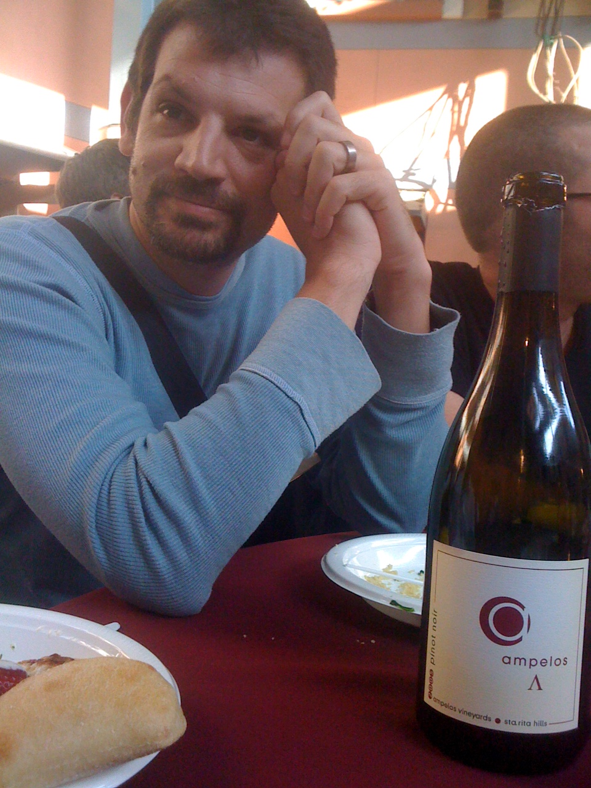

Slide 27
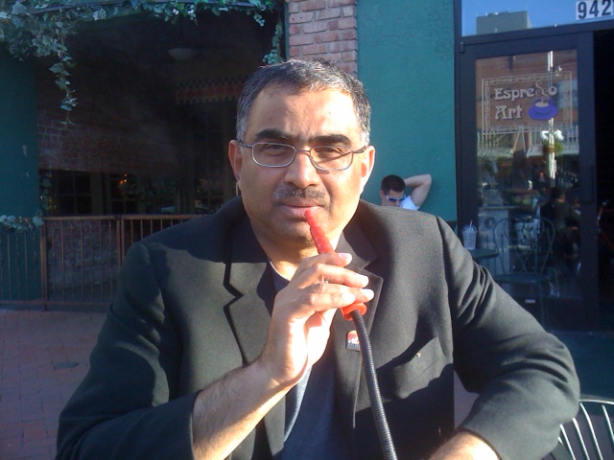

Slide 28
הצגת הפרויקט
לראש סוכנות החלל הישראלית
ולמנכ"ל משרד המדע
יום רביעי, 7 למרץ, 2012

Slide 29

Mission Concept
A small space mission designed to carry out a wide-field UV transient survey
Eli Waxman
Weizmann Institute of Science

Slide 30
And we needED a go

Slide 31
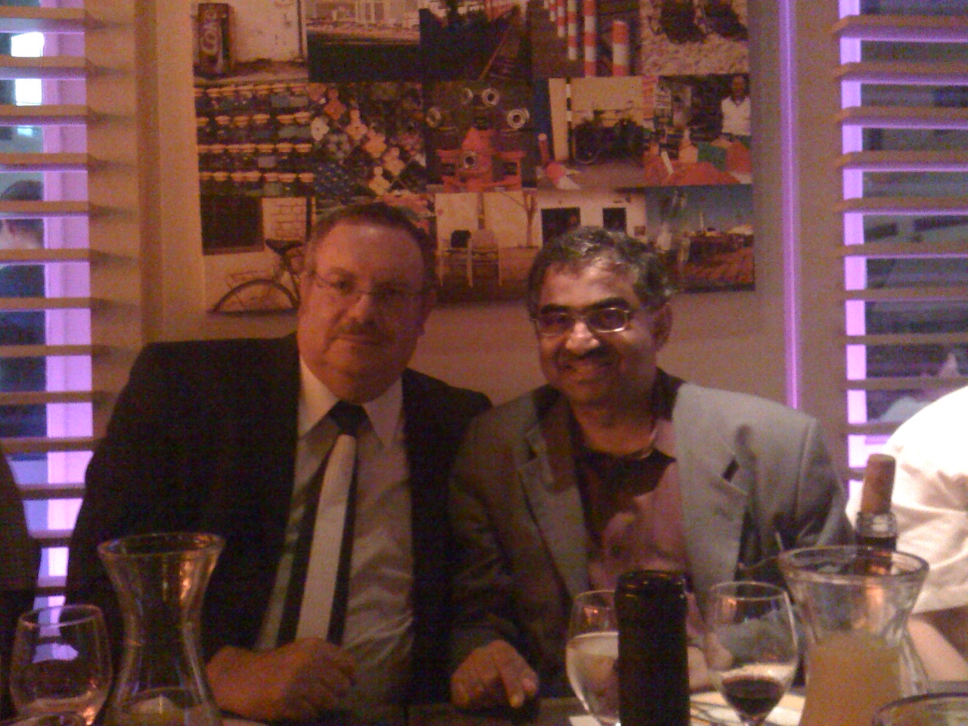

Slide 32
Wide field UV: Requirements
Sensitivity: One tenth GALEX
SNR=5 for ~0.01 photons/cm²s within Δλ=0.044μ at λ<0.35μ and 300s integration)
Field of View: 1000 times larger than GALEX
If the above requirements are met, the detection rate would be 30 times that of GALEX.
Guaranteed events.
supernova shock breakout events (10 per year)

Slide 33
Proposed System – Summary (1)
Eight identical telescopes, each with:
Aperture diameter 120 mm
Focal length 290 mm
F/# F/2.4
Field of view 12.1° x 12.1°
IFOV 20 arcsec
Plate scale 710”/mm
Percent energy/pixel >75% (result of PSF)
Spectral band 200-240 nm (:)
Filter type Reflective (two in series)
Visible suppression 2 x 10⁻³ from 300 to 1100 nm

Slide 34
Proposed System – Summary (2)
Detector type CCD
Pixel array 4096 X 4096
Pixel size 15 x 15 µm
Array size 61.4 mm square
Binning 2 x 2
Effective size 30 x 30 µm, 2048 X 2048 pixels
One binned pixel = 21.3 x 21.3 arcsec
Quantum efficiency 60% average over band

Slide 35
Proposed System – Summary (3)
Performance
Total field of view 8 x 146 = 1170 sq. deg.
Fraction of sky covered 2.8%
Detection threshold 0.006 ph/cm²/sec
Limiting AB magnitude 18 at 300 secs integration time
Diffuse background 0.08 ph/cm²/sec/(‘)² (assumed)

Slide 36
Proposed System – Summary (4)
Orbit
Sun synchronous polar orbit
LTDN 06:00 hrs
Altitude (depends on launch possibilities)
Minimum 720 km
Desirable >1400 km
Inclination depends on altitude (e.g. 8° for 720km)
Stability Better than 50µrad in 300 sec

Slide 37












The Team
Scientific
Weizmann Institute of Science O. Aharonson, A. Breskin, A. Gal-Yam, E. Ofek, I. Sagiv, J. Topaz, E. Waxman
Caltech S. R. Kulkarni, F. A. Harrison, E. S. Phinney
NASA Ames Research Center S. P. Worden
Tel Aviv University D. Maoz
Indian Institute of Astrophysics J. Murthy
University of McGill V. Kaspi
U. Toronto M. H. van Kerkwijk
Raman Research Institute B. Paul
Inter-Univ. Center for A&A D. Bhattacharya
Gov.
ISA (Z. Kaplan) A. Kafri
IMOD DDR&D Space Program O. Lapid, N. Ganot, A. Perry, U. Segalis
NASA Ames Research Center
J. Belgacem, M. Bicay, J. Cohen, J. L. Dotson, S. P. Worden
Industry
IAI Y. Yaniv
Elbit Systems electro optics (El-Op) O. Braun, A. Nir, I. Porat, T. Sprecher
Eli Waxman | Weizmann Institute of Science

Slide 38
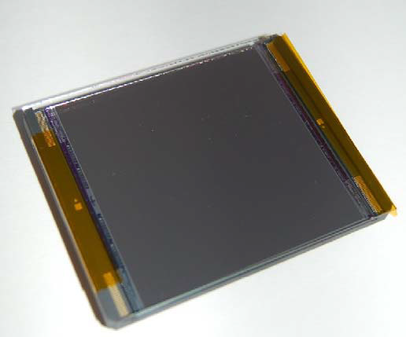
Detector Choice
Best detector so far - e2v CCD 231-84 (Considering Delta-Doped CCDs)
4096 X 4096 pixels, 15µm square
Use 2 x 2 binning (30 x 30 µm) to match optics
To keep dark current low, need cooling to ~230°K
Jeremy Topaz | Weizmann Institute of Science

Slide 39
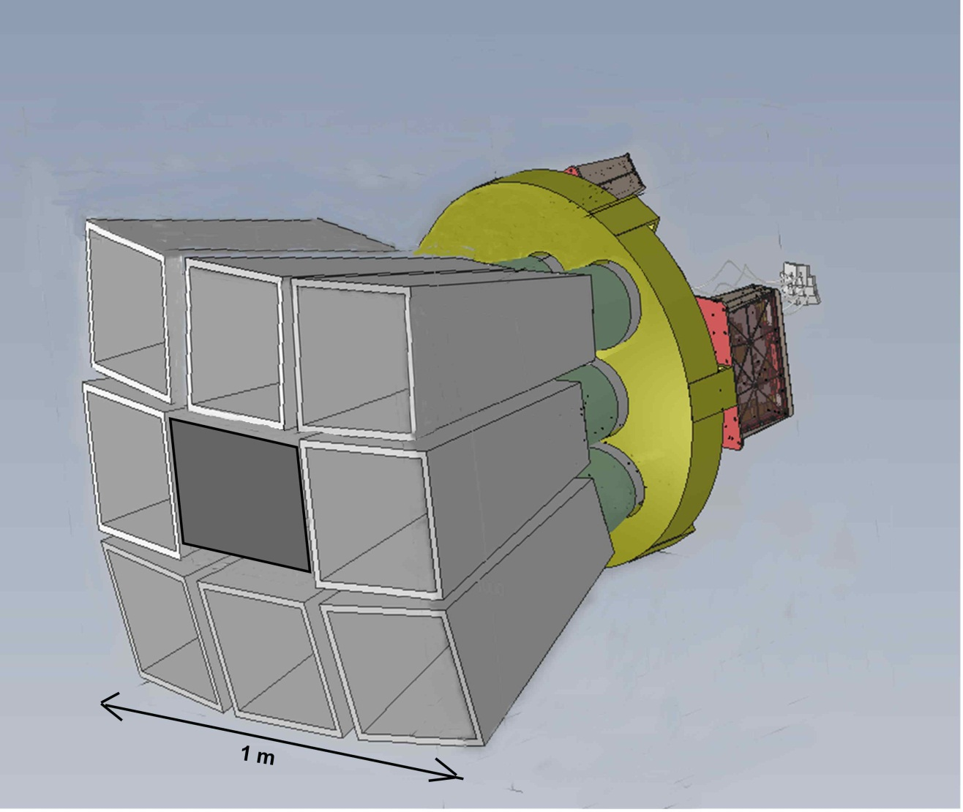
Preliminary Mechanical Layout
Telescopes and detectors
Detector cooling radiator
Baffles
Jeremy Topaz | Weizmann Institute of Science

Slide 41

Orbit and FOV options
Equatorial
Sun Sync. 12:00
Sun Sync. 06:00
Polar
(incl. 90º)
fov
fov
fov
Sun
fov
Sun
Sun
fov
Sun during half year
Preferred orbit
Yoram Yaniv | Israel Aerospace Industries MBT Space Division

Slide 42
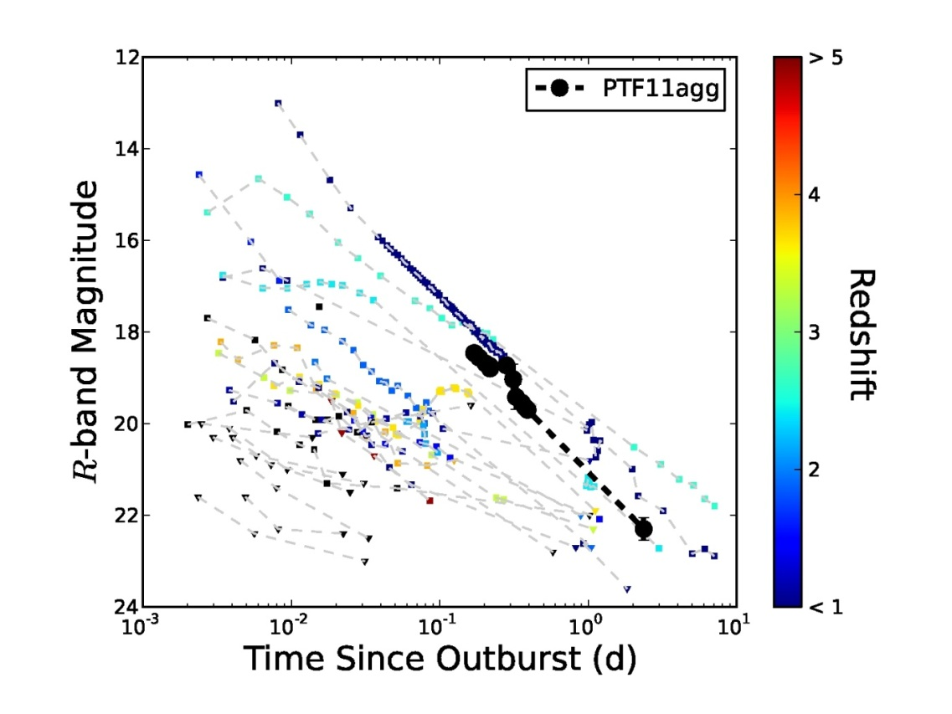
What will we see in the LIM Field of View?
~10⁵ sources in 1 exposure (NUV~18)
~3x10⁵ sources in 20 co-added (NUV~19.6)
~30,000 stars (with photometry <1% in 6-hr integration)
~600 RR Lyr stars (Galactic halo structure and extinction maps)
~30 White Dwarfs
~6000 QSOs (BH mass measurements, accretion disk sizes)
A few very small NEOs per year
~10 GRBs per year + orphan GRBs?
Eran Ofek | Weizmann Institute of Science

Slide 43
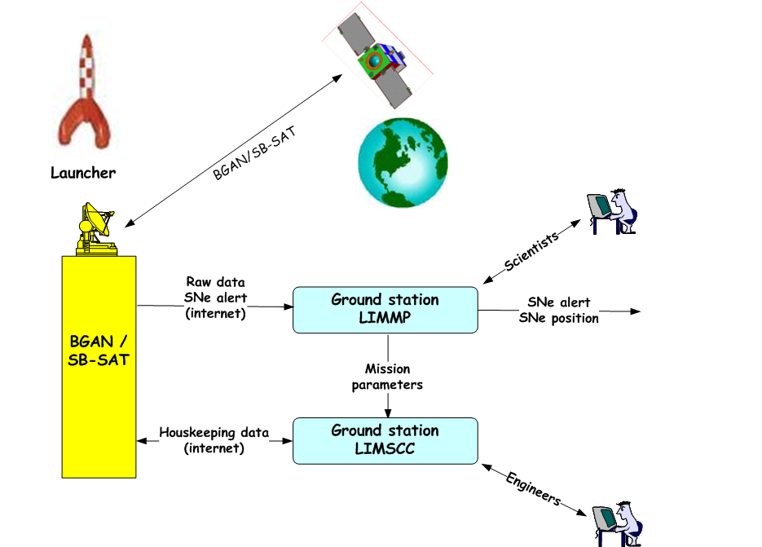
LIM System
LIM Satellite (LIMSAT), injected into a Low Earth Orbit
Platform with SB-SAT terminal
UV Camera
Yoram Yaniv | Israel Aerospace Industries MBT Space Division

Slide 44
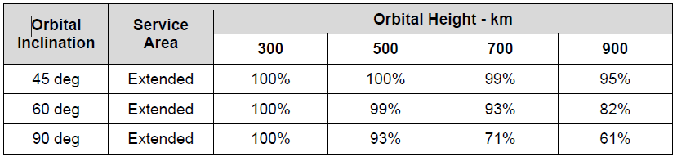
Communication – SB-SAT
Service Coverage for a Standard SB-SAT Terminal
Polar View of Inmarsat I4 Constellation and Composite Coverage
Yoram Yaniv | Israel Aerospace Industries MBT Space Division

