Slide 1
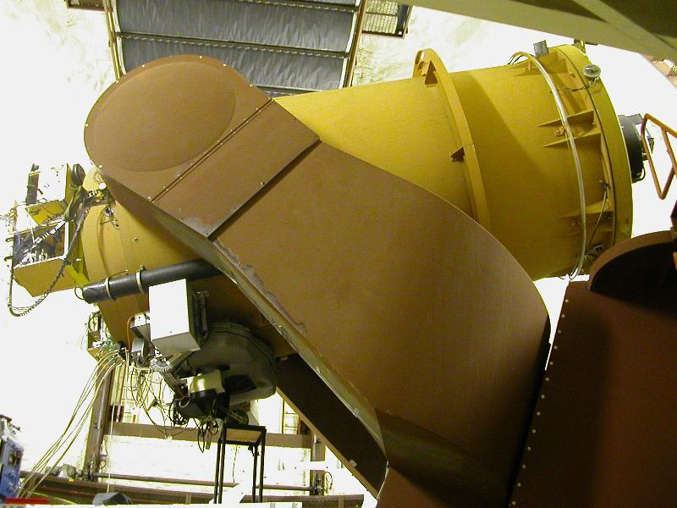
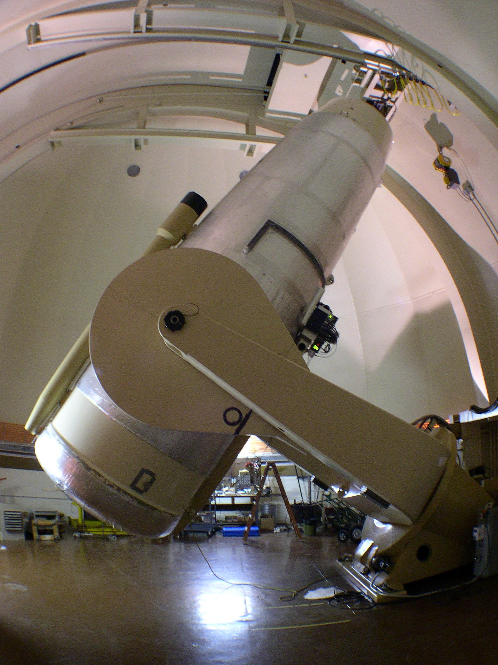
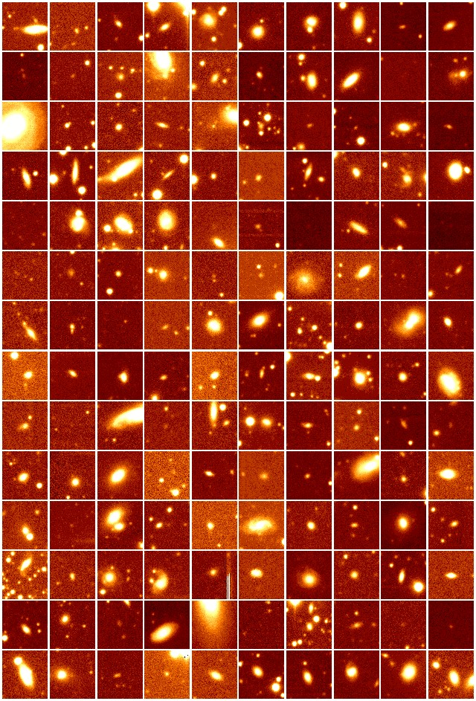
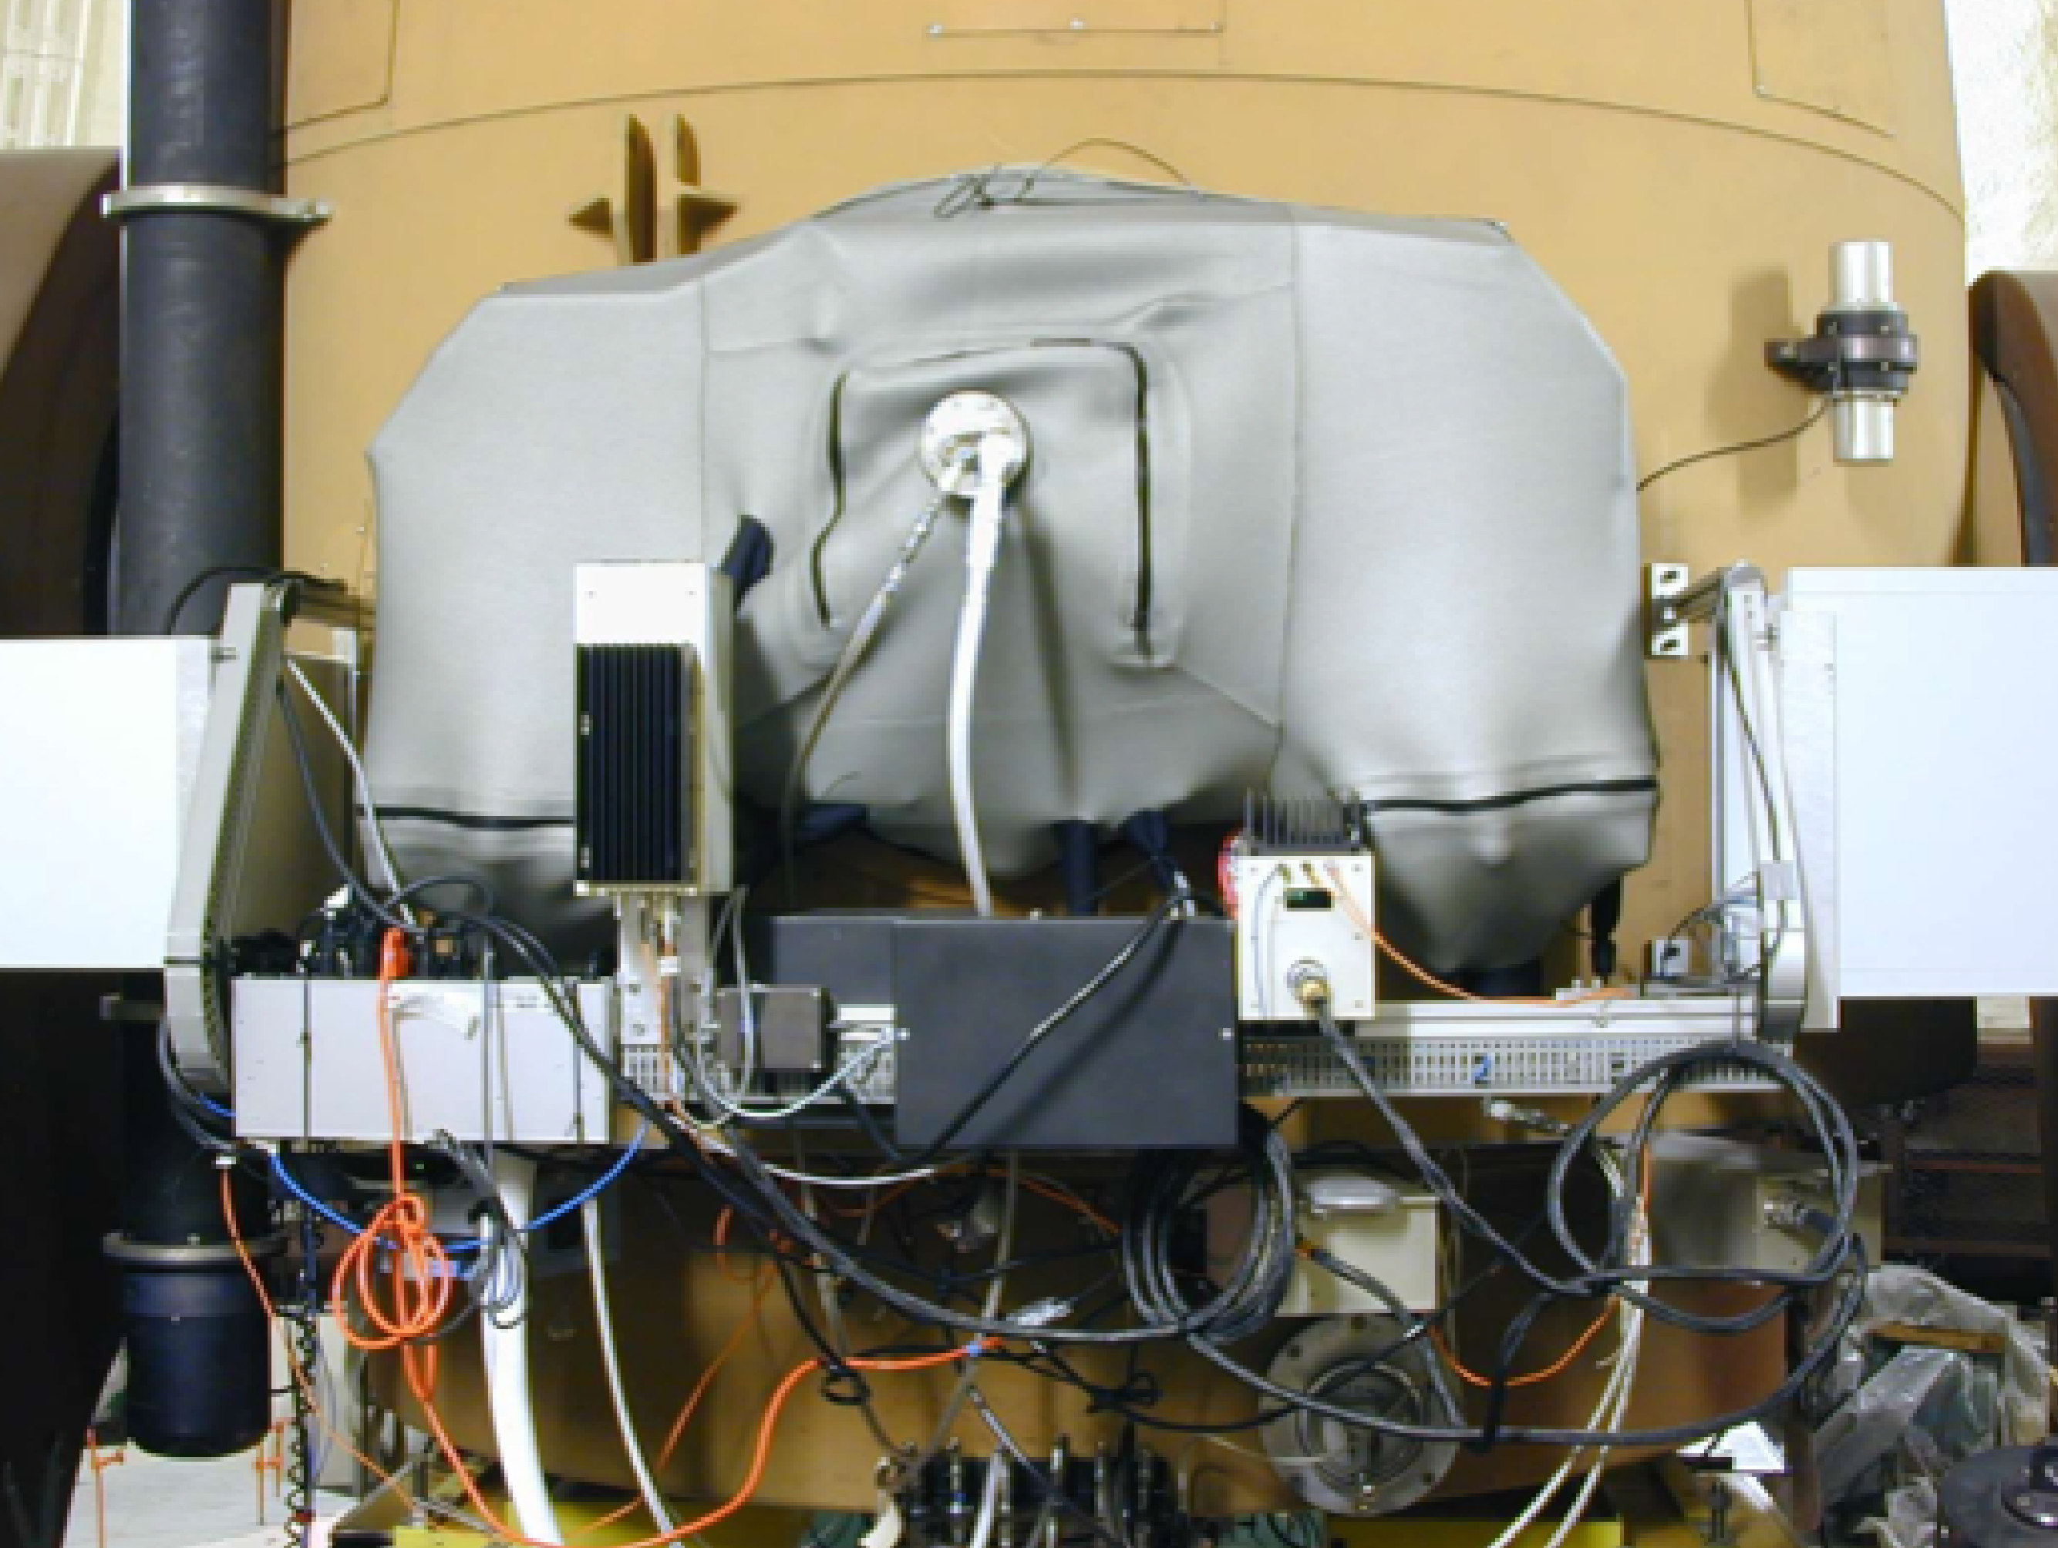
Nearby Supernova Factory
LBL
G. Aldering
S. Bailey
(M. Childress)
H. Fakhouri
A. Kim
J. Nordin
S. Perlmutter
P. Nugent
(R. Scalzo)
C. Saunders
N. Suzuki
R. Thomas
K. Runge
Yale
C. Baltay
D. Rabinowitz
IPNL
C. Buton
N. Chotard
Y. Copin
E. Gangler
G. Smadja
R. Pereira
M. Rigault
LPNHE
P. Antilogus
C. Balland
S. Bongard
F. Cellier-Holzem
A. Canto
J. Guy
R. Pain
C. Wu
CRAL
E. Pecontal
CPPM
C. Tao

Slide 2
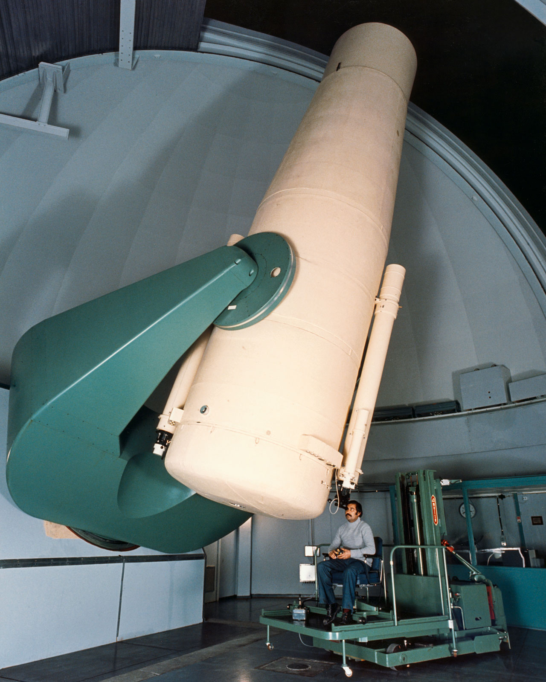
Nearby Supernova Factory II
CPPM/THCA
C. Tao
N. Chotard
J. Chen
D. Fouchez
A. Tilquin
Bonn
C. Buton
U. Feindt
M. Kerschlaggel
M. Kowalski
MPA
S. Benitez
W. Hillebrandt
M. Kromer
M. Sasdelli
A. Sternberg
S. Taubenberger
LBL
G. Aldering
S. Bailey
(M. Childress)
H. Fakhouri
A. Kim
J. Nordin
S. Perlmutter
P. Nugent
(R. Scalzo)
C. Saunders
N. Suzuki
R. Thomas
K. Runge
Yale
C. Baltay
D. Rabinowitz
E. Hadjyska
IPNL
Y. Copin
E. Gangler
G. Smadja
R. Pereira
M. Rigault
LPNHE
P. Antilogus
C. Balland
S. Bongard
F. Cellier-Holzem
A. Canto
J. Guy
R. Pain
CRAL
E. Pecontal

Slide 3
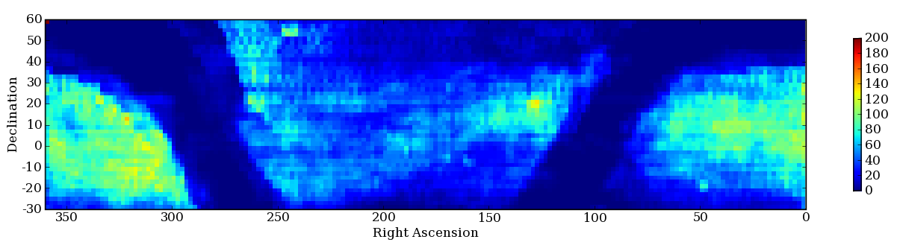
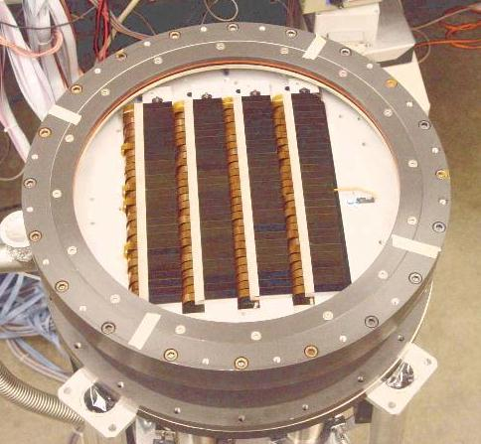
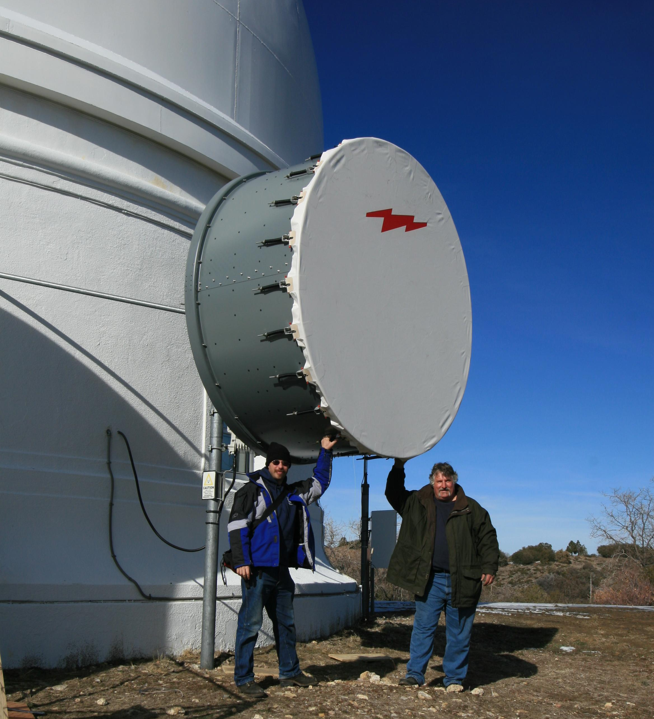
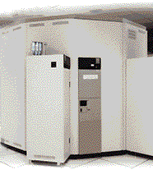
Nearby Supernova Factory Search
+
+
+
=
QUEST Camera
Oschin Schmidt
HPWREN
NERSC

Slide 4
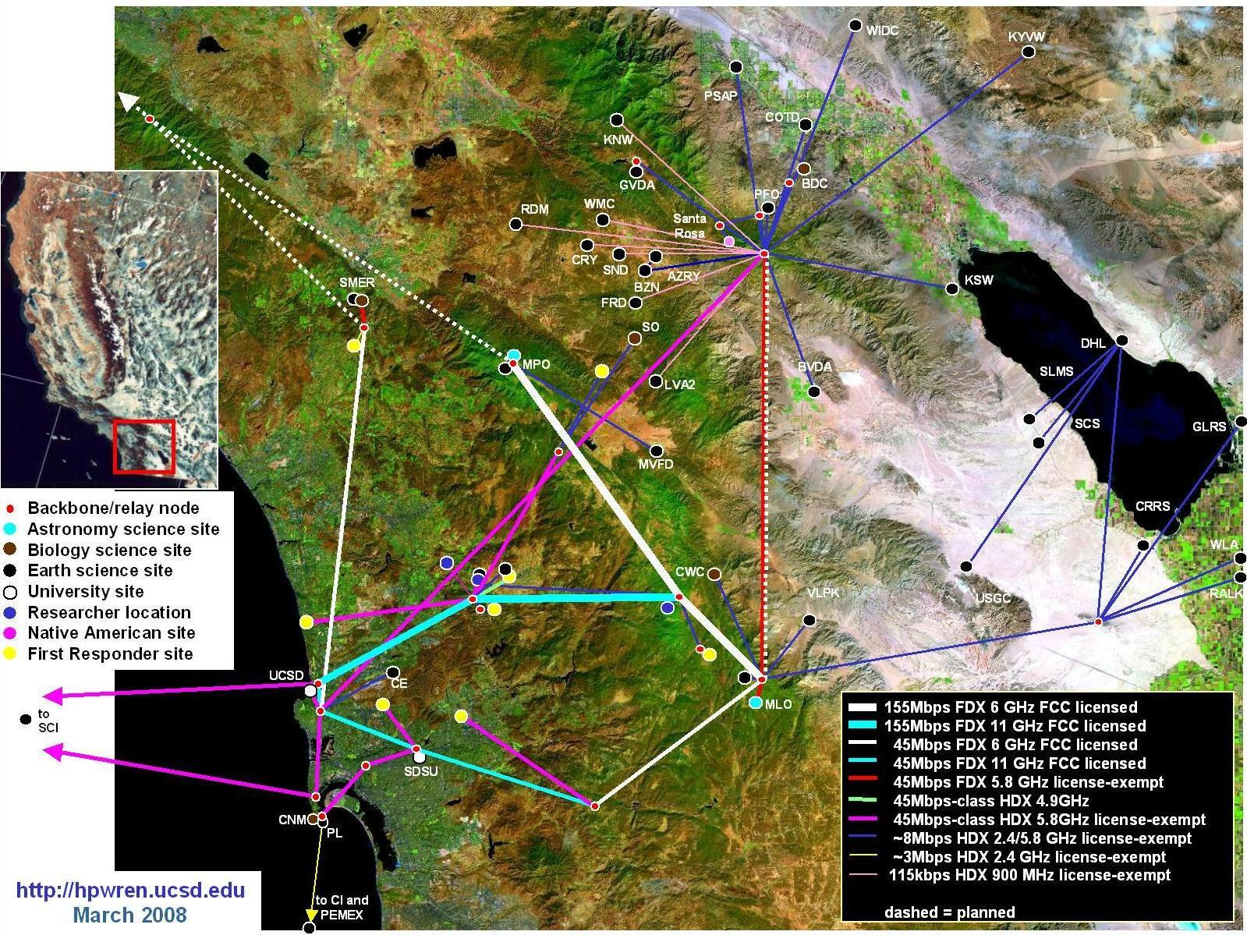
SNfactory-I / PTF Data Transfer

Slide 5


Slide 6
SNF-I Operations
Ancillary Data:
weather, Skyprobe, …
Search
US0: Daytime
Calibration
CCIN2P3 & NERSC
US0: Evening
Setup
Data Processing
Selection
DB Registration
Scheduling
FR1+2: Night
Operations
SNwarehouse
Data Transfer
Postmortem:
QA & Classify
SNIFS+telescope
webpage
SNfactory-I

Slide 7
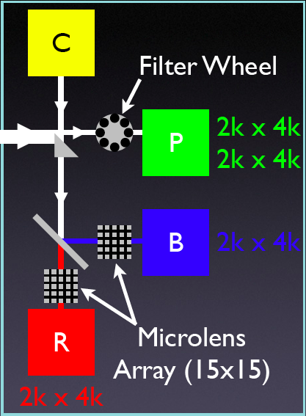
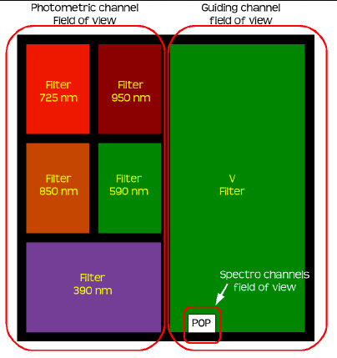
Schematic SNIFS Layout
Spectroscopy Channels:
MLA 6 x 6 arcsec
0.4 arcsec/spaxel
Blue 320-520 nm
Red 510-1000 nm
Calibration Unit
arcs
continuum
Photometric Channel
9 x 9 arcmin
0.14 arcsec/pixel
8 slot filter wheel
acquisition
guiding (left)
parallel extinction monitoring

Slide 8
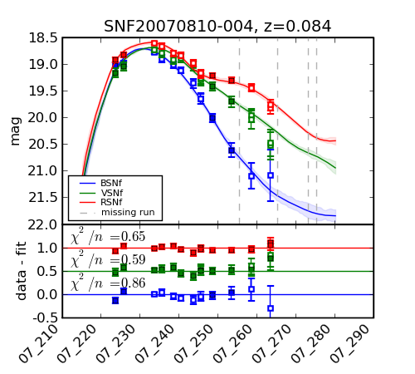
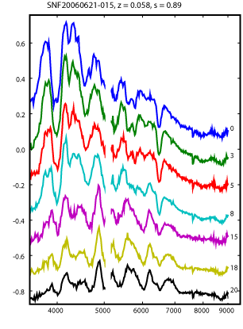
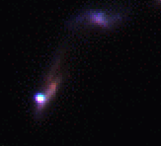
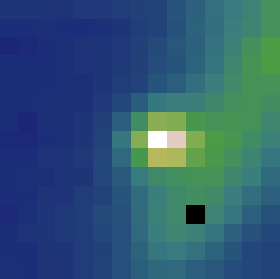
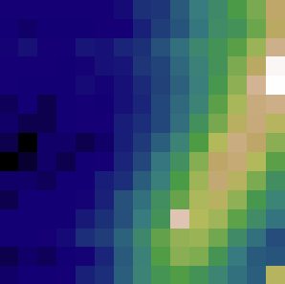
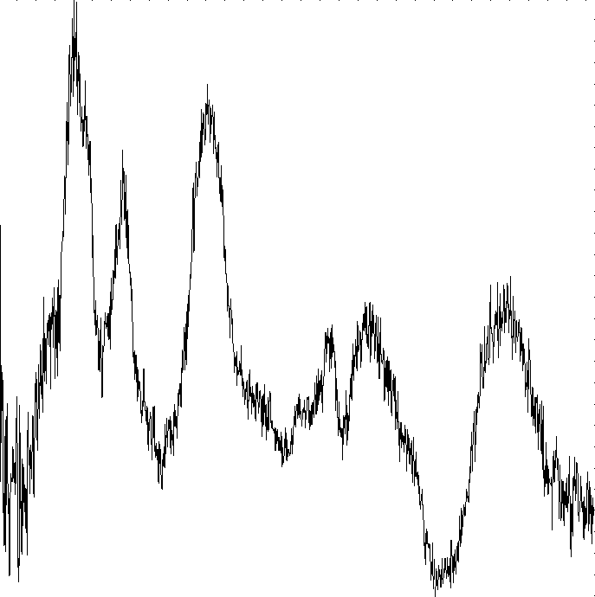
SNfactory Follow-up Method
−
=

Slide 9
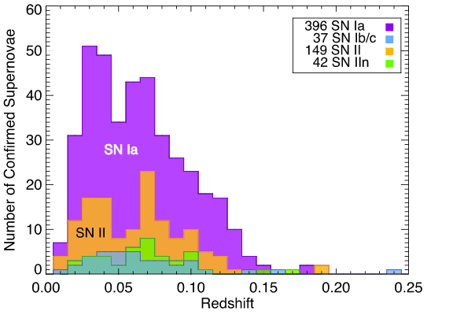
SNfactory-I Search Results
Spectroscopic
Sample

Slide 10
SNfactory & SNfactory-II Searches
Etendue (m² - deg²)
SNfactory
SNfactory-II

Slide 11
SNF-II Operations
Searches
Ancillary Data:
weather, Skyprobe, …
Selection
US0: Daytime
Calibration
CCIN2P3 & NERSC
Scheduling
US0: Evening
Setup
Data Processing
DB Registration
FR1+2: Night
Operations
SNwarehouse
Data Transfer
Postmortem:
QA & Classify
SNIFS+telescope
Telegram
SNfactory-II

Slide 12
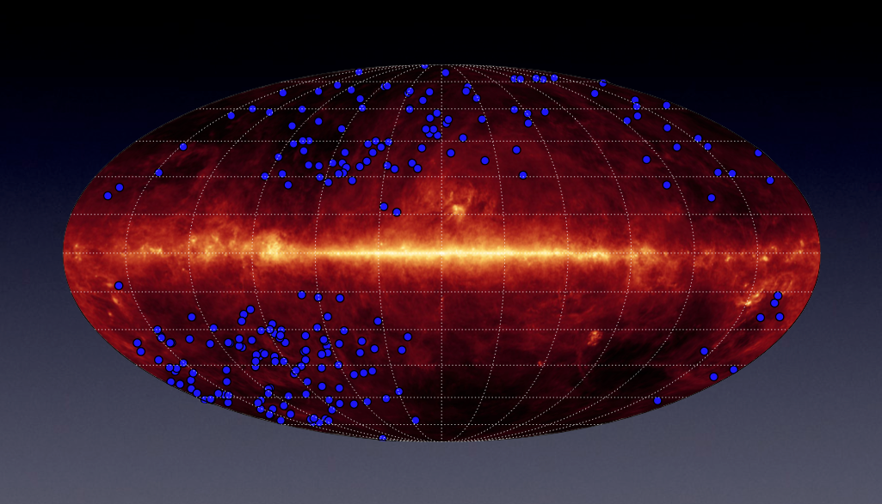
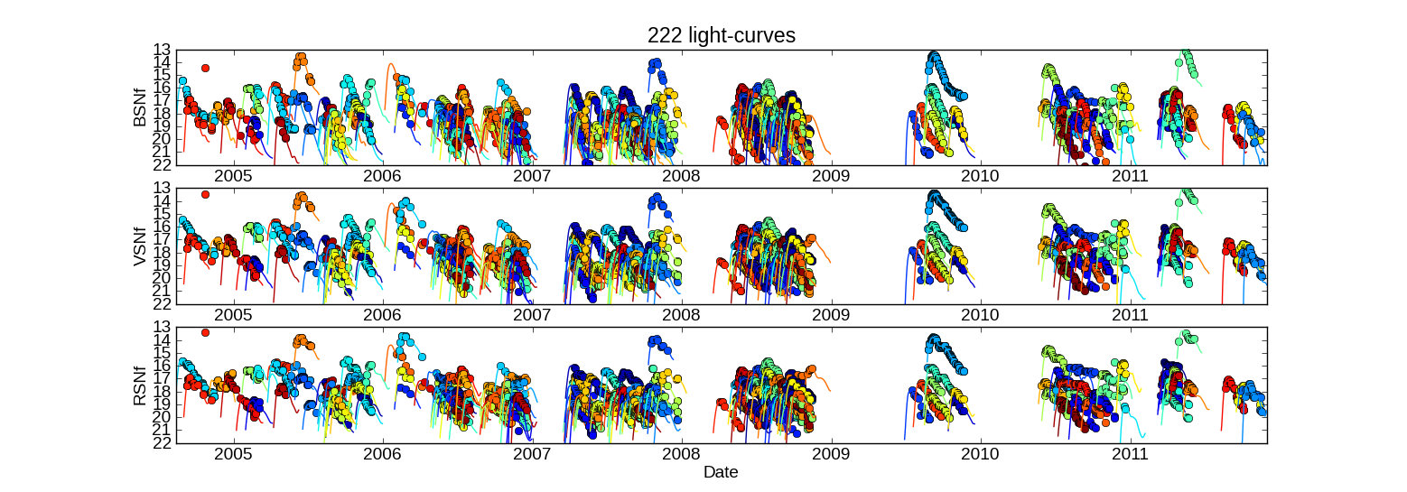
SNfactory Sample

Slide 13
A few words about Techniques

Slide 14
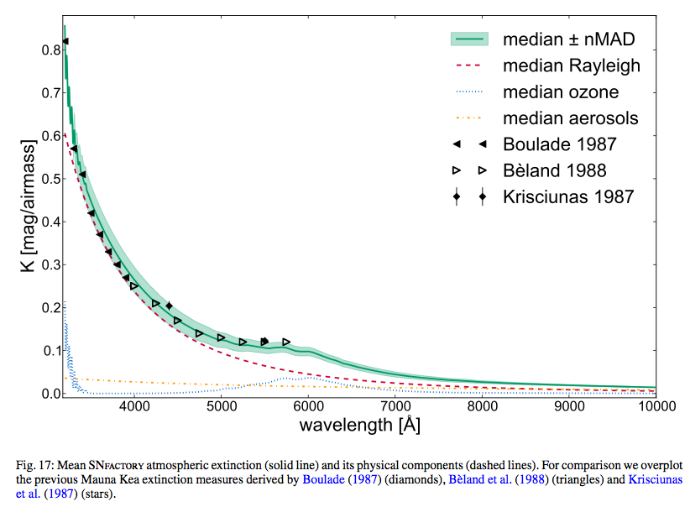
New Mauna Kea Extinction Curve
Buton et al. 2012 (SNfactory)

Slide 15
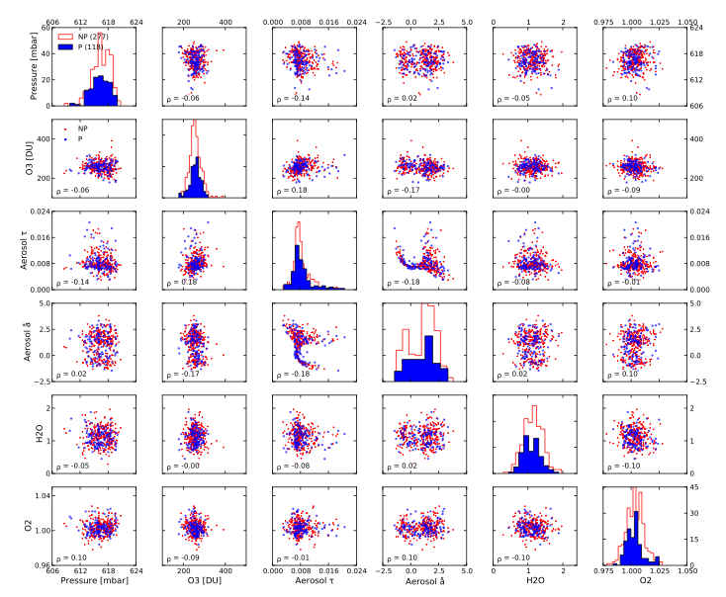
Extinction Parameter Correlations
Buton et al. 2012 (SNfactory)

Slide 16
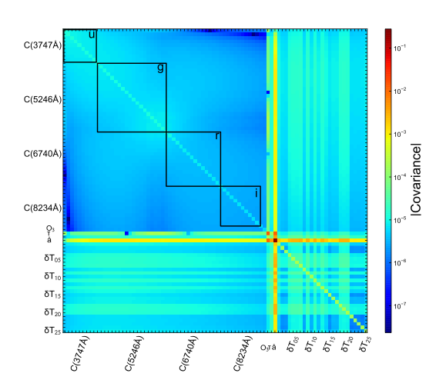
Extinction Parameter Covariance
Buton et al. 2012 (SNfactory)

Slide 17
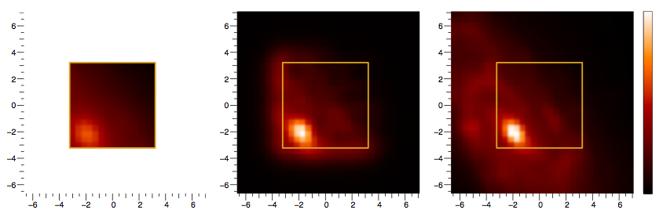
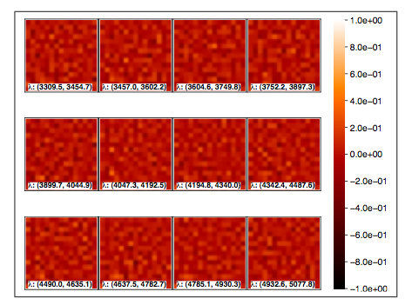

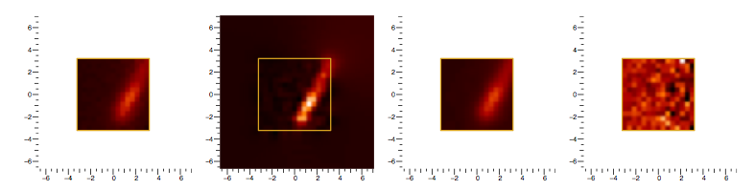
Hyperspectral host galaxy subtraction methodology
Bongard et al
2011
Data
Model
Truth
Residuals
Bongard et al. 2011 (SNfactory)

Slide 18
Standardization

Slide 19
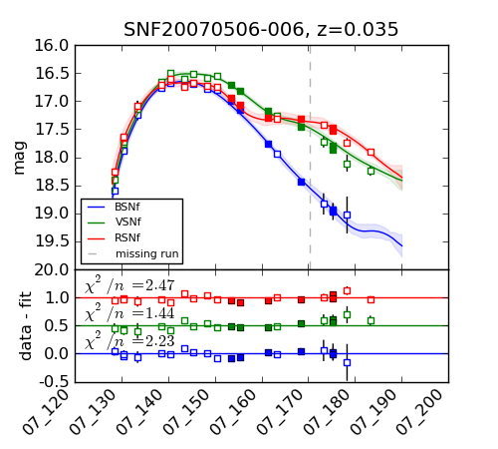
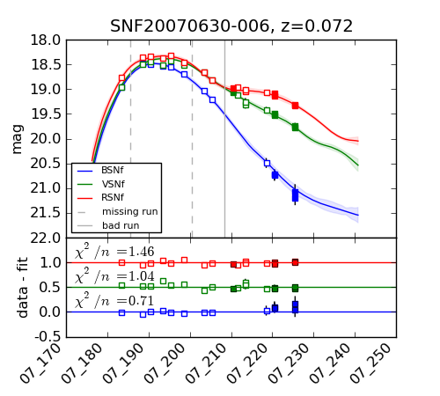
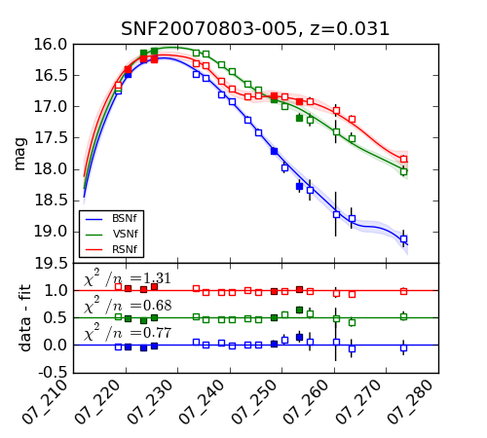
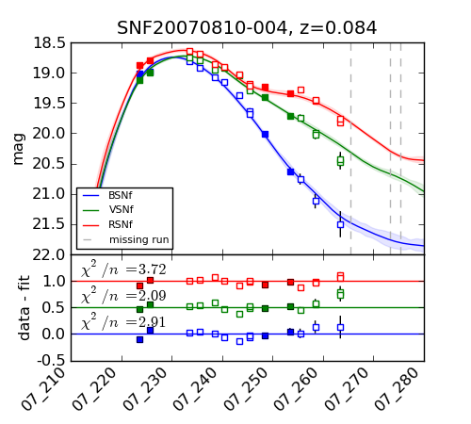
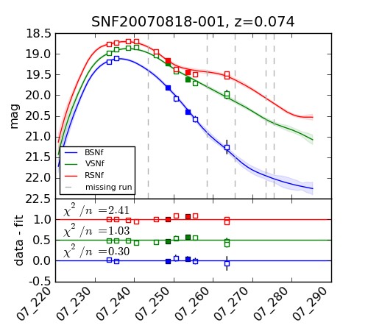
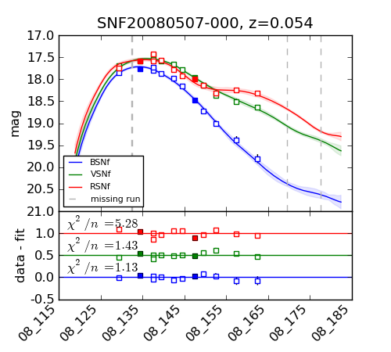
Unstandardized
normal
peculiar
reddened
Each point is a SN
before any correction
Each point is synthesized photometry from a flux-calibrated spectrum

Slide 20
Lightcurve Standardization
σ(d_{L}) = 7.4%
Each point is a SN
After width-color correction
Each point is synthesized photometry from a flux-calibrated spectrum

Slide 21
Spectral Flux Ratio Standardization
Training sample
σ(d_{L}) = 5.9%
Each point is from a
single at-max spectrum
Bailey, et al. 2009 (SNfactory)
Requires only 1 spectrum at peak
S/N ~ 15 @ R ~ 100
Now tested on 2x larger sample!

Slide 22
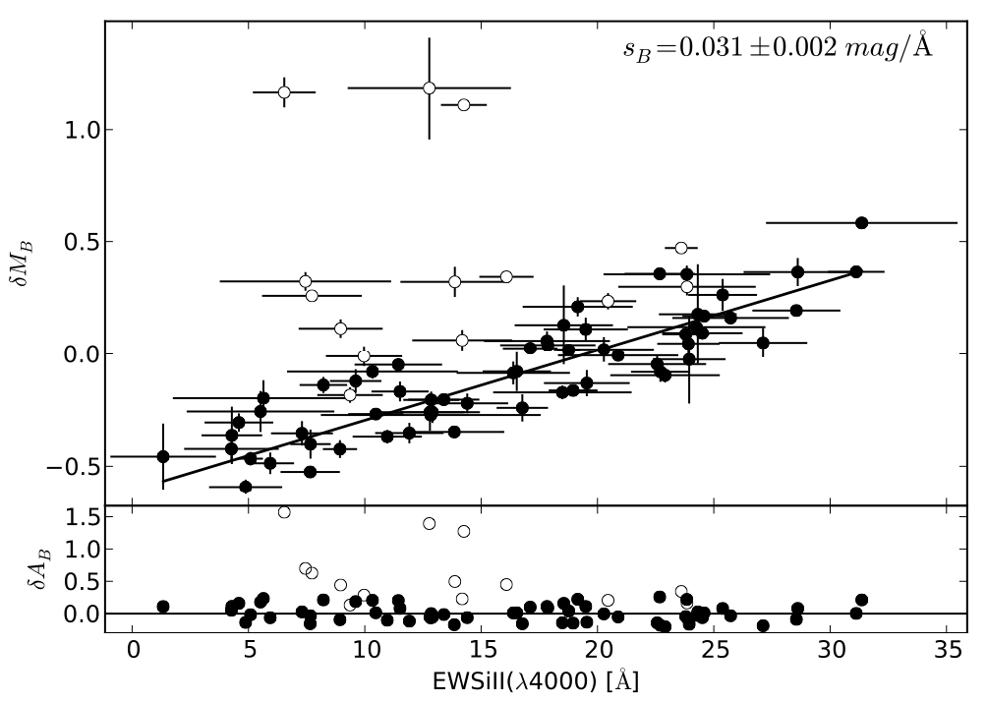
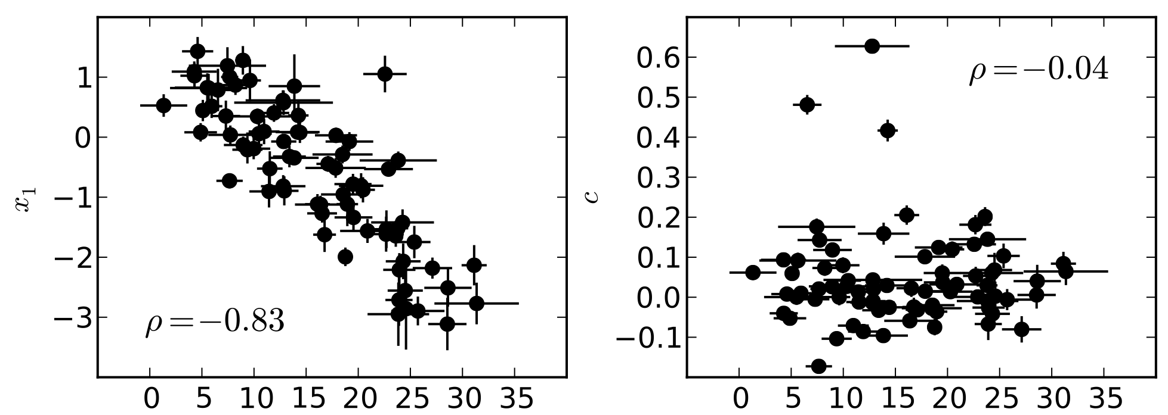
EW_{Si}, EW_{Ca} & Color
EW(SiII 4000) Standardization
Only requires
spectrum at
peak
Fainter
Wider/Slower
Redder SN Color
EW(SiII 4000)
EW(SiII 4000)
Chotard et al 2011 (SNfactory)

Slide 23
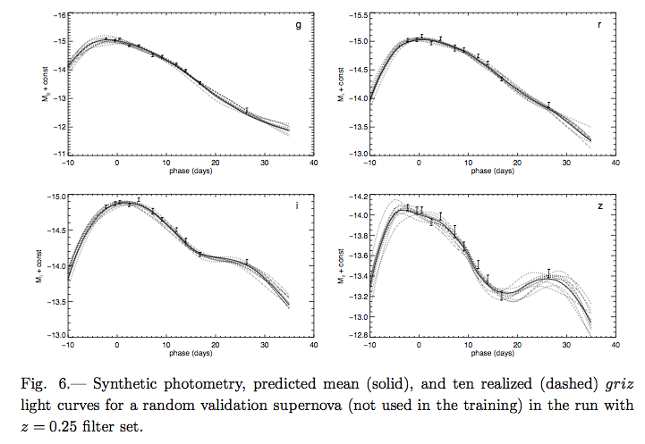
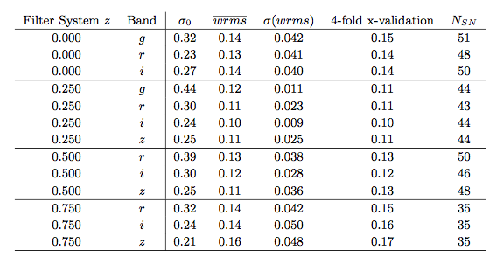
Gaussian Process Standardization
Here is a SN lightcurve:
covariance
noise
LC data
hyperparameters
PRELIMINARY
PRELIMINARY
PRELIMINARY
Kim et al. 2012 (SNfactory submitted)

Slide 24
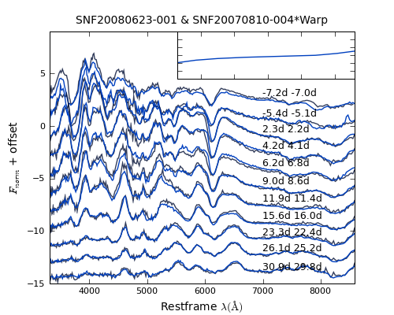
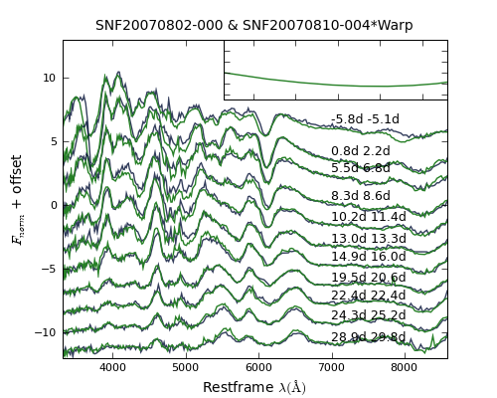
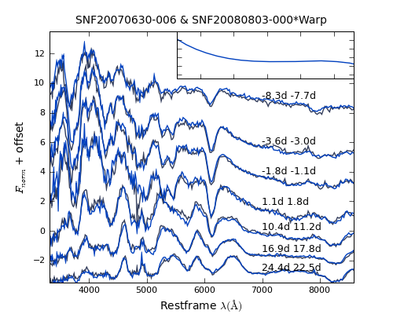
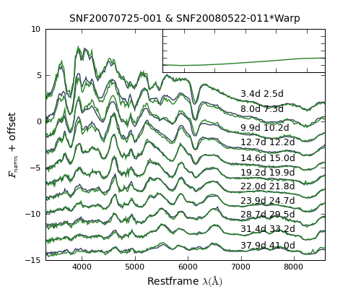
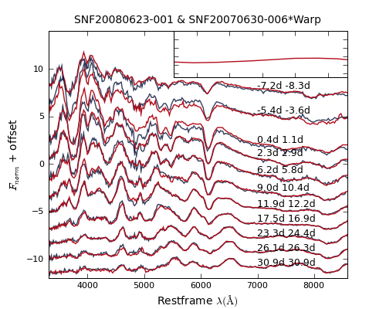
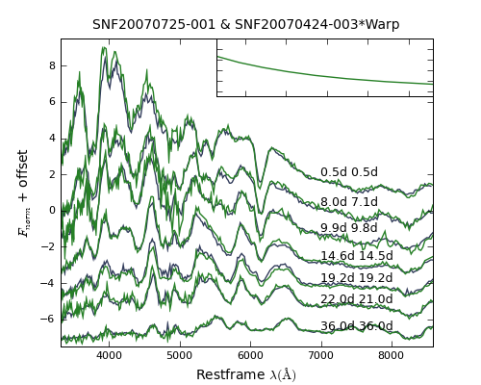
Twin SNe
Fakhouri (SNfactory)

Slide 25
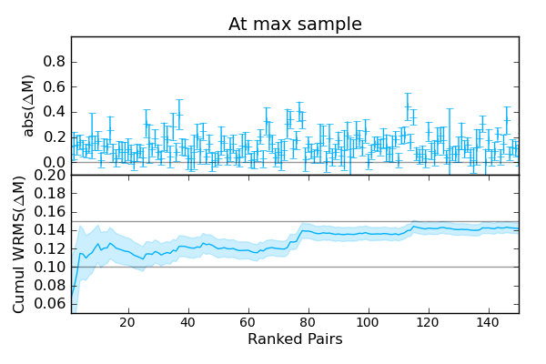
Twin SNe
Implies ~ 0.06 mag RMS per SN
Fakhouri (SNfactory)

Slide 26
SN Cosmology Use Case: the Dust Extinction Law & Intrinsic SN Colors

Slide 27
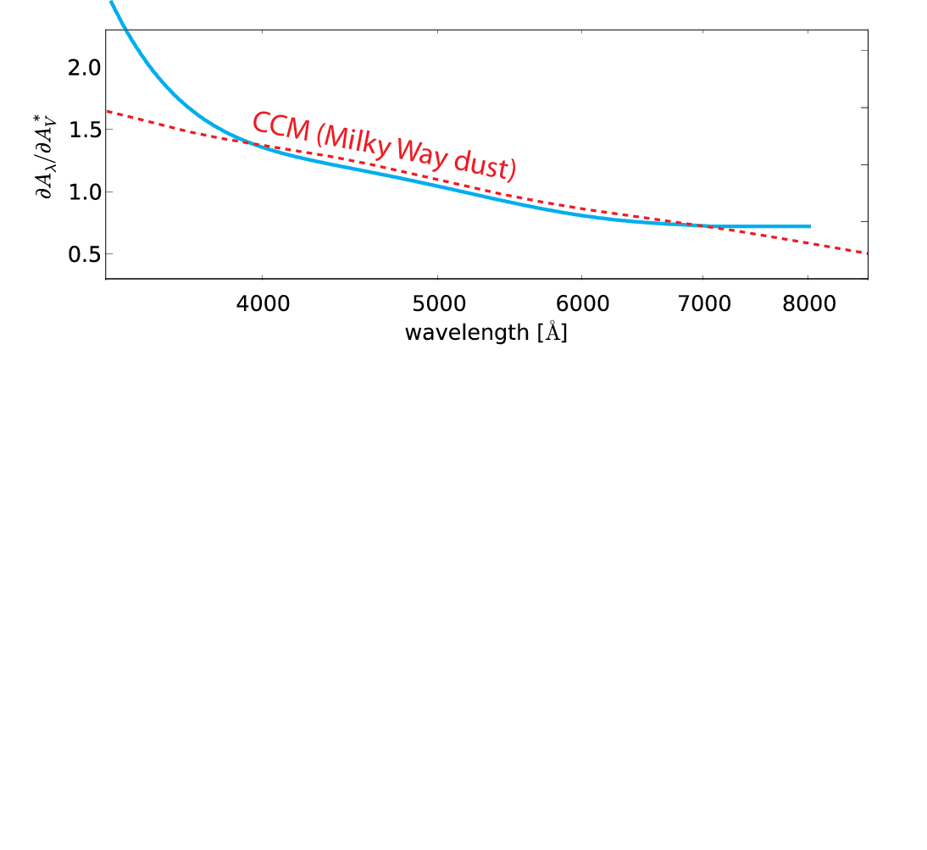
Spectral indicator distinguishes dust reddening from intrinsic SN color
broadband
observed
more dimming due to dust
expected
bluer
redder

Slide 28
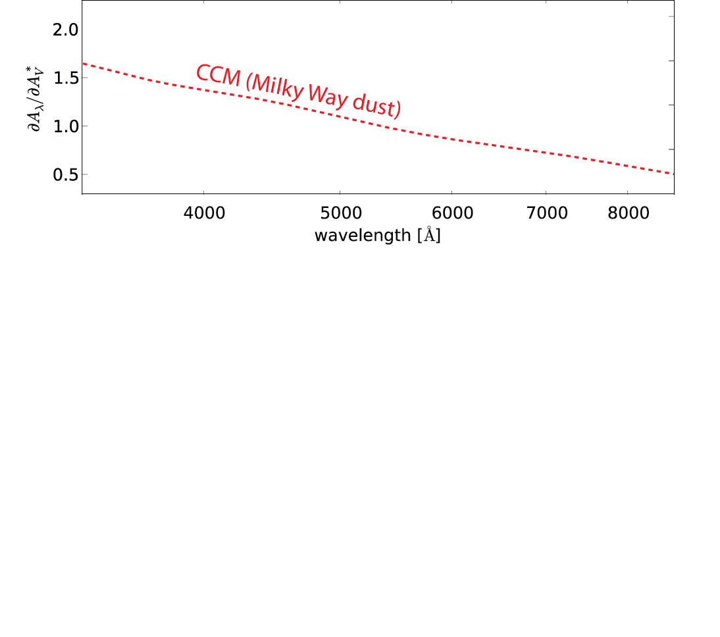
If we assume that all the color variation is due to dust …
more dimming due to dust
expected
bluer
redder

Slide 29
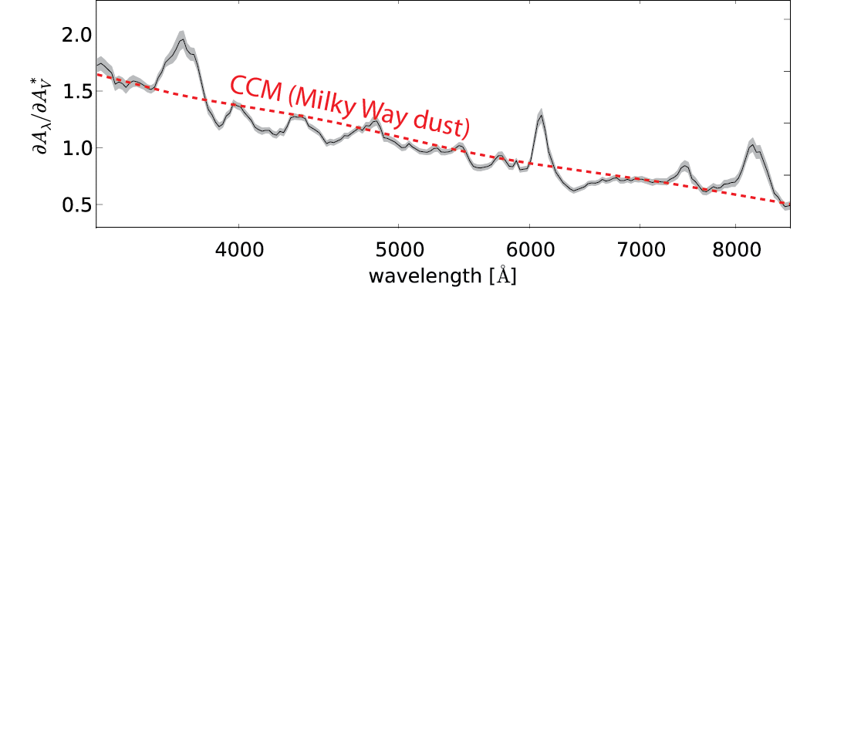
If we assume that all the color variation is due to dust … we don’t get Milky Way reddening:
more dimming due to dust
bluer
redder

Slide 30
This is not surprising – we already know that there are spectral features associated with the “stretch” of the lightcurve timescale.

Slide 31
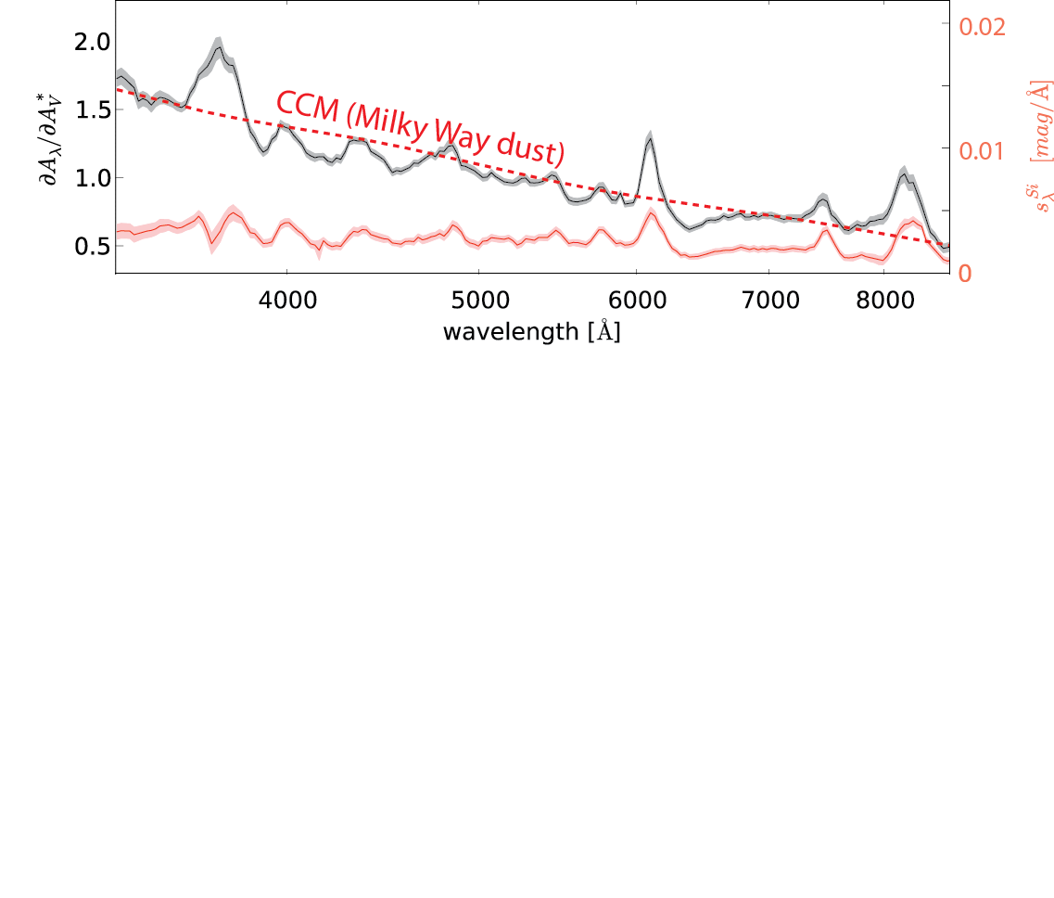
Spectral variation
1st component
highly correlated with “stretch”
This is not surprising – we already know that there are spectral features associated with the “stretch” of the SN lightcurve timescale.

Slide 32
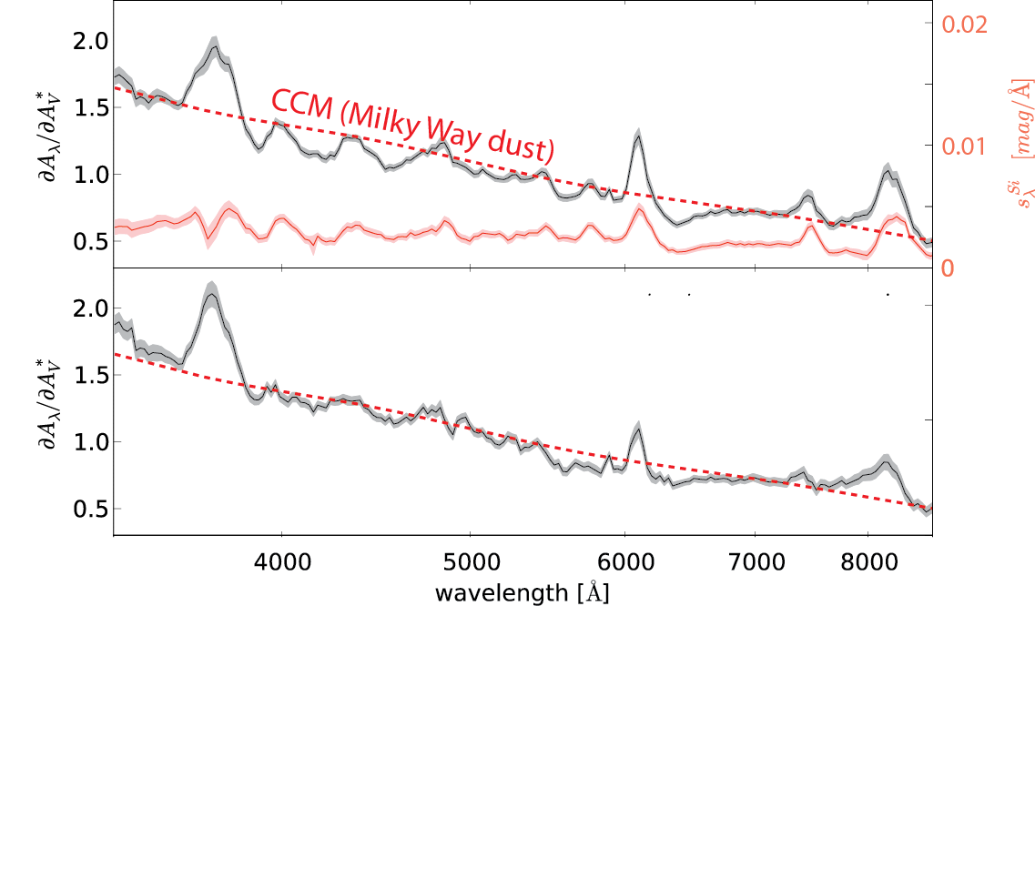
1st component
After removing 1st component of spectral variation

Slide 33
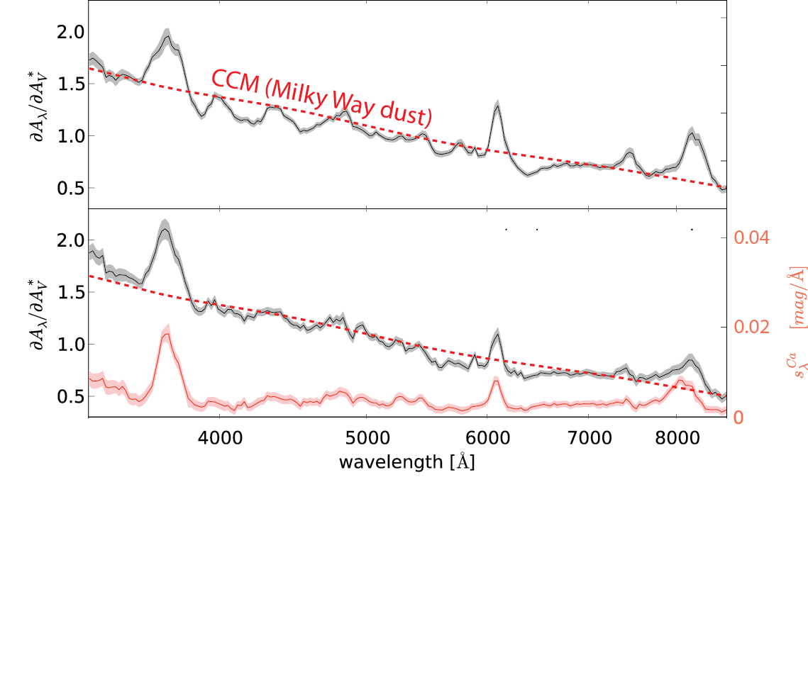
Spectral variation
2nd component

Slide 34

Spectral variation
2nd component

Slide 35

After removing 1st and 2nd components of spectral variation

Slide 36
Chotard et al (A&A, 2011) Nearby Supernova Factory
After removing 1st and 2nd components of spectral variation

Slide 37
SN Cosmology Use Case: redshift-dependent coverage of imaging lightcurves (aka K-corrections)

Slide 38

SNe Ia do not all show the exact same spectral time series, so the K corrections are not identical.
Distance measurements should therefore be based on matched low- and high-redshift SNe, with matching spectral time series.
Average error on K-correction
using a single-parameter model for spectral time series template
Dispersion of K-correction
using a single-parameter model for spectral time series template
Saunders (SNfactory)

Slide 39
SN Systematics – environment dependence

Slide 40






Progenitor Environments
SNe overcorrected?
There is a step in corrected SN luminosity w/ host mass.
Is metallicity, or age, the driver?
Kelly 2010
SNLS 2010
SNe undercorrected?
SNfactory: M. Childress PhD thesis
Other host studies:
Age constraint on SN Ia w/ CSM interaction (Aldering ‘06)
Examined Super-C SNe host properties (Childress ‘11)

Slide 41


SNfactory host galaxy metallicity dependencies
PRELIMINARY
PRELIMINARY
Metallicity might affect color, and hence standardized magnitude.
Metallicty might affect Ni⁵⁶ production and hence standardized magnitude.
Childress et al. 2012 (SNfactory submitted)

Slide 42
Cosmology

Slide 43




Redshift Range & Cosmological Weight
0.01
0.03
0.10
0.30
1.00
Redshift
✔ Random velocity statistical error
✔ Correlated motions systematic error
✔ Insensitivity to dark energy

Slide 44



SNfactory Cosmology Constraints
Cosmological parameters using ~100 SNe Ia from existing processing
Standard stars scatter by 2.4% - achromatic (colors < 1%)
Comparison to literature photometry for overlapping SNe shows bias below 1.5% - except for u-band, where we think our calibration is the better choice
PRELIMINARY
PRELIMINARY
SNfactory Mark-I, before and after standardization
SNfactory
Mark-I
Union 2.1

Slide 45


The Optimistic Future
Notes:
Uniformly analyzed for 1st time

Slide 46



The Optimistic Future
WFIRST BAO (optimistic)
Notes:
Uniformly analyzed for 1st time

Slide 47
Rosetta Stone SNe

Slide 48



SN2011fe
Roepke et al 2012 (SNfactory)
Pereira et al (SNfactory)

Slide 49





A Super-Chandrasekhar SN Ia
SNF20070825-001/SN2007if
Most luminous SN Ia ever: M_{V} = -20.4
First total mass measurement clearly beyond Chandrasekhar limit
First Super-C with age and metallicity determination
Slow, unchanging photospheric velocity
M_{tot} > 2.05 M_{sun} 99% CL
whereas Chandrasekhar mass is 1.4 M_{sun}
Scalzo et al., 2010 (SNfactory)
Childress et al, 2011 (SNfactory)

Slide 50




More Super-Chandrasekhar SNe Ia
5 new candidates
3 definitely SC
2 probably
New 91T-like fraction: 2.3 ^{+1.2} %
_{-0.6}
Scalzo et al., 2012 (SNfactory)

Slide 51


Unburned Carbon Discovery Constrains Explosion Mechanism
SNfactory spectrum of SN2006D shows first clear evidence for unburned material - Carbon at photospheric velocity.
Thomas et al. 2007

Slide 52


New Unburned Carbon Discoveries Constrains Explosion Mechanism
Carbon seen in 22⁺¹⁰ % of cases
Present early, then fades (dilution)
Symmetry more likely than blobs
Low stretch and Blue
₋₆
Thomas et al, 2011 (SNfactory)

Slide 53

Thank You

